Slide 1
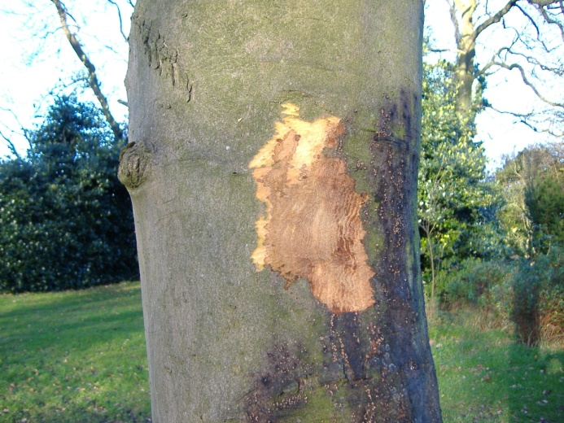
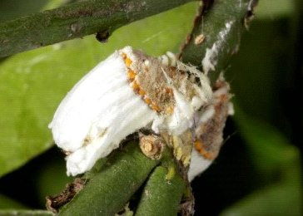
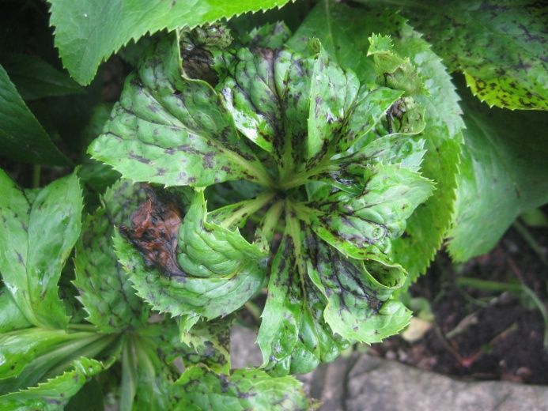
General guide to the recognition of plant pests and diseases

Slide 2
Aim of the presentation
To provide an overview of the types of pest and disease that cause damage on plants and produce
To demonstrate the types of symptoms that each type of pest or disease can cause
To allow better recognition of symptoms of these pests and diseases and to improve detection.

Slide 3
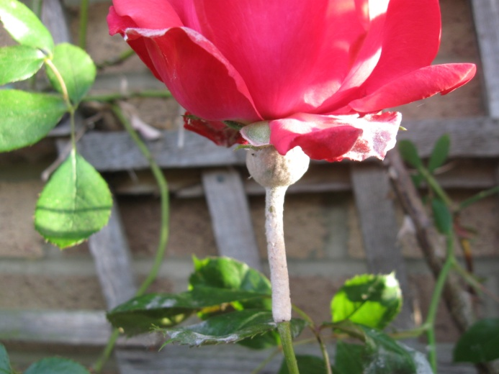
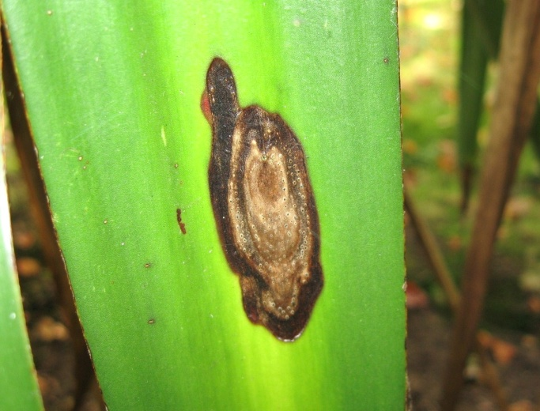
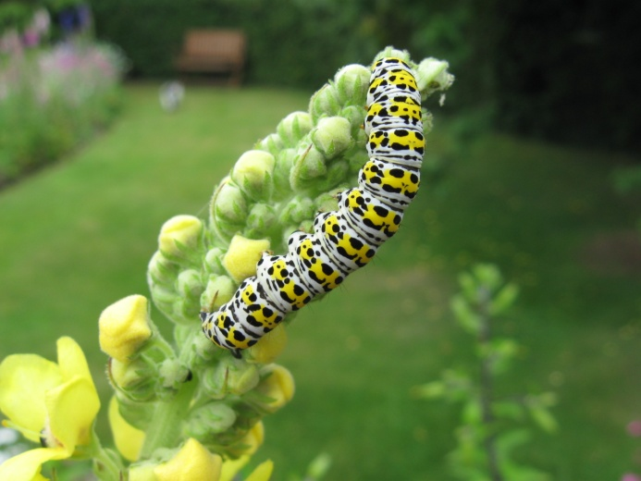
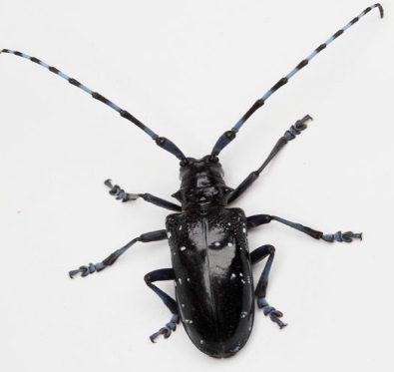
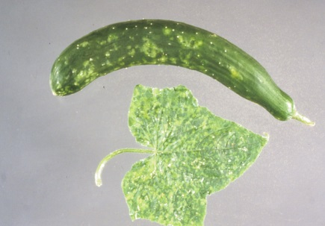
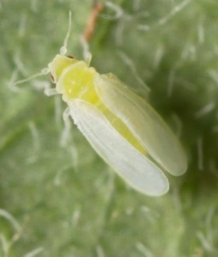
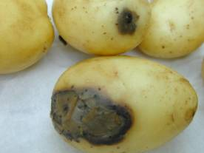
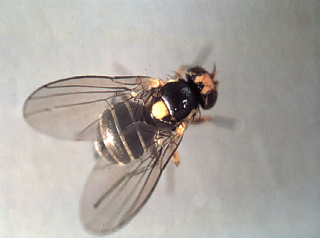
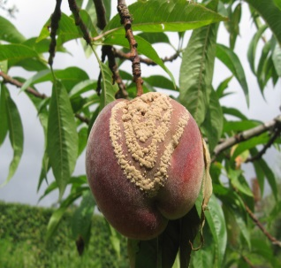
Contents
Diseases
Causes of disease
Types of disease affecting different parts of the plant
Common symptoms
Pests
Groups of pests
Symptoms caused

Slide 4
Plant diseases

Slide 5
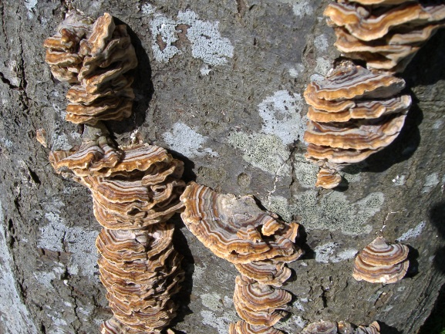
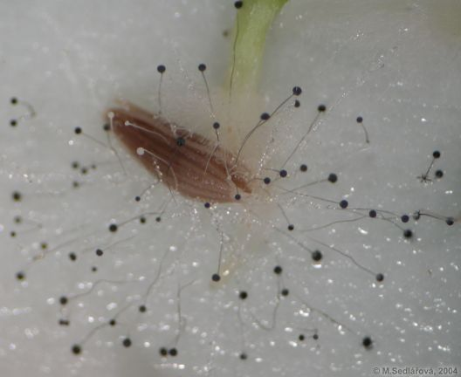
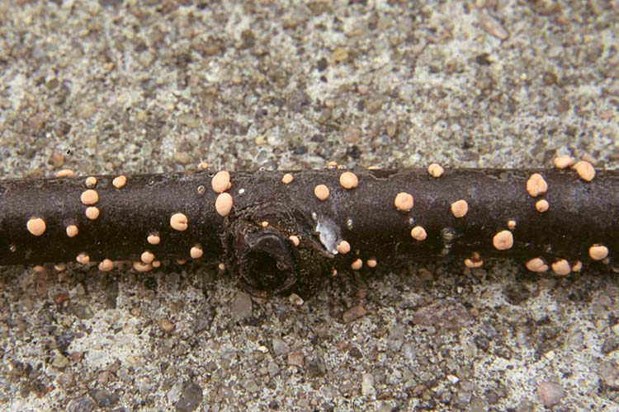
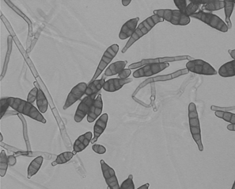
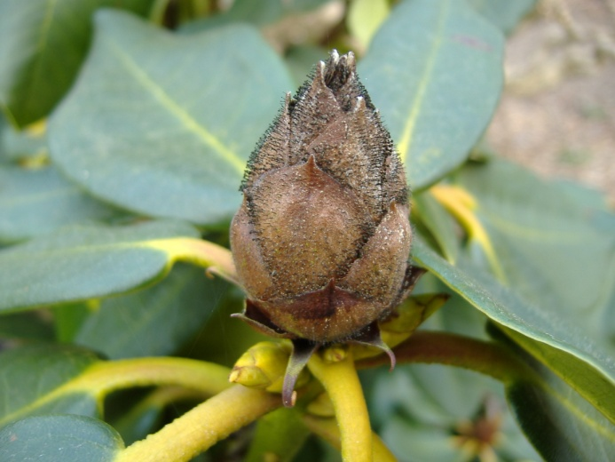
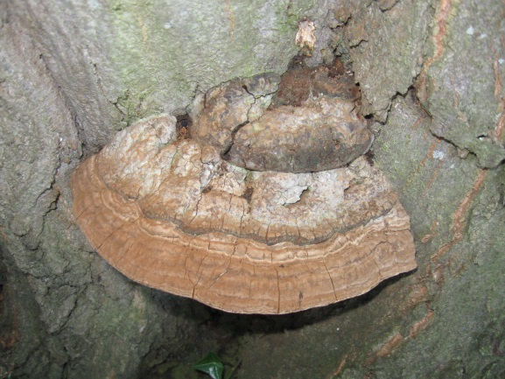
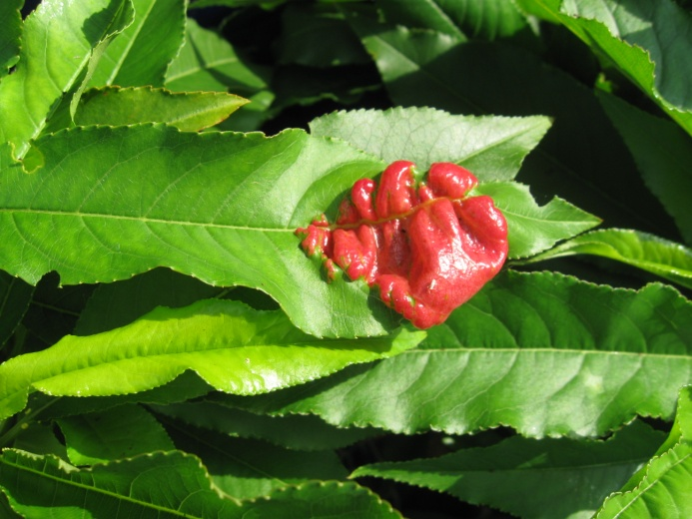
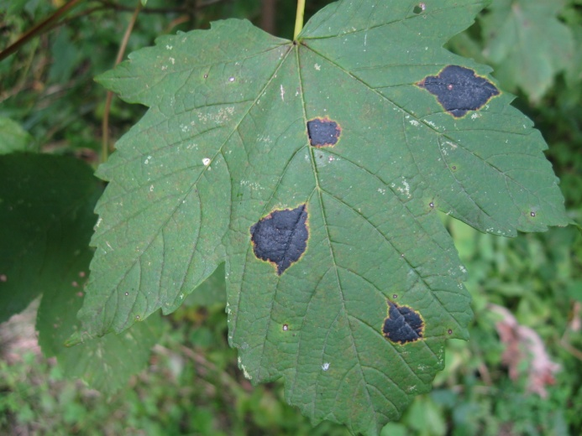
Causes of Plant Disease
Fungi
Pictures: Trametes versicolor, Rhizopus/Mucor, coral spot, Alternaria spores, rhododendron bud blast, Ganoderma on hornbeam, peach leaf curl, acer tar spot.

Slide 6
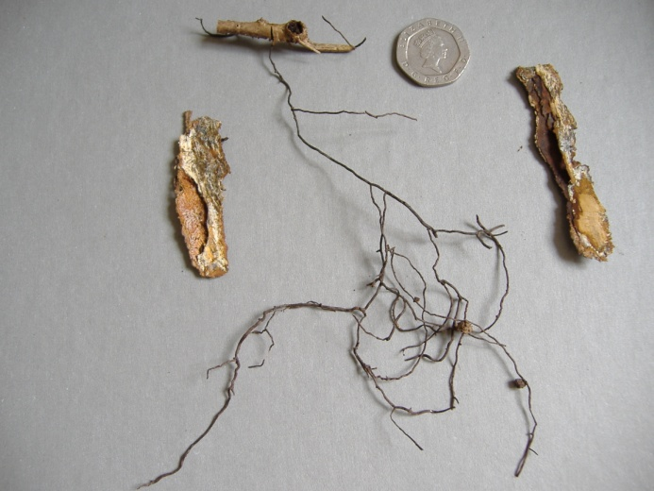
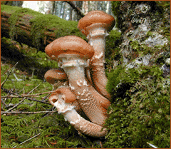
Fungi
About 100,000 species, about 10,000 cause plant disease. The most common causes of disease in our temperate UK climate.
Range in size from large mushrooms and brackets to tiny microscopic organisms.
Fascinating fact – the biggest organism ever found is a fungus. This is a honey fungus in USA, whose network of mycelium covers the area of over 1200 football pitches, and over 2000 years old.

Slide 7
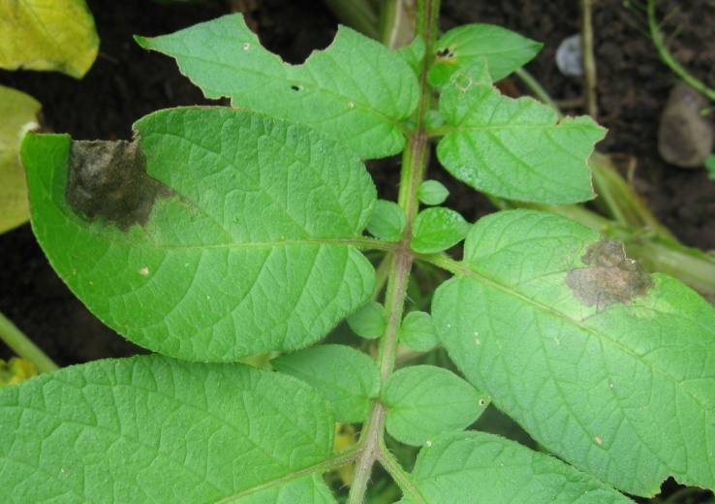
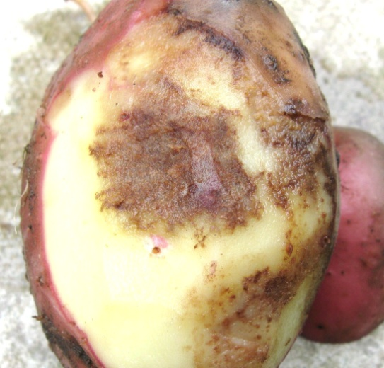
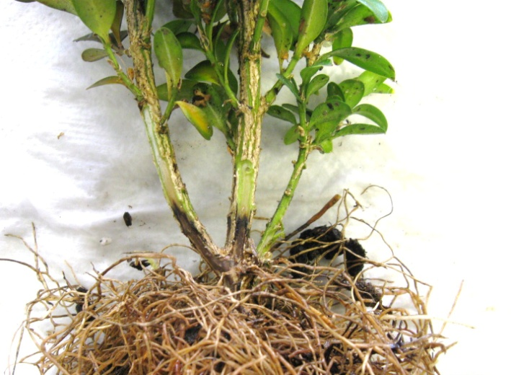
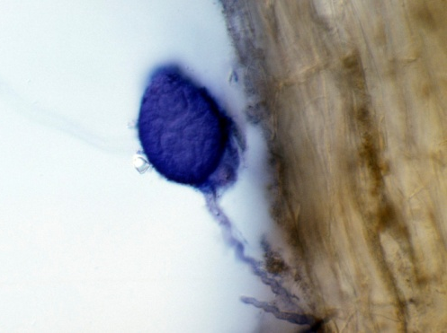
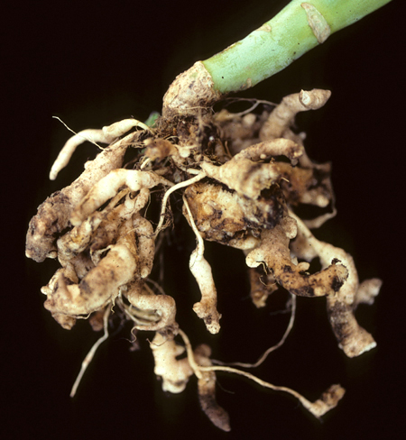
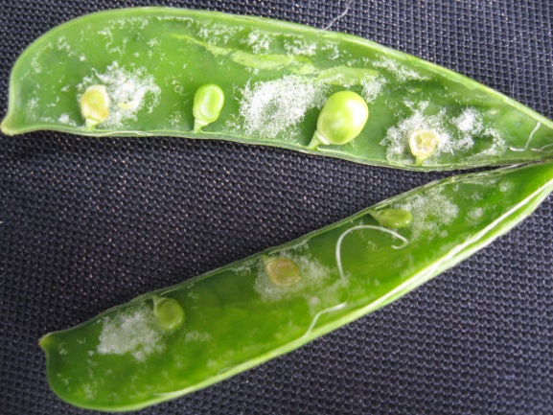
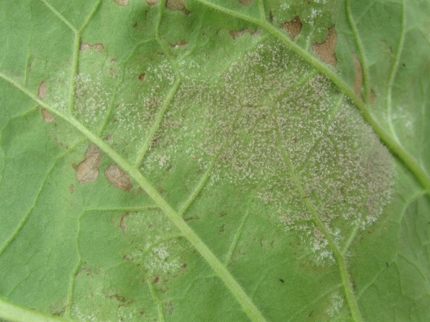
Causes of Plant Disease
Fungus-like organisms
Pictures: foliar blight, tuber blight, Phytophthora root rot on box, Phytophthora bleeding canker on sycamore, Phytophthora sporangium, clubroot, pea downy mildew, nicotiana downy mildew.

Slide 8
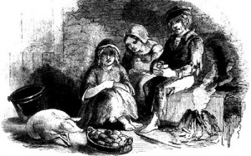
Fungus-like organisms
Some of these are now known to be more closely related to algae, but many look very like fungi and the diseases they cause are still known by many people as ‘fungal’ diseases.
This group of organisms include some very important diseases, like Phytophthora, downy mildews, and clubroot.
Fascinating fact – this group includes one of the diseases with the biggest impact on history – potato blight (Phytophthora infestans)
This was the cause of the Irish potato famine in 19th century. Starvation caused by repeated crop failures resulted in over a million dead, and a million more forced to emigrate, mainly to USA. Population of Ireland fell by one quarter.

Slide 9
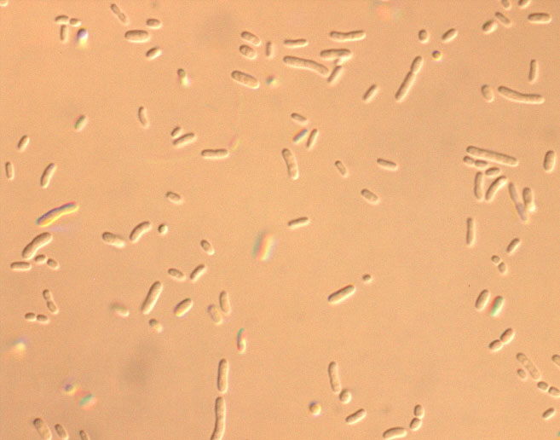
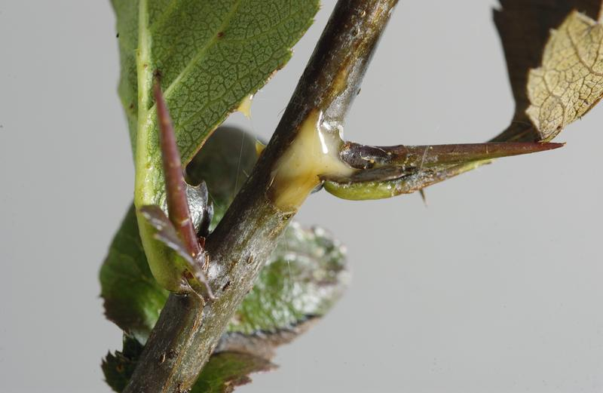
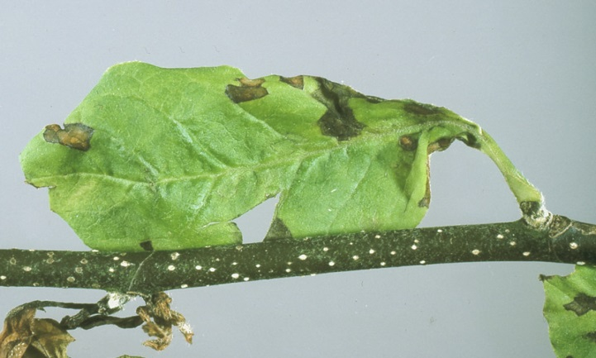
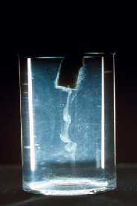
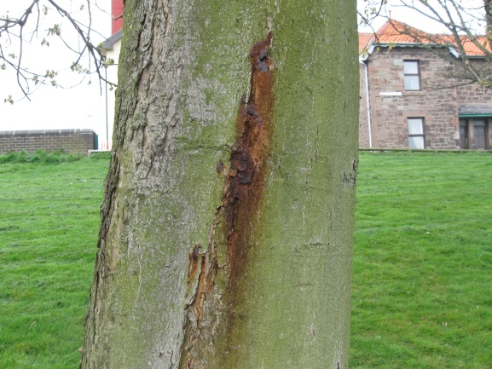
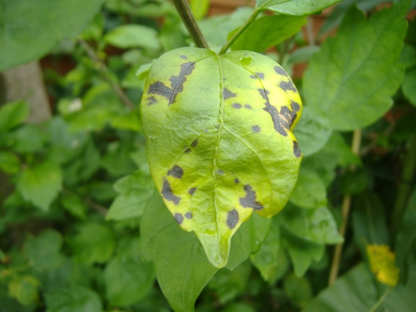
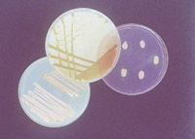
Causes of Plant Disease
Bacteria
Pictures – fireblight, Pseudomonas syringae on magnolia, horse chestnut bleeding canker, Pseudomonas syringae on hibiscus, potato soft rot.

Slide 10
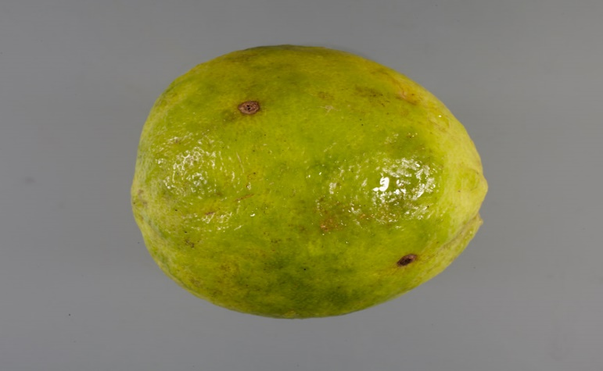
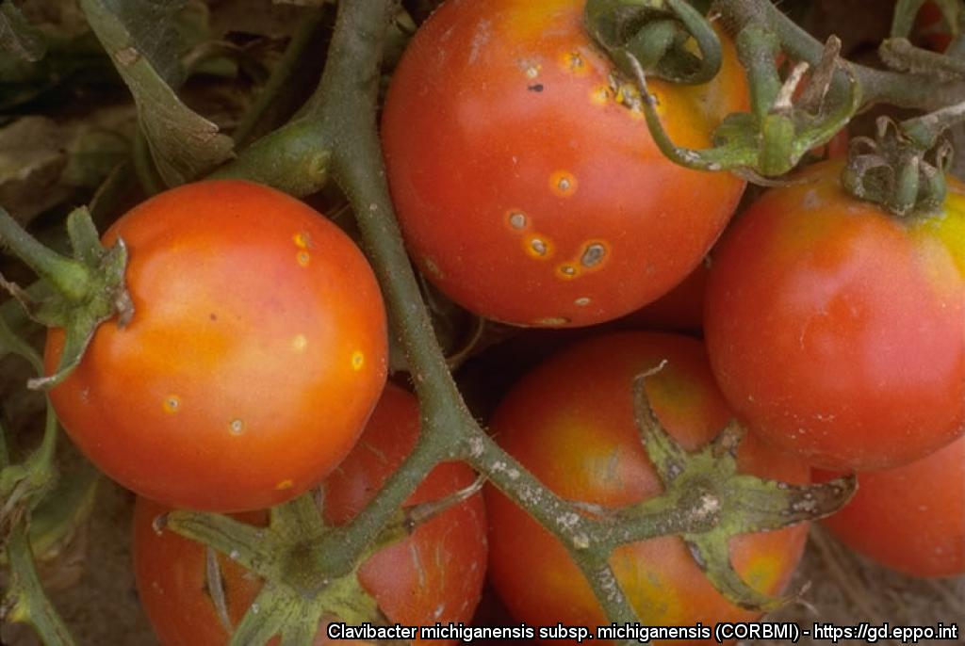
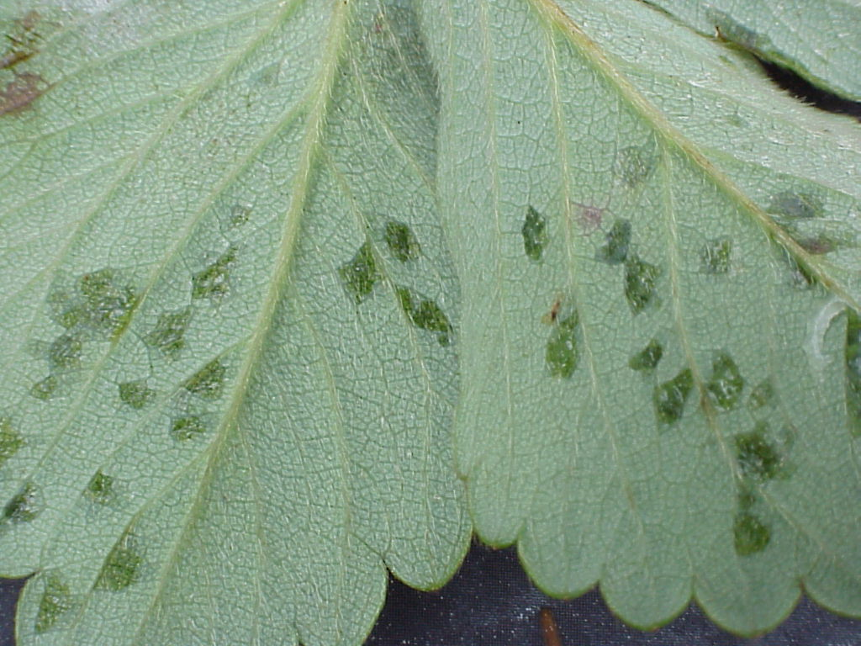
Bacteria
Bacterial diseases are fewer in number than fungal diseases in UK’s temperate climate, although much more common in the tropics.
Still some damaging diseases in the UK though, including fireblight, bacterial canker of prunus, bleeding canker of horse chestnut.
There are many bacteria that are regulated in both EU and UK legislation
Fascinating fact – bacteria are extremely adaptable. Species of bacteria can live in ice, boiling hot thermal springs, and even radioactive waste!

Slide 11
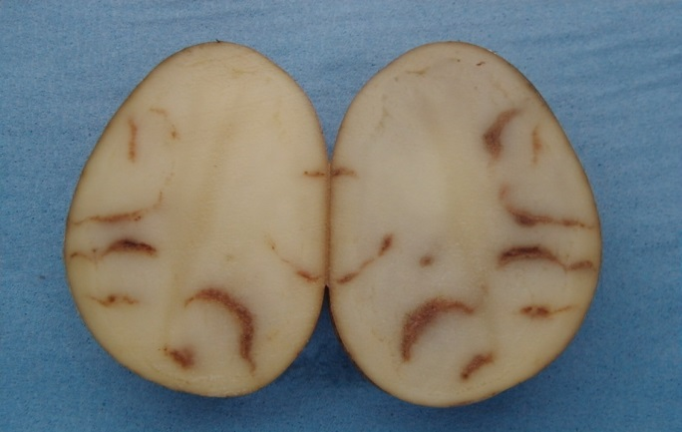
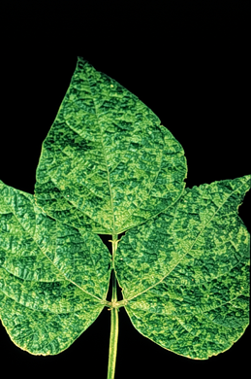
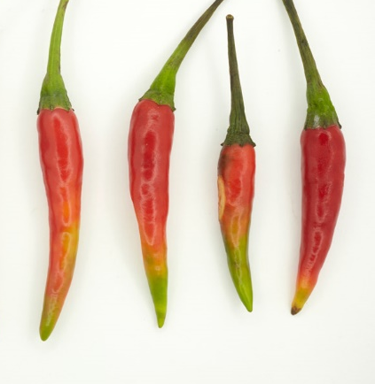
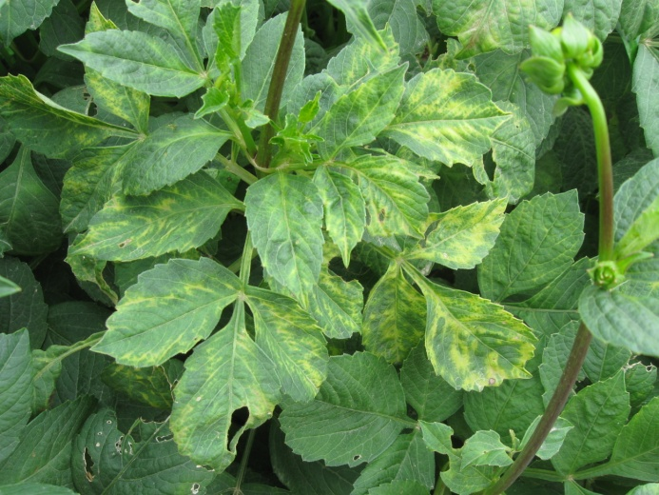
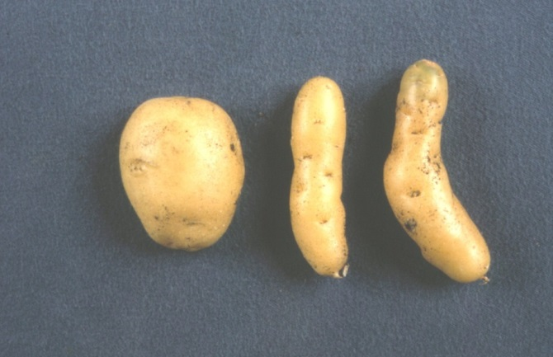
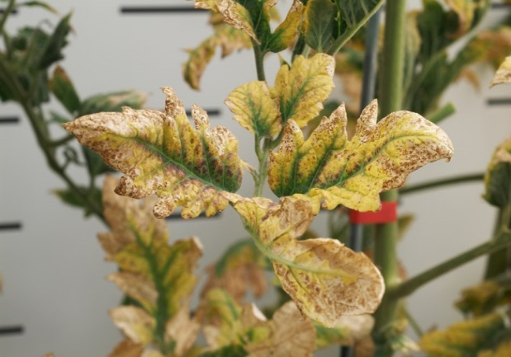
Causes of Plant Disease
Viruses / Viroids / Phytoplasmas
Pictures: Cucumber mosaic virus, spraing (tobacco rattle virus), elm yellows phytoplasma, bean common mosaic virus, Chilli vein mottle virus on chilli, Tomato spotted wilt virus on dahlia, potato tuber spindle viroid, columnea latent viroid.

Slide 12
Viruses / Viroids / Phytoplasmas
Viruses are very small and can only be seen with powerful electron microscopes. Viroids are even smaller, and are just naked pieces of genetic material. Phytoplasmas are more closely related to bacteria than viruses, but often cause virus-like symptoms.
Viruses have no means of movement and rely on ‘vectors’ to move them from plant to plant. Common vectors include insects such as aphids, thrips, whiteflies.
People can move some ‘mechanically-transmitted’ viruses by transferring sap from a virus-affected to a healthy plant (via tools, or simply by touching the plants).
Fascinating fact: some plant viruses are extremely contagious. Plant sap containing tobacco mosaic virus can be diluted a million times and still be infectious.

Slide 13
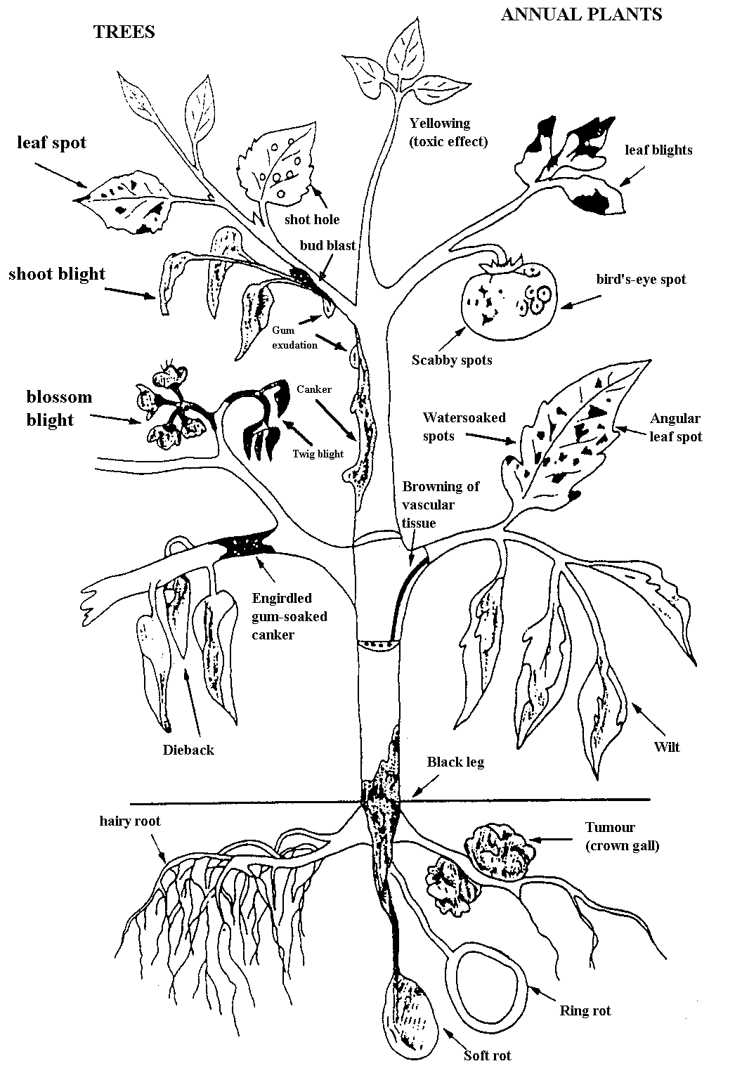
Symptoms of plant disease
Vary enormously.
These are just the symptoms caused by bacteria!

Slide 14
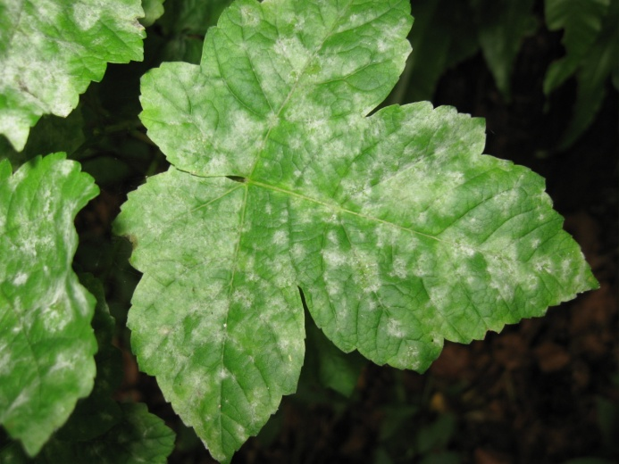
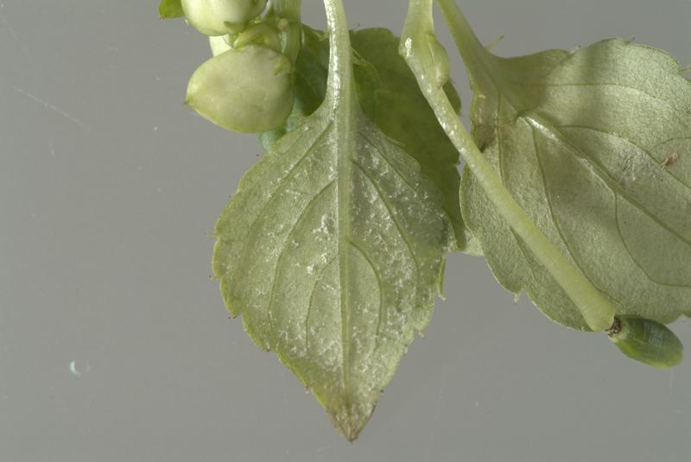
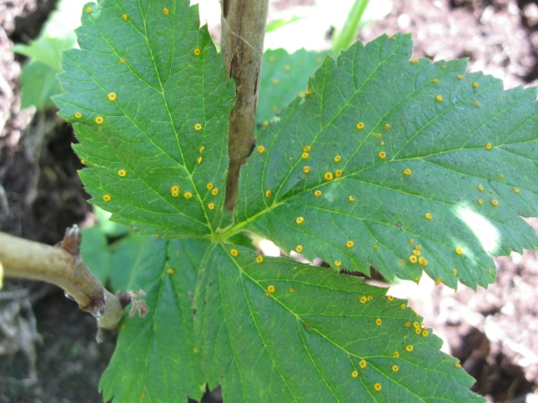
Leaf diseases
Powdery mildews
Downy mildews
Rusts
Leaf spots

Slide 15
Powdery mildews
Fungus - lots of different species
Typically whitish, powdery growth
Can affect leaves and other aerial parts
White growth on top or both sides? Powdery mildew
White growth on bottom surface? Could be powdery or downy
A few powdery mildews aren’t so ‘classic’
Host-specific, so each plant or group of related plants are affected by a different powdery mildew species.

Slide 16
Powdery mildew symptoms
Start off as small colonies from infections by individual spores. Top photo - Aquilegia
Colonies get bigger and merge together. Middle photo – Verbascum (mullein)
Young soft growth is often attacked preferentially. Bottom photo – young gooseberry shoot

Slide 17
Downy mildews
Fungus-like organism: lots of different species
Often (not always) confined to leaves
Discolouration of top surface
‘Fungal’ growth below; white, purple or brown
May cause leaf distortion or shedding
Host-specific, so each plant or group of related plants are affected by a different downy mildew species.
Growth on leaf underside consists of spore stalks and spores.

Slide 18
Top L&R: Downy mildew of oriental poppy. Discolouration of upper leaf surface. Growth of organism is also visible on corresponding underside. Often white, may be purplish or brownish depending on downy mildew species. Also depending on species, host plant or even variety, the growth may be thick or sparse.
Bottom left: Downy mildew of Nicotiana (tobacco ‘blue mould’). Prominent yellow patches on upper surface. Can see growth of the mildew at bottom right where leaves have twisted to show the underside – white, turning blue-purple with age.
Bottom right: Impatiens downy mildew. Note leaf distortion and yellowing. Affected leaves are quickly shed.

Slide 19
Rusts
Fungus - lots of different species
Host-specific, so each plant or group of related plants are affected by a different rust species
Often (not always) confined to leaves
Discolouration of top surface
Pustules underneath – various colours
Up to five spore types and may need two host plants. These host plants in two-host life-cycles are often completely unrelated.
Colour of pustules will depend on rust species & type of spore being produced.

Slide 20
From the top:
Chrysanthemum white rust showing discolouration of upper surface and buff/white pustules on lower surface.
Blackberry rust (orange summer pustules, but note a few black overwintering ones beginning to develop).
Rose rust, showing infection of emerging shoot.
Pear rust

Slide 21
Leaf spots
Can be caused by fungi, bacteria or viruses
Huge number of different species
Fungal fruiting bodies sometimes visible
Effects on plant very variable
Some may also cause diebacks
Most plant species will suffer from at least one leaf spot, often several.
Some leaf spot diseases have very little effect on the plant, others can be much more damaging, causing defoliation and dieback.
Photos: Septoria leaf spot of escallonia, Ramularia leaf spot of pansy, Pseudomonas leaf spot of hibiscus

Slide 22
Top R: Phoma on brassica: Leaf spots showing fungal fruiting bodies
Septoria leaf spot of Escallonia – a relatively new and very damaging fungal leaf spot
Cylindrocladium blight of box – fungus causing leaf loss and dieback, as well as spotting.
Xanthomonas arboricola pv pruni on Prunus – a bacterial leaf spot
Pseudomonas syringae on hibiscus – a bacterial leaf spot

Slide 23
Cankers and diebacks
Top left - bleeding canker of horse chestnut (P. syringae pv. aesculi)
Bottom left – apple canker (Neonectria ditissima)
Right – ash dieback (Hymenoscyphus fraxineus)

Slide 24
Cankers and diebacks
Canker = infection causing lesion on stem or branch
May be flat, raised or sunken
Some have associated bleeding of sap
Can be fungal or bacterial
May be other symptoms present (e.g. leaf spots)
Photos: apple canker, pine pitch canker, horse chestnut bleeding canker

Slide 25
Examples of fungal and bacterial cankers and dieback.
Top left: apple canker
Top right: dieback of cotoneaster due to fireblight
Bottom: horse chestnut bleeding canker (note dried sap on bark)

Slide 26
Phytophthora diseases
Top left – Phytophthora root rot of box
Top right – bleeding canker of sycamore
Bottom left – P. ramorum on rhododendron
Bottom right – P. ramorum on camellia

Slide 27
Phytophthora diseases
Fungus-like organisms
Many different species
Some cause root and stem base decay
Some affect aerial parts
Some can do both
Photos: potato blight, sporangium, red core of strawberry

Slide 28
Viruses, viroids & phytoplasmas
Photos: Top: paeony ringspot virus, Middle: hellebore black death (hellebore net necrosis virus), Bottom left: potato spindle tuber viroid, Bottom right: aster yellows phytoplasma on delphinium

Slide 29
Viruses, viroids & phytoplasmas
Huge range of symptoms
Mottles, mosaics, stripes, spots, rings, patterns
Symptoms can affect leaves, flowers and fruit
Insects are common vectors, but there are many others
Some are mechanically transmitted
Photos: Cucumber mosaic virus, tomato spotted wilt virus on dahlia

Slide 30
Examples of virus symptoms
From Top:
Mosaic symptom on leaves and fruit caused by cucumber mosaic virus
Rings and patterns caused by Paeony ringspot virus
Uneven fruit ripening and leaf distortion caused by Pepino mosaic virus.
Chlorotic spots and rings on Prunus leaves and fruit caused by Plum pox virus
Notes:
e.g. of symptom type: mosaic
Cucumber mosaic

