Slide 1
Regulated diseases commonly found on imported fruit and vegetables

Slide 2
Import interceptions
There are comparatively few findings of regulated diseases on imported fruit and vegetables in comparison to findings of insect pests.
In recent years the 2 main commodities in which we have found such diseases are a range of citrus fruit in which we find a range of fungal and bacterial diseases causing scabs, spots and cankers; and in sweet peppers and chillies (Capsicum) which we’ve found to contain regulated viruses.
The majority of findings in Citrus have been from South Asia, in particular Bangladesh, but also North Africa (e.g. Egypt) and Central and South America (Guatemala and Argentina)
Most findings in peppers have been from sub-Saharan Africa, and in particular from East African countries, but also from China and Pakistan.

Slide 3
Regulated Citrus diseases
Citrus black spot Phyllosticta citricarpa (fungus)
Citrus scab Elsinoë fawcettii and Elsinoë australis (fungi)
Citrus canker Xanthomonas axonopodis pv. citri (bacteria)

Slide 4
“Guignardia” citricarpa (Citrus Black Spot)
Preferred name is Phyllosticta citricarpa
EU Quarantine fungal pathogen
Wide distribution around tropical and sub-tropical areas
Primarily a disease of the fruit, the unsightly blemishes render the fruit unmarketable
Takes it’s name from the black pycnidia that form in the centre of mature spots

Slide 5
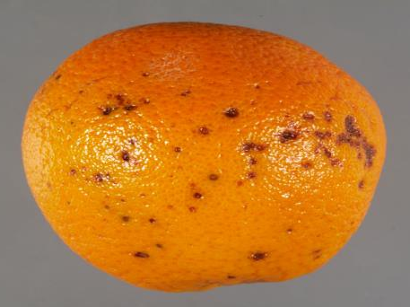
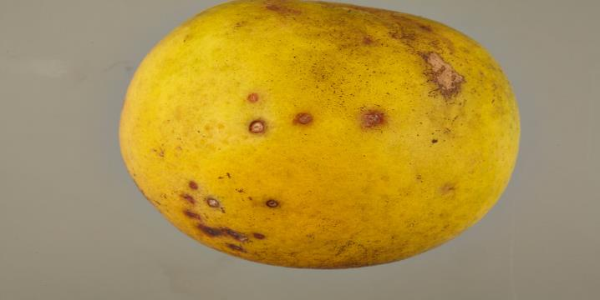
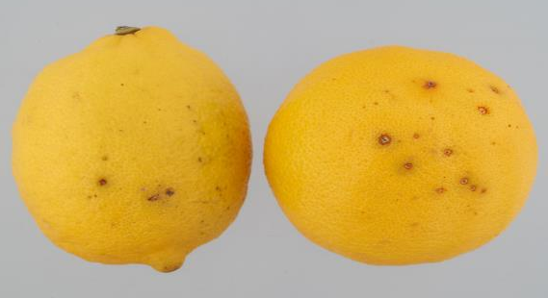
Citrus black spot symptoms
Range of symptoms from early indentations to dark spots with pycnidia (dark fungal structures that are visible using a hand lens).
Sometimes has green halos on lemons.
Looking for sunken spots with greyish centre, with or without pycnidia, but always have brick red margins.

Slide 6
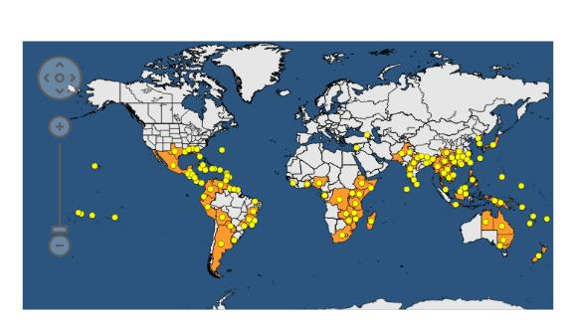
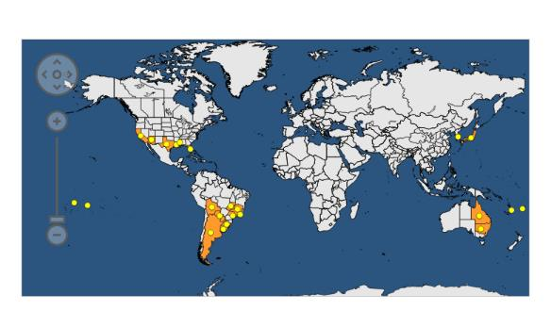
Elsinoë fawcettii & Elsinoë australis (Citrus Scab)
EU regulated fungal pathogens
Elsinoë spp. are only actionable from South America and only on Citrus sinensis and C. reticulata
E. fawcettii is more widely distributed that E. australis
Of the two, E. australis can be considered more economically significant as it affects species of citrus which are more widely grown (e.g. C. sinensis and C. reticulata) – but does affect interior part of fruit
E. fawcettii causes warty, irregular and deeply fissured scabs, whereas E. australis causes larger, smoother more rounded scabs
Distribution of E. fawcettii (above and E. australis (below)

Slide 7
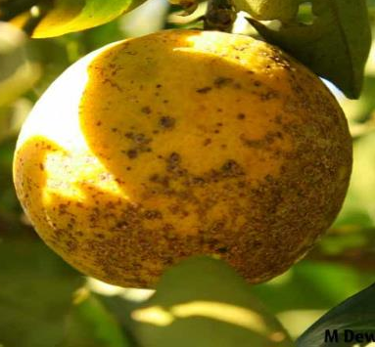
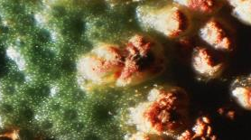
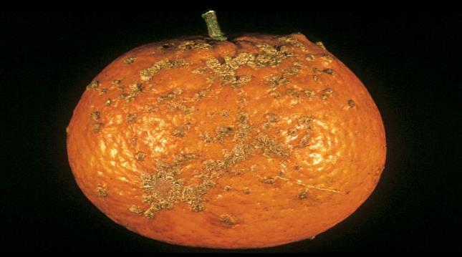
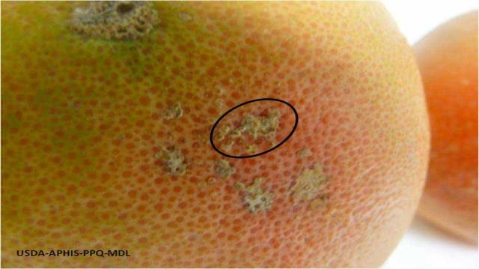
Citrus scab symptoms
Top left and centre: Warty irregular scabs caused by E. fawcettii. The image in the centre shows the scab close up.
Top right: Disease can just be on one side of the fruit – can look like scorch, wind scarring or mechanical damage
Bottom left: This could also be Citrus canker

Slide 8
Xanthomonas axonopodis pv. citri (Citrus canker)
EU Regulated bacterial pathogen
Distribution is wide-spread throughout Asia, South America, Africa and Oceania
Potential to infect all Citrus species with varying degrees of susceptibility
Causes raised, corky/spongy looking cankers on fruit which can be easily confused with Elsinoë (Citrus scab) or physical damage.

Slide 9
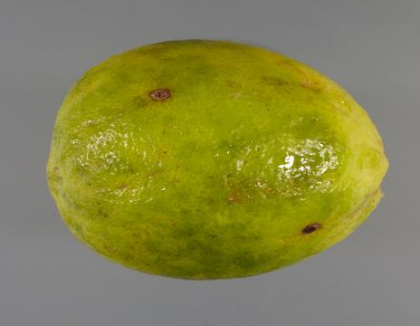
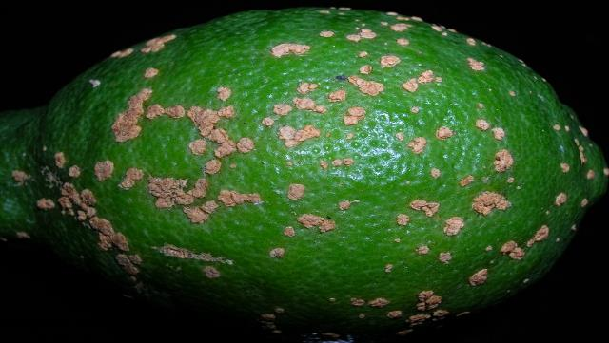
Citrus canker symptoms

Slide 10
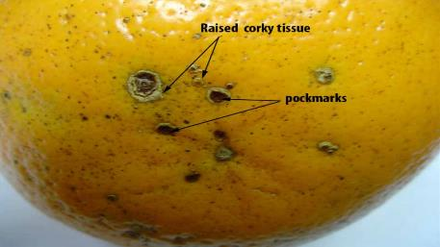
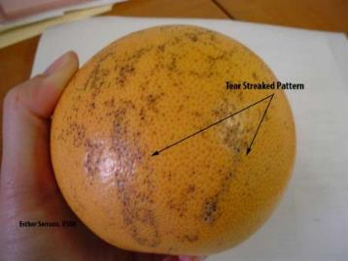
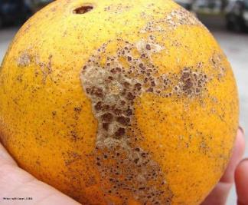
What can these diseases be confused with?
Top left: Physiological – associated with high humidity around time of harvest. Oil gland ruptures and damage the skin.
Top right: Alternaria alternata (fungus)
Bottom left and right: Melanose caused by Diaporthe citri (fungus)

Slide 11
Regulated viruses on Capsicum
In recent years we’ve seen an increase in consignments of Capsicum showing a range of potential virus symptoms.
When tested we’ve found a proportion of samples to contain regulated viruses.
The majority of findings on imported chillies and peppers have been of non-European isolates of Potato virus Y from Africa, but we’ve also found chilli vein mottle virus on chilli samples from China and Pakistan.
Infected consignments have been destroyed.

Slide 12
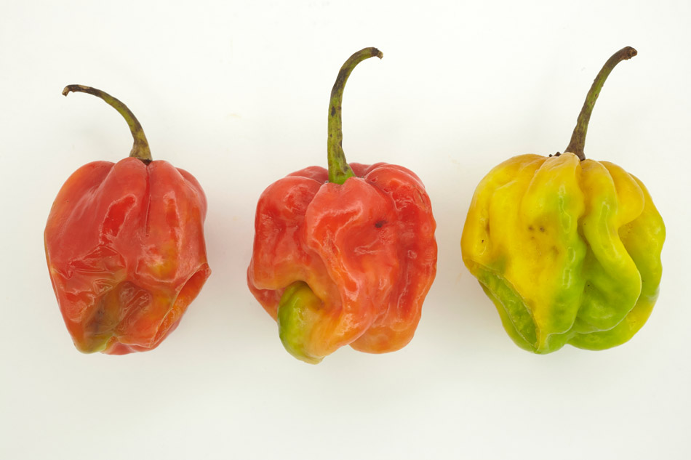
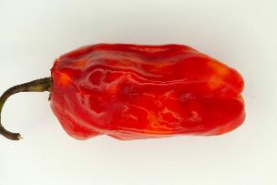
A range of symptoms, including mottling, discolouration and distortion of fruits can occur but are not diagnostic of a particular virus. Be on the look out for any of these symptoms and be aware that they could well be caused by a regulated virus.
Viruses on Capsicum – peppers and chillies

