Slide 1
Invertebrate Pests

Slide 2
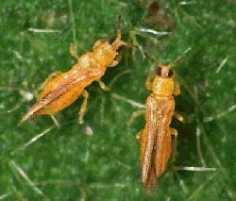
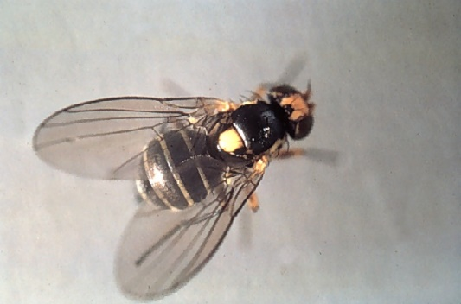
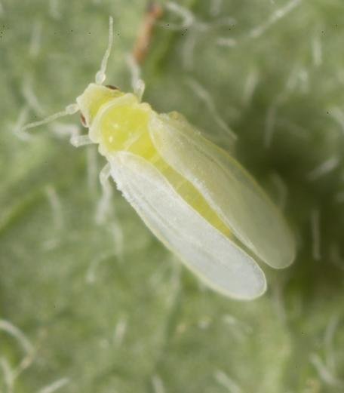
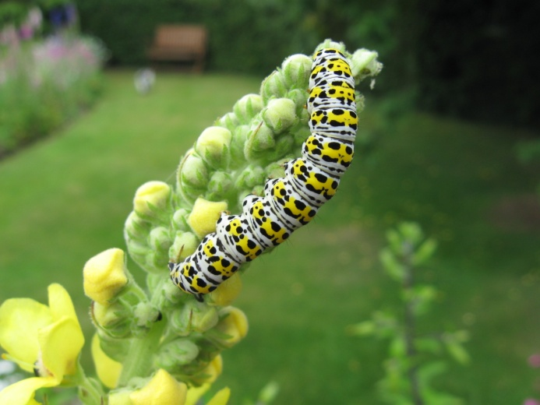
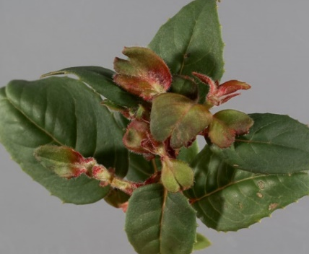
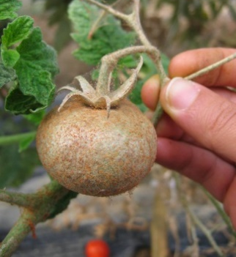
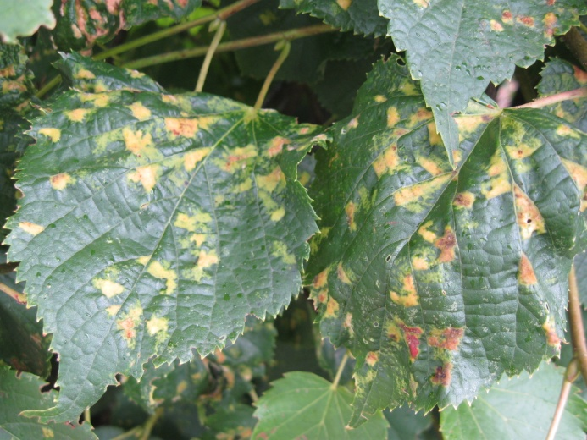
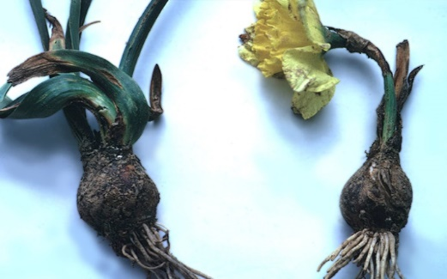
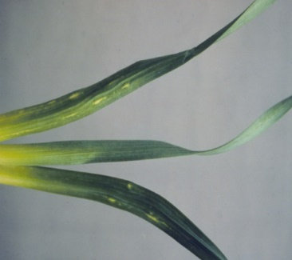
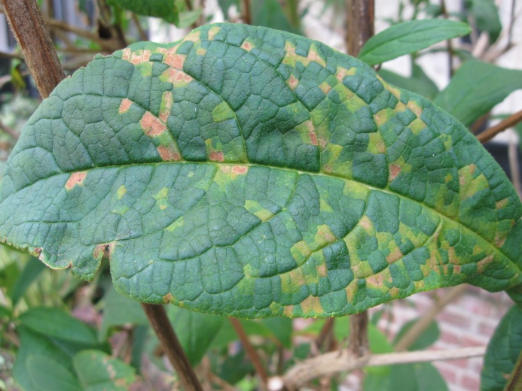
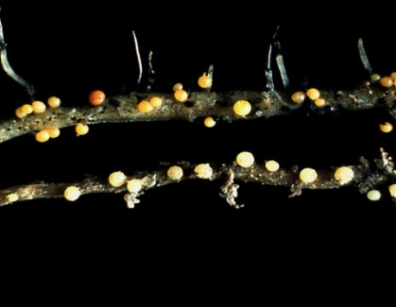
Plant Pests – Main groups of pests
Insects
Sap suckers
Chewers and tunnellers
Mites
Nematodes

Slide 3
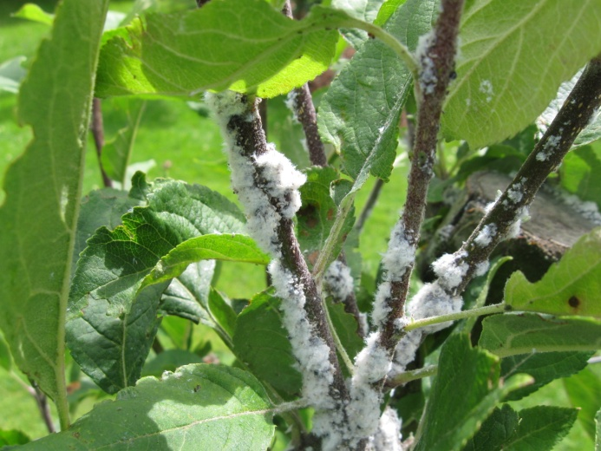
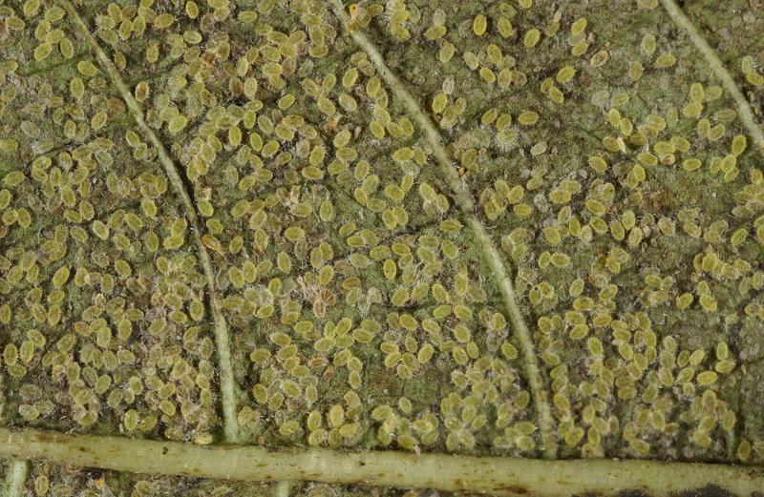
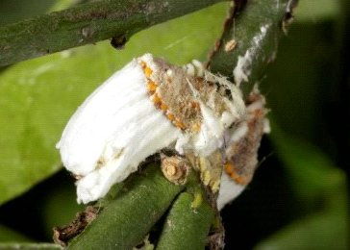
Insect pests – sap suckers
Photos:
Top: woolly aphid on apple, mealybugs
Bottom: whitefly scales, scale insects

Slide 4
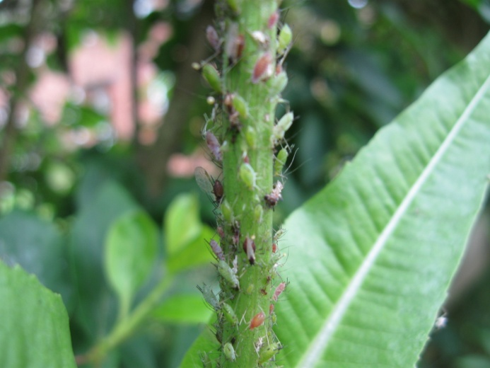
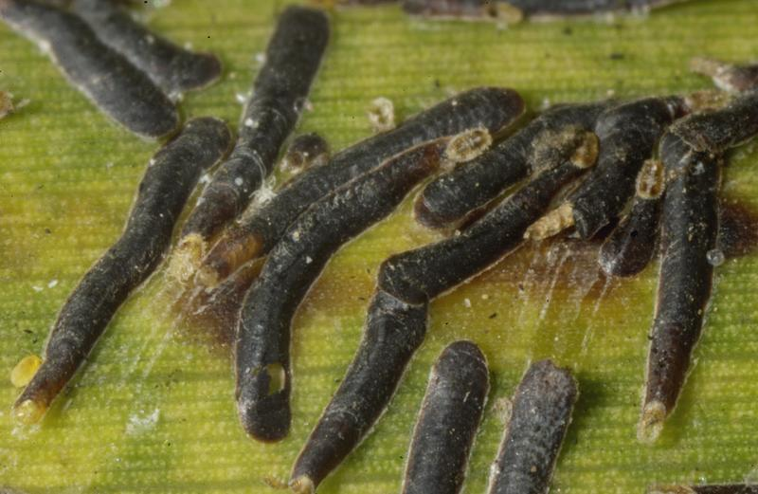
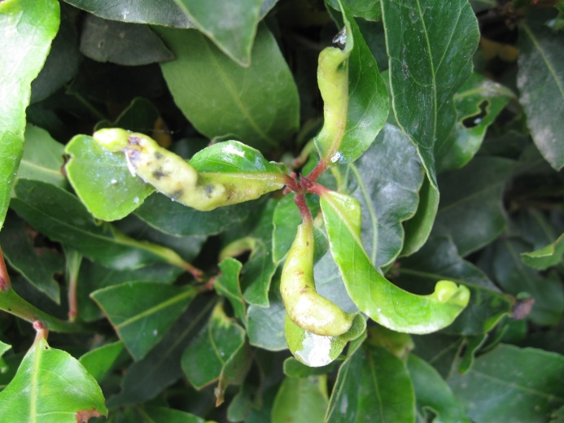
Different types of sap-sucker
Aphids
Whiteflies – adults and scales
Scale insects
Thrips
Mealy bugs
Psyllids

Slide 5
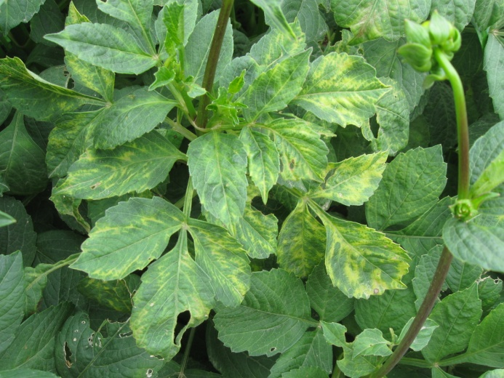
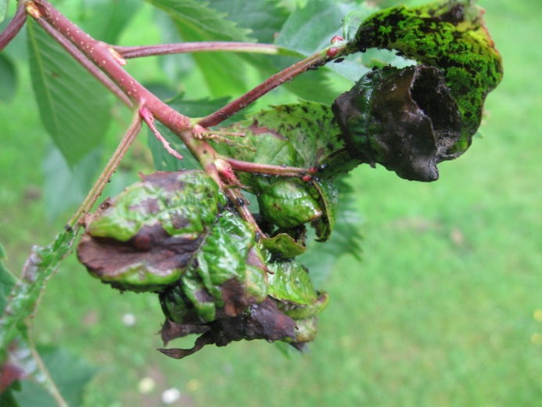
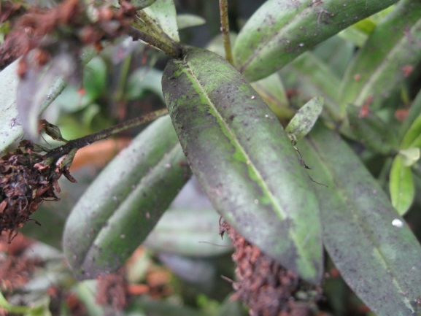
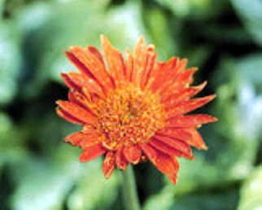
Insect pests – sap suckers
Unsightly
Reduce vigour
Cause discolouration
Cause distorted growth
Produce honeydew
Sooty mould growth
Transmit viruses
Photos: Top row: left: bay sucker damage, right: tomato spotted wilt virus (thrips-transmitted). Middle row: left cherry blackfly damage, right: sooty mould on hebe. Bottom row: left: thrips damage to flower, right: woolly aphid.

Slide 6
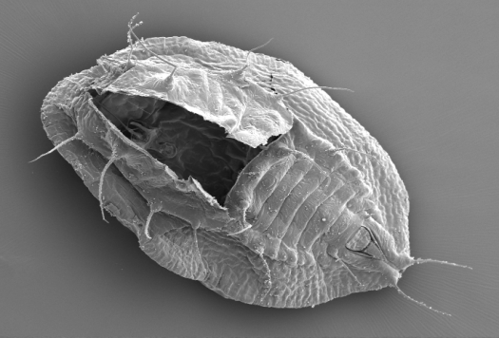
Key species - Tobacco whitefly (Bemisia tabaci)
Can feed on over 800 different plant species.
As well as causing plant damage from its feeding, honeydew and associated sooty mould, it can transmit over 100 different plant viruses, including some very damaging ones not present in the UK, such as tomato yellow leaf curl virus.
It is commonly transported in the horticultural trade, e.g. cases on poinsettia cuttings.
Adult tobacco whiteflies hold their wings in a tent-like fashion, & slightly apart to reveal the yellow body. In comparison, the indigenous and common glasshouse whitefly holds its wings flatter and closer together so you can’t see the body.
Photos: B. tabaci pupa and adult. Smaller adult photo on animation is glasshouse whitefly.

Slide 7
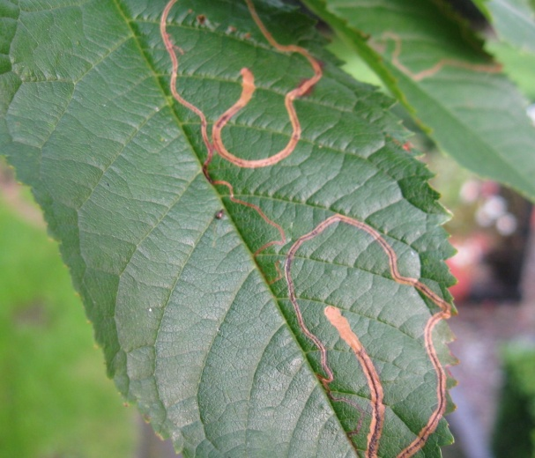
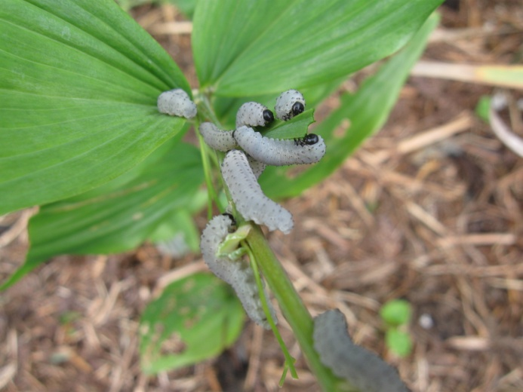
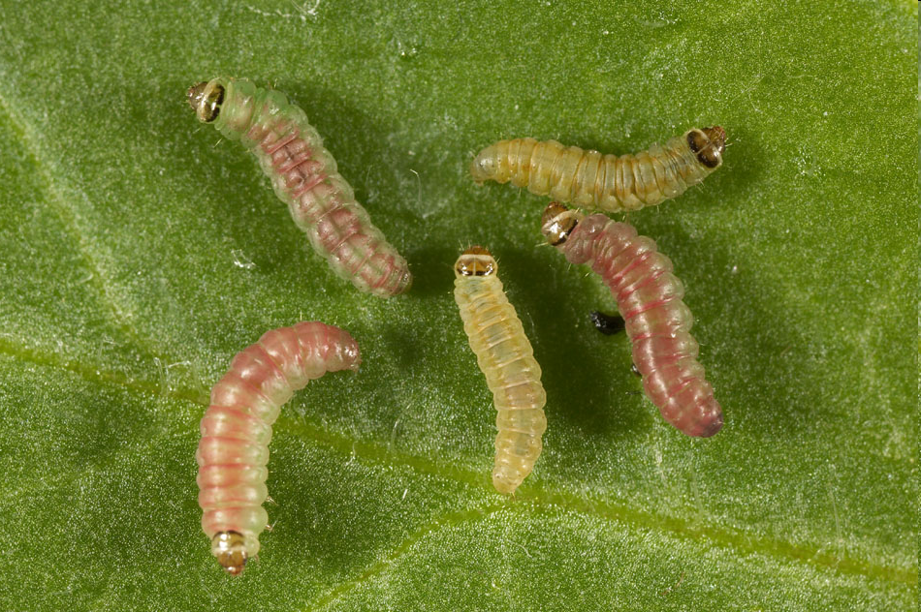
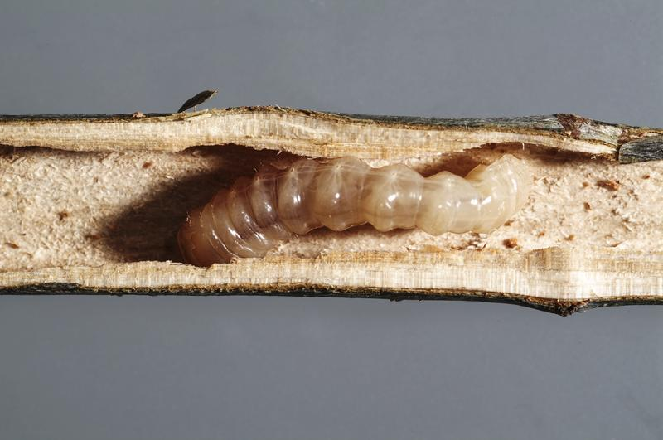
Insect pests – chewers and tunnellers
Photos:
Top left: Solomon’s seal sawfly
Top right: leaf mine caused by the cherry leaf miner (moth)
Bottom left: longhorn beetle larvae in a stem
Bottom right: Spodoptera caterpillars (moth)

Slide 8
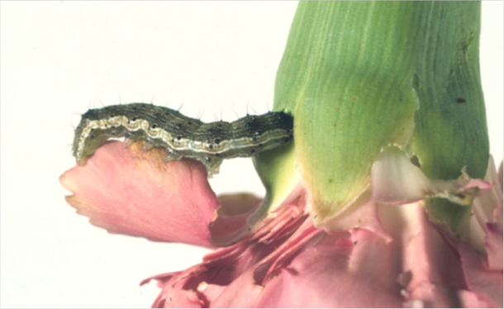
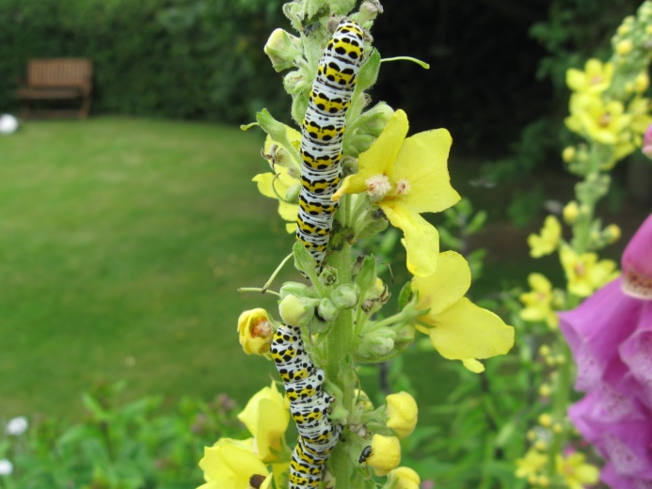
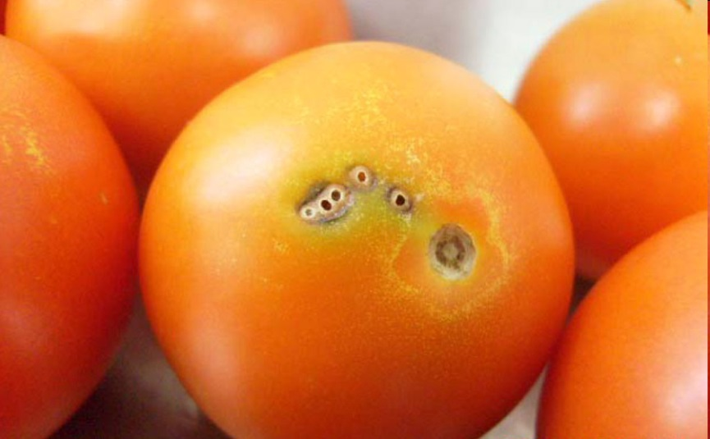
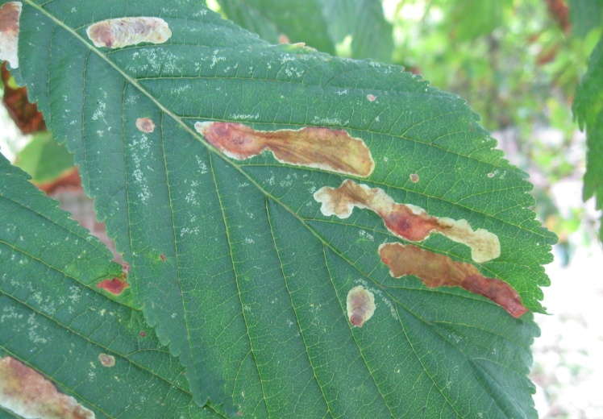
Insect pests – chewers and tunnellers
Butterfly and moth caterpillars
Some will chew leaves and stems, some tunnel into fruit or vegetables, some act as leaf miners.
Photos:
Top left: Spodoptera caterpillar tunnelling into a flower head
Top right: Mullein moth caterpillar feeding on flower
Bottom left: Tunnels in tomato fruit caused by Tuta absoluta (South American tomato moth)
Bottom right: Leaf mines caused by caterpillars of the horse chestnut leaf-mining moth

Slide 9
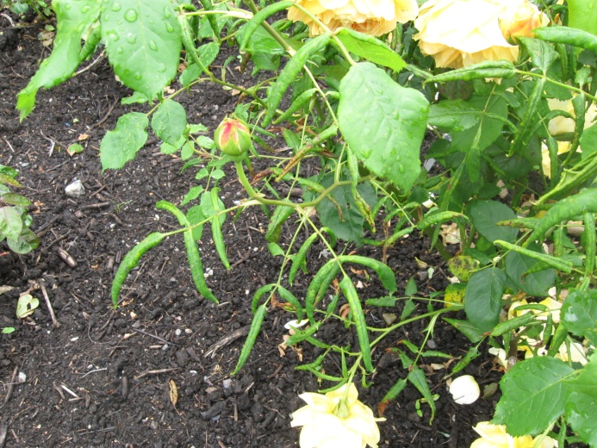
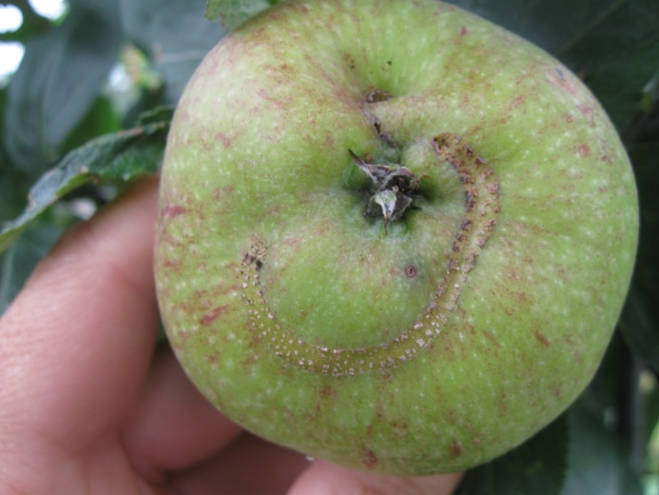
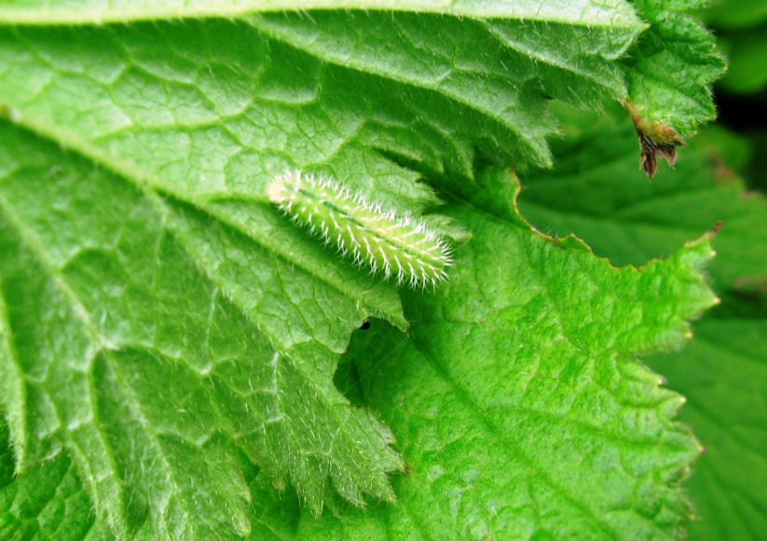
Insect pests – chewers and tunnellers
Sawfly larvae
Related to bees, wasps & ants, larvae look like caterpillars, adults like small flies or wasps.
Photos:
Top left: Solomon’s seal sawfly
Top right: Rose leaf-rolling sawfly
Bottom left: scar caused by apple sawfly
Bottom right: Geun sawfly larva

Slide 10
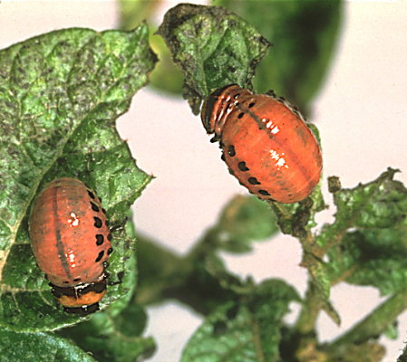
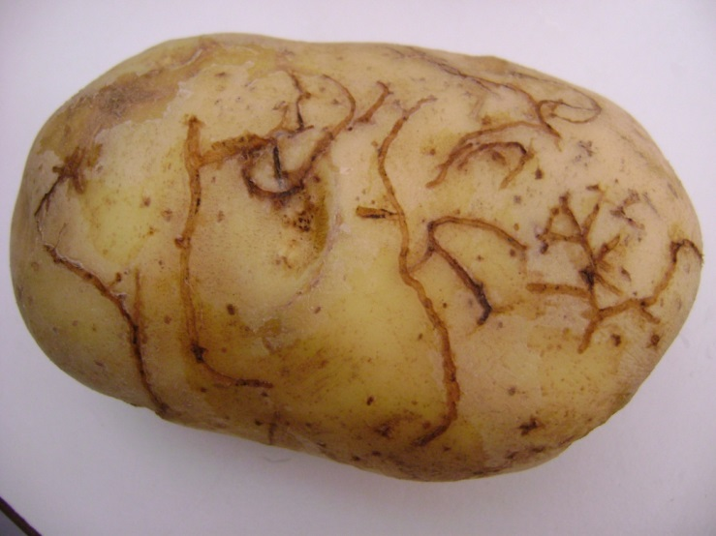
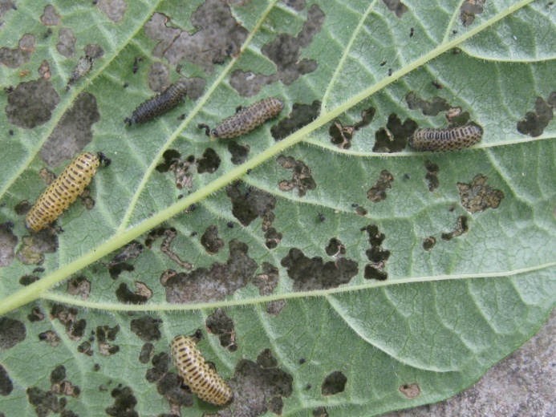
Insect pests – chewers and tunnellers
Beetles and their larvae
Over 400,000 species worldwide, make up 40% of all insect species. More than 40 species are quarantine organisms in the EU.
Symptoms include chewing damage, tunnelling and boring, according to species. Mainly caused by larvae, but adults sometimes also cause damage.
Photos:
Top left: Colorado beetle larva & adult; top right: Asian longhorn beetle larvae, pupa, adult
Bottom left: Epitrix (potato flea beetle) tuber damage; bottom right: Viburnum beetle larvae

Slide 11
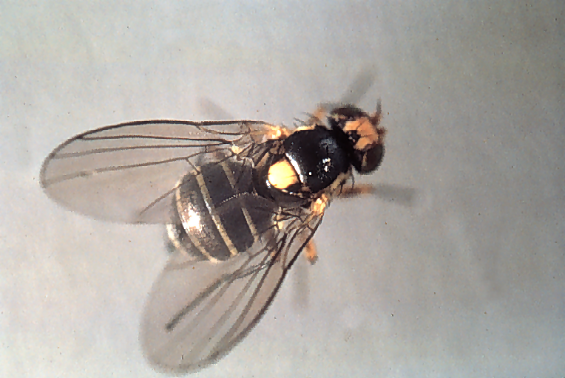
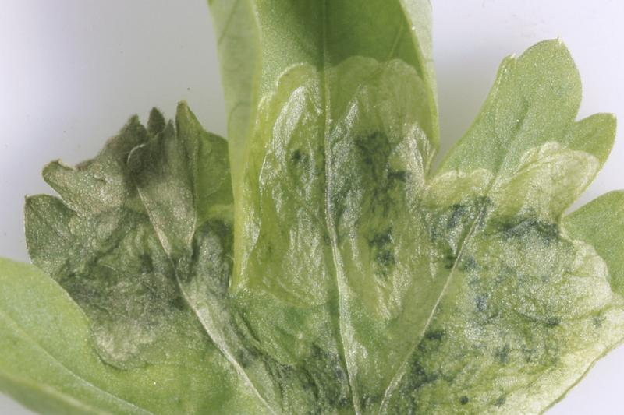
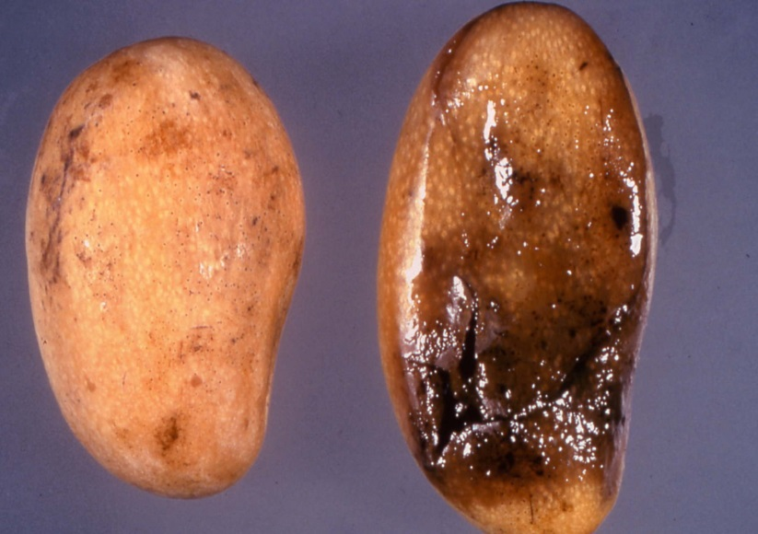
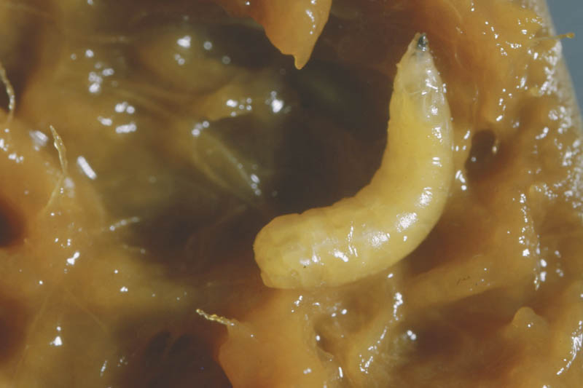
Insect pests – tunnellers
Fly larvae
Have sucking rather than chewing mouthparts, but will tunnel into plant tissues.
Includes leaf miners & fruit flies (latter really suck in juices but still burrow into the fruit)
Photos:
Top – Leaf miner adult, celery leaf miner damage
Bottom – Mango damaged by fruit fly, fruit fly larva

Slide 12
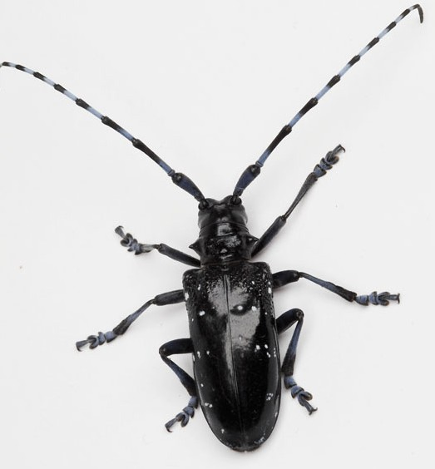
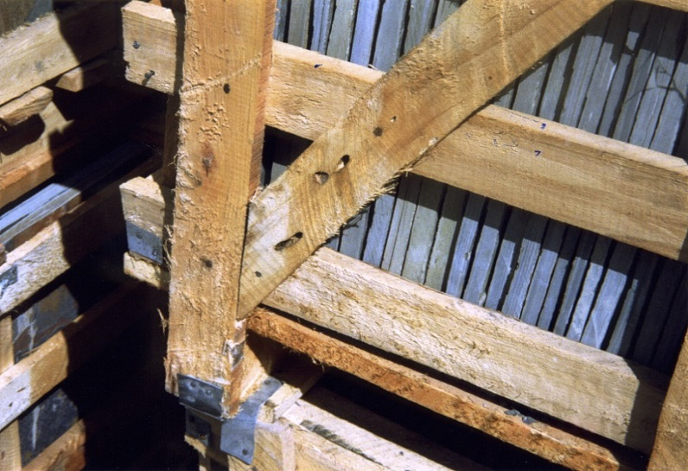
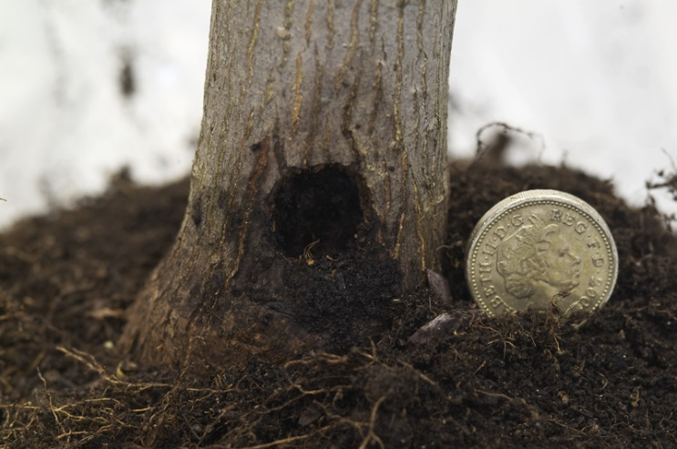
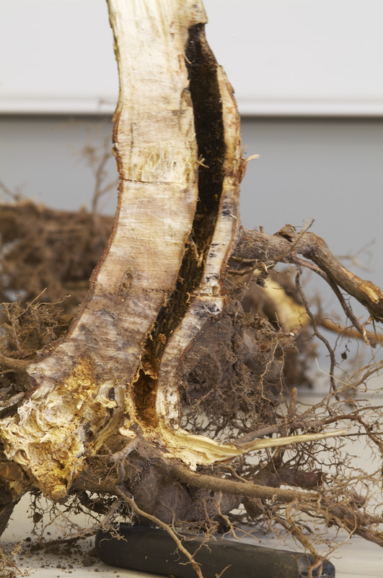
Key species - Asian and citrus longhorn beetles (Anoplophora spp.)
Neither are present in the UK.
Larvae cause substantial damage to broadleaved trees by burrowing in trunk and branches.
Citrus longhorn tends to arrive in young plants (often Acer), Asian longhorn in timber products (e.g. pallets)
Outbreak of Asian longhorn in Kent in 2012, Paddock Wood area. Eradicated but over 2000 trees felled.
Photos: adult emergence hole, larval damage on timber crate, tunnel in stem, adult citrus longhorn, citrus longhorn larva in stem.

Slide 13
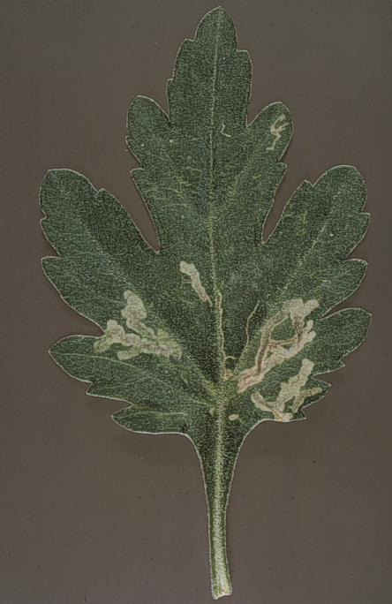
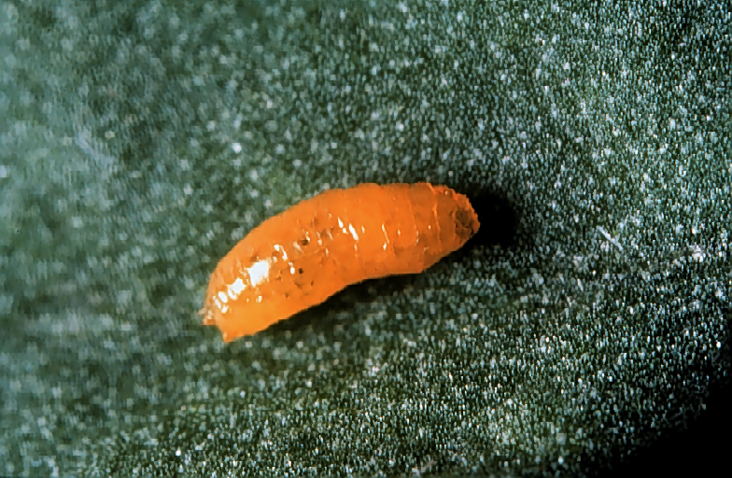
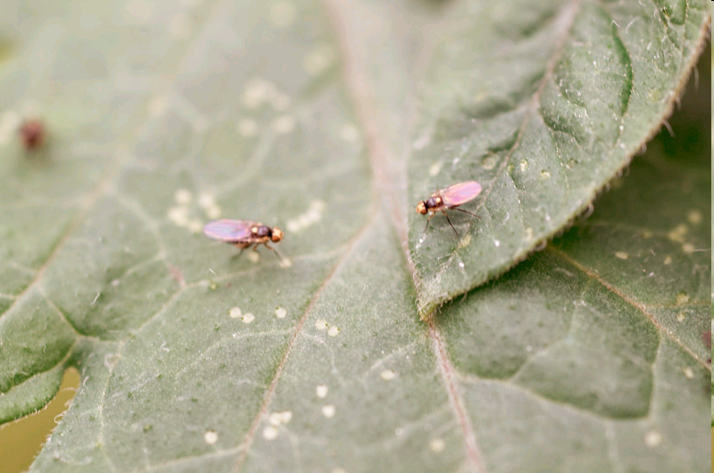
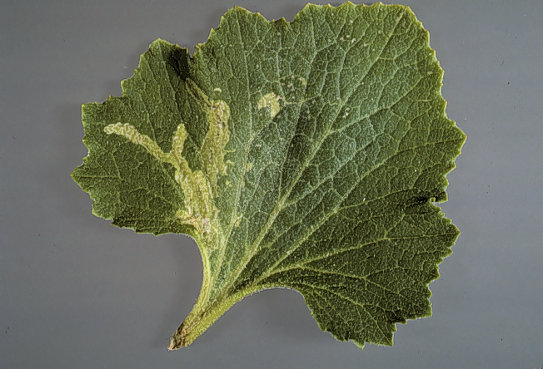
Key species - Liriomyza species (leaf-mining flies)
4 quarantine-listed species in EU (39 species indigenous to UK but these have limited host ranges and do not damage commercial crops).
Quarantine species have potential to cause substantial damage to a range of glasshouse crops (both edible and ornamental).
Adults are small flies with a yellow spot on their back; they leave puncture marks on foliage when laying eggs. Larvae burrow in leaves and cause the major damage.

Slide 14
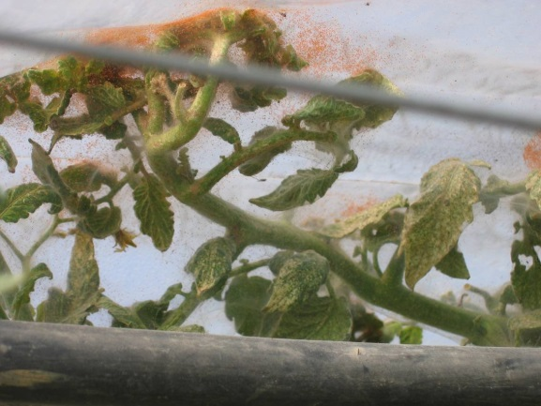
Mites

Slide 15
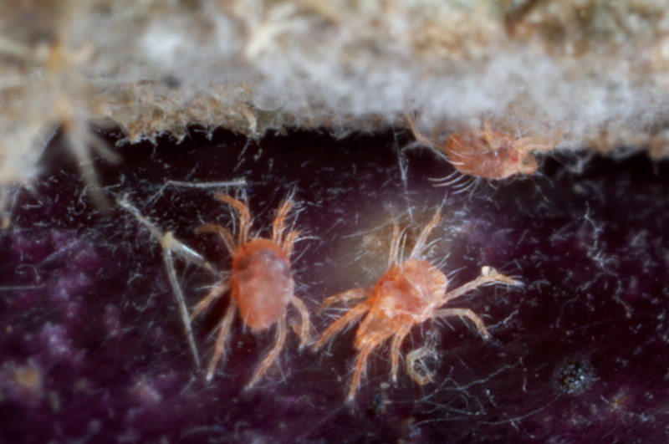
Mites
Suck sap
Reduce vigour, yield loss
Cause yellowing
Cause distorted growth
Some mites (e.g. tarsonemid) are found commonly within the growing points. Others feed more widely.
Gall mites can cause very characteristic distortion of their host plant (e.g. the fuchsia and sycamore pictures).

Slide 16
Nematodes
Photos:
Top left: angular leaf spot caused by leaf and bud nematode on strawberry
Top right: Cysts on roots of potato plants caused by the potato cyst nematode
Bottom left: Internal rotting of a daffodil bulb cause by Ditylenchus
Bottom right: Pratylenchus sp – a free-living nematode viewed under a microscope

Slide 17
Nematodes
Plant parasitic nematodes are microscopic and worm-like
Can affect roots or aerial parts of plants
They can cause stunting, distortion, leaf spots
May transmit viruses
Photos, top right to bottom left: Potato cyst nematode cyst and eggs viewed under a microscope, leaf and bud nematode on buddleia, Ditylenchus (stem nematode) on daffodil, same, nematodes attracted to plant roots.

Slide 18
Key species - Ditylenchus dipsaci (stem & bulb nematode)
Ditylenchus dipsaci infesting onion
Progression of symptoms from left (healthy) to right (severe infestation)

