Slide 1
Export Training Programme for Plant Health Exports Audited Trader Scheme (PHEATS)
V1 Dec 2020

Slide 2
Exports - Introduction

Slide 3
Content
2
In this module we will explore how the trade and movement of plants (and plant products) is controlled and regulated
We will also learn about how control measures designed to regulate plant movement operate internationally, nationally and at a regional level
To understand how this affects us working in UK Plant Health, the module will be divided into three sections:
International plant health
European plant health
Plant health within the UK

Slide 4
International plant health learning objectives
3
Understand:
That plant health is a global issue
The international frameworks and approaches that regulate it
The plant biosecurity continuum

Slide 5
What is plant health?
Plant health is ‘the discipline that uses a range of measures to control and prevent pests, weeds and disease-causing organisms that specifically affect plants from spreading into new areas, especially through human interaction such as international trade.
Legislative and administrative procedures used by governments to inhibit plant pests from entering and spreading within their territories .
Plant quarantine.
Certification schemes (health standards for production and marketing of healthy planting material).
Plant health activities can include: border controls, import requirements and inspection regimes.

Slide 6
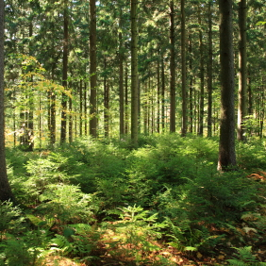
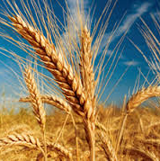
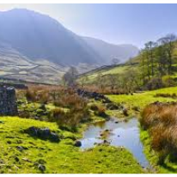
The value of plant health
An estimated £6bn value to UK society each year comes from maintaining healthy crops and forestry - £3.3bn of commercial crop value, around £1.8bn of social/environmental value of forestry and £0.9bn direct commercial value of forestry and sawmilling (likely to be an underestimate as social/environmental benefits are not easy to monetise)
Food and drink exports are worth around £20bn to the UK economy; these exports rely on our excellent plant and animal health status
A healthy, vibrant environment supports an outdoor recreation industry estimated to be worth £20bn

Slide 7
Plant health is a global issue
4
The movement of plants and plant products is a global business. In recent years we have seen an increase in the:
Range and volume of products
Number of trading countries
Use of air freight or rapid movement
This has seen an increase in the number of pests being intercepted or introduced:
Intercepted means: The detection of a pest during inspection or testing of an imported consignment
Introduction: The entry of a pest resulting in its establishment

Slide 8
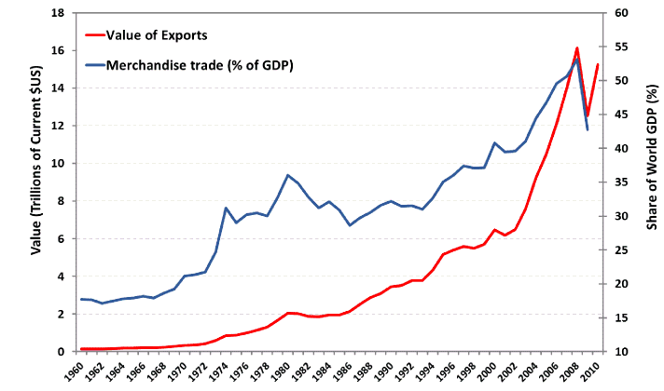
Increasing numbers/volume of pathways
Increased global trade

Slide 9
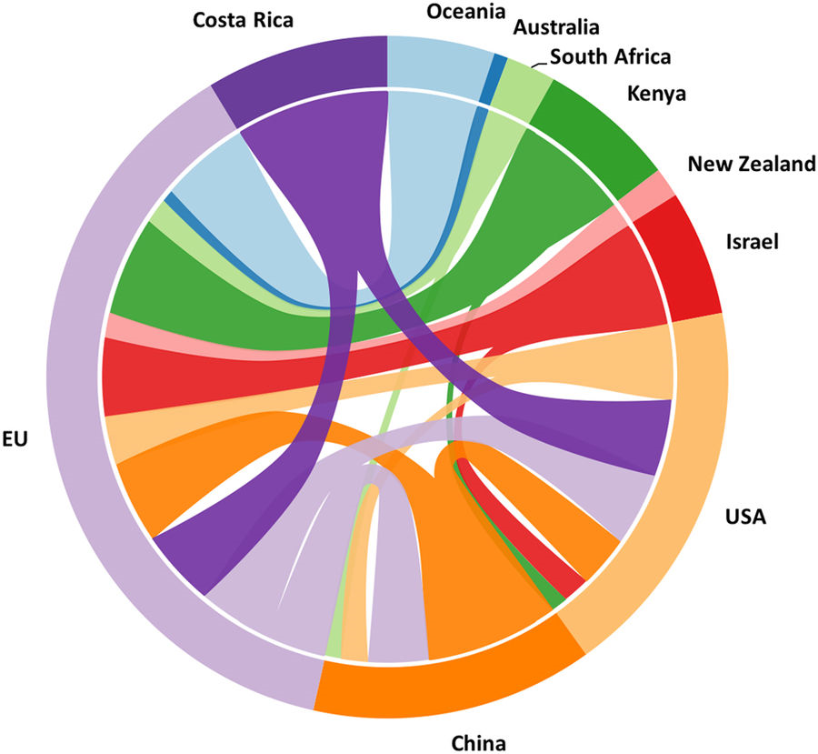
Pathway networks
Plant trade among principle trading countries.
Widths proportional to 2015 import & export values.
(Commodity code 0602: Live trees, including roots, cuttings, slips and mushroom spawn).
Source UN Comtrade Database http://comtrade.un.org/
Santini et al. 2018 Tracing the role of human civilization in the globalization of plant pathogens. The ISME Journal
https://doi.org/10.1038/s41396-017-0013-9

Slide 10
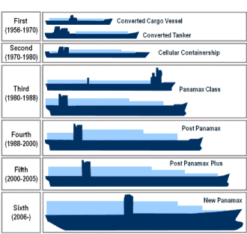
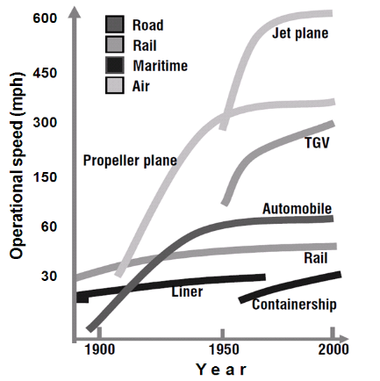
Increased global trade
Source: adapted from Rodrigue et al., 2006

Slide 11
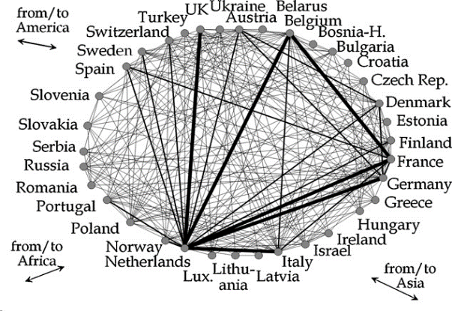
Pathway networks
European horticultural trade network
Source: Scientia Horticulturae (2010) 125, 1–15

Slide 12
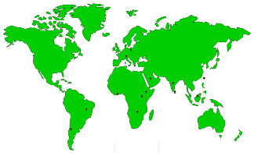
Changing volumes of trade eg: cut flowers
UK imports of cut flowers (CN 0603 1080/ 0603 1990)
2000 46,364 tonnes 26 countries
2005 68,449 tonnes 39 countries
New country sources in 2005
Austria, Brazil, Chile, Cote D'Ivoire, Ethiopia, India, Malaysia, Poland, Saudi Arabia, Sri Lanka, Taiwan, Uganda, Zambia

Slide 13
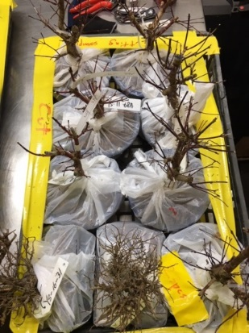
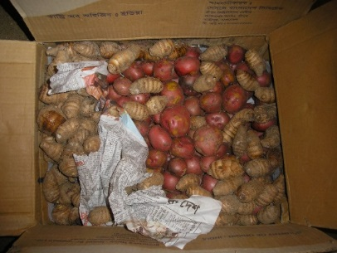
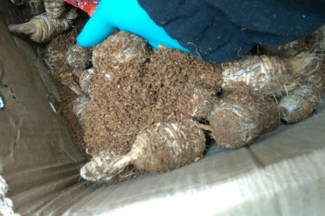
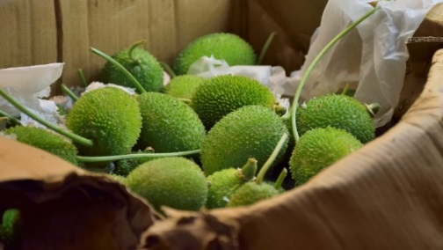
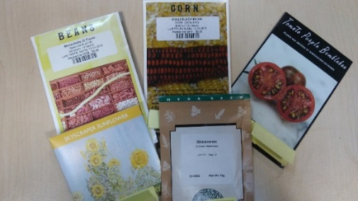
Plant health is a global issue
Therefore there is a need to balance trade vs protection from pests. Depending on the level of risk they pose, the movement of plants and plant products may be:
Prohibited: e.g. seed potatoes from certain third countries and soil
Controlled: e.g. all plants, most plant products, some seeds
Unrestricted: e.g. bananas and pineapples, canned and frozen veg
A third country is a country that is not part of Great Britain
An importing country may require exporting countries to meet certain requirements such as Pest Free Areas (PFAs).

Slide 14
International frameworks
WORLD TRADE ORGANISATION (WTO)
Is an international organisation dealing with the global rules on trade, with its main aim being to ensure trade flows smoothly and freely as possible.
WTO roles:
Trade rules and agreements
Dispute settlement & Forum for trade negotiation
Assisting developing countries
5
Any changes to a country’s import requirement that will have a significant impact on trade, even in the event of an emergency should be notified to the WTO. This enables trading partners to be aware of any change to any import or export requirements.
SPS Agreement - The Agreement on the Application of Sanitary and Phytosanitary (SPS) Measures (1995):
The agreement applies to all sanitary and phytosanitary measures which may, directly or indirectly, affect international trade.
It concerns the application of food safety
and animal and plant health regulations.

Slide 15
International frameworks
SPS Agreement
Justified measures
Application of International Standards
Equivalence
Risk assessment
Transparent
Reducing protectionism
WTO
There are several key features to the SPS agreement:
Protectionism:
A phytosanitary measure must not be required where there are no health reasons
Justified measures:
Measures must not be applied for no other purpose than to ensure that plants and plant products are safe from pests
Application of international standards:
Governments must apply SPS measures consistent with international standards – for plants this is the International Standards for Phytosanitary Measures (ISPMs)
Equivalence:
Risks can be mitigated by differing and alternative measures but can provide the same level of protection
Risk Assessment:
SPS measures must be on an appropriate assessment of risks
Transparent:
Government should make their phytosanitary measures transparent to trading partners and notify countries of any changes.
Phytosanitary measures must be:
based on scientific and technical justification
Consistent with international standards
non-discriminatory (when compared to internal markets)
based on an “appropriate level of protection” ALOP
Transparent, notified and non discriminatory
based on international standards where available

Slide 16
International frameworks
INTERNATIONAL PLANT PROTECTION CONVENTION (IPPC)
An international treaty (under the FAO) that aims to protect the world’s cultivated and natural plant (including tree) resources from the spread and introduction of plant pests while minimizing interference with the international movement of goods and people. There are currently 184 contracting parities to the convention. The UK ratified the convention in 1953. The Convention has a governing body known as the Commission on Phytosanitary Measures (CPM), which oversees the implementation of the Convention.

Slide 17
International frameworks - IPPC
INTERNATIONAL PLANT PROTECTION CONVENTION (IPPC)
The IPPC is the only recognised standard-setting body for plant health.
Under the IPPC, International Standards for Phytosanitary Measures (ISPMs) are developed.
A key obligation under the IPPC is the establishment of a National Plant Protection Organisation (NPPO).
Aims to:
Protect plant life
Prevent introduction & spread of plant pests
Promote fair & safe trade
UN FAO offices, Rome, IT, Home of IPPC

Slide 18
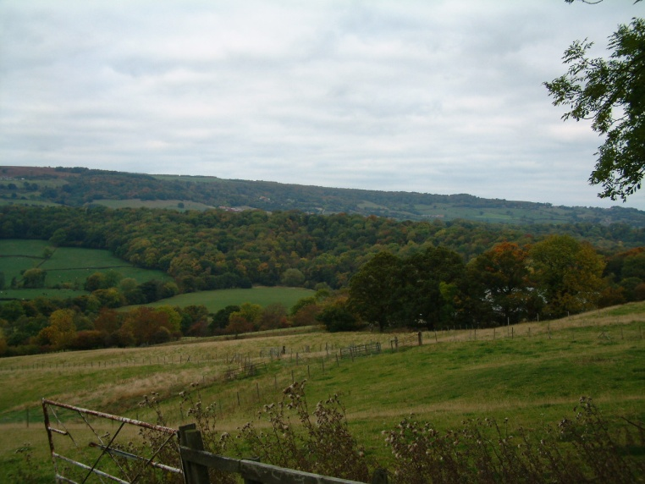
Scope of the IPPC
By protecting plant resources from pests and diseases, the IPPC helps to:
1. Protect farmers from economically devastating pest outbreaks.
2. Protect the environment from loss of species diversity.
3. Protect ecosystems from loss of viability and function as a result of pest invasions.
4. Protect industries and consumers from the costs of pest control or eradication.
5. Facilitate trade through Standards that regulate the safe movements of plants and plant products.
6. Protect livelihoods and food security by preventing the entry and spread of new pests of plants into a country.

Slide 19
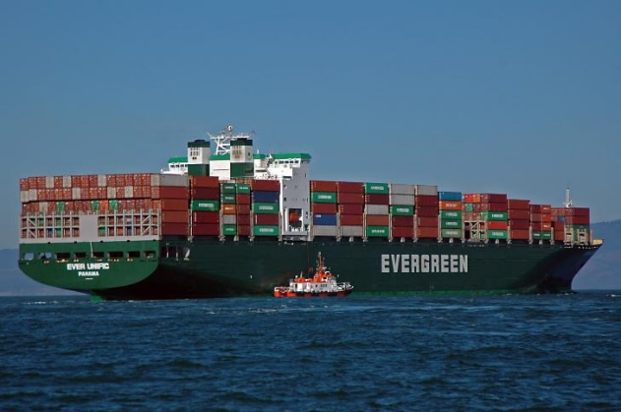
Scope of the IPPC
Extends to items capable of harbouring or spreading pests, such as:
storage places
conveyances
Wood Packaging Material (WPM)
plant products
Includes intentional introductions of organisms, such as:
biological control organisms
organisms for research (e.g. plant pests)

Slide 20
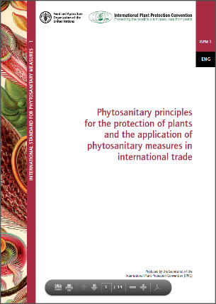
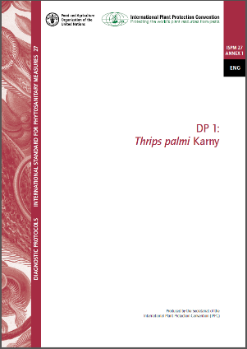
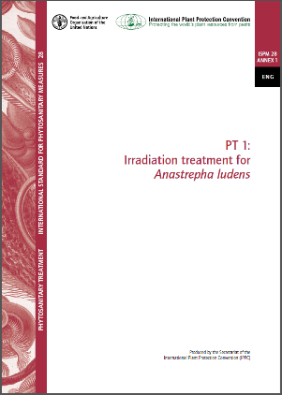
International Standards for Phytosanitary Measures (ISPMs)
Provide guidance to member countries in implementing national programs and fulfilling requirements of the IPPC and to help establish and maintain harmonization of phytosanitary measures used in international trade.
May be very general (e.g., Glossary, Principles etc.), or highly specific (e.g. Pest status, Diagnostic protocols)
Currently there are:
43 International standards for Phytosanitary Measures (ISPMs)
32 Phytosanitary treatments for regulated pests (PT)
29 Diagnostic protocols (DP)
https://www.ippc.int/en/core-activities/standards-setting/ispms/#publications

Slide 21
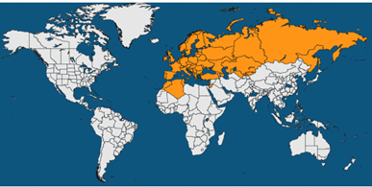
European Plant Health
The European & Mediterranean Plant Protection Organisation (EPPO) is a regional plant protection organisation that comprises of 52 member countries, covering a wide geographical area (see map), including the UK. Their aim is to:
Promote the exchange and synthesis of information
Facilitate collaboration
Produces recommendations to help member countries develop their plant health controls, it does not however regulate.
11
There are other regional plant protection organisations that cover regions around the world:
Asia and Pacific Plant Protection Commission (APPPC)
Caribbean Plant Protection Commission (CPPC)
Comité de Sanidad Vegetal del Cono Sur (COSAVE)
European and Mediterranean Plant Protection Organization (EPPO)
Interafrican Phytosanitary Council (IAPSC)
North American Plant Protection Organization (NAPPO)
Near East Plant Protection Organization (NEPPO)
Organismo Internacional Regional de Sanidad Agropecuaria (OIRSA)
Pacific Plant Protection Organization (PPPO)

Slide 22
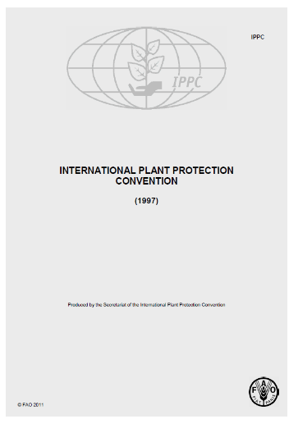
What is an NPPO?
The IPPC (convention text) mandates that an National Plant Protection Organisation (NPPO) should be established by a contracted party.
Function of the UK NPPO is provided by Department for Environment Food & Rural Affairs (Defra) but can also be provided by Scottish, Welsh and Northern Irish Governments.
Functions include:
the issuance of certificates relating to the phytosanitary regulations
the surveillance of growing plants,
the inspection of consignments of plants and plant products moving in international traffic
the disinfestation or disinfection of consignments of plants, plant products and other regulated articles moving in international traffic
the protection of endangered areas and the designation, maintenance and surveillance of pest free areas and areas of low pest prevalence
the conduct of pest risk analyses

Slide 23
NPPO
Policy, Legislation and Coordination
England | Wales | Scotland | Northern Ireland
Monitoring, Surveillance and implementation of controls

Slide 24
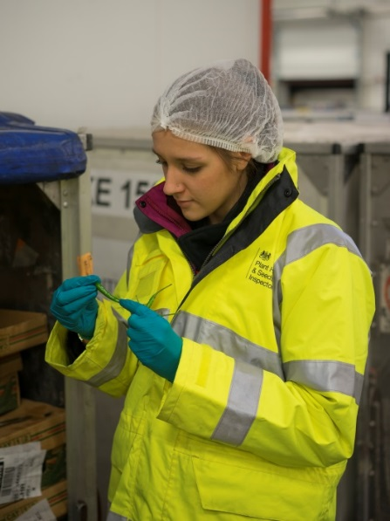
Animal & Plant Health Agency (APHA)
Plant Health and Seed Inspectorate (PHSI)
The Plant Health and Seeds Inspectorate (PHSI) is part of the Animal and Plant Health Agency.
It executes plant health policy in England and Wales under a Memorandum of Understanding with Defra and with the Welsh Government.
PHSI carry out import, export, monitoring and survey inspections, issue phytosanitary certificates, and oversee import controls, plant passporting arrangements and eradication campaigns. They also issue scientific licences for work on prohibited pests and plants. PHSI inspect and certify crops in relation to the statutory seed potato classification scheme and voluntary schemes on certain fruit and ornamental species and hops.
It carries out work on seed certification and enforcement for the Plant Variety and Seeds team within Defra’s Policy team. The Chief Inspector reports to APHA’s Chief Executive.

Slide 25
Animal & Plant Health Agency (APHA)
Centre for International Trade
The Centre for International Trade – Plant Health (CIT) are responsible for completing desk based inspections in relation to the import of controlled plant materials coming into England and Wales.
CIT also process and issue export phytosanitary certificates for a number of materials including plant products, produce grain, seeds, and potatoes, ensuring they are free from pests and disease to allow their customers to export their products to third countries.
Other schemes managed within the CIT team include Seed Potato Classification Scheme (SPCS) tasks, EU Notifications, Scientific Licensing, Plant Passport registrations and authorisations as well as answering Plant Health related queries and providing customer advice.

Slide 26
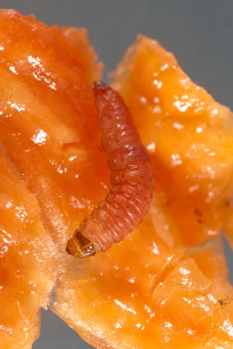
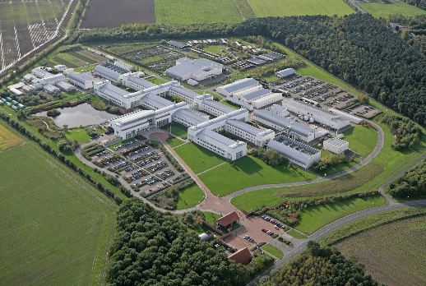
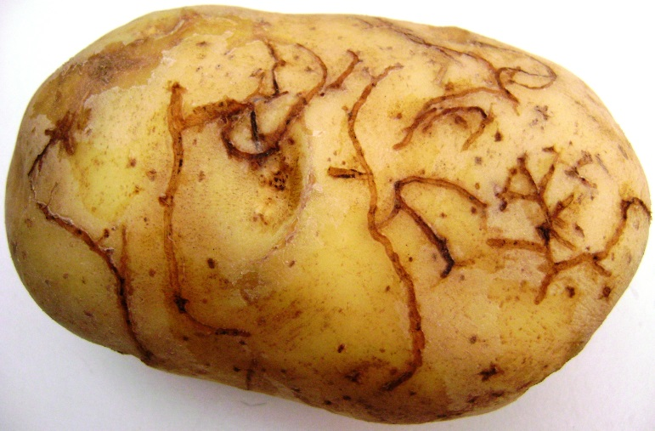
Fera Science
Laboratory Diagnostics
Pest and disease identification and diagnosis is carried out by the Pest and disease ID team, within the plant protection programme of Fera, from samples submitted by PHSI and members of the public. They also carry out research and development projects linked to the needs of the UK Plant Health Service.
They will carry out the laboratory examination of plants, produce, seeds, plant products and other materials as required by importing countries regulations.

Slide 27
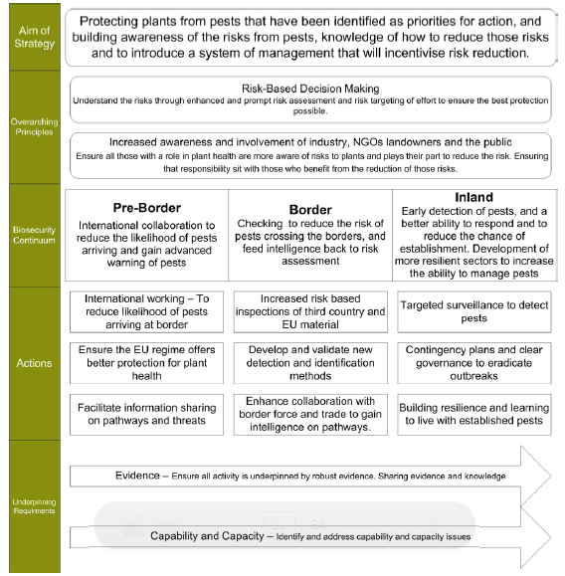
Biosecurity Continuum
Provides a multi-layered approach of deploying control measures to prevent harmful plant pests from entering the EU/UK at the following critical points in the system:
Pre-border
Border
Inland
It can be applied at a national/regional level, or equally at a local or site level
Pre-border – pre-purchase
Border – at ‘goods-in’
Inland – on-site nursey activities
6
https://assets.publishing.service.gov.uk/government/uploads/system/uploads/attachment_data/file/307355/pb14168-plant-health-strategy.pdf

Slide 28
International Trade in Plants and Plant Products
Goods that are regulated in a third country will quite often a require a Phytosanitary Certificate (PC) to accompany the goods.
What is the purpose a Phytosanitary Certificate?
Phytosanitary certificates are issued to attest that plants, plant products or other regulated articles meet the phytosanitary import requirements of importing countries and are in conformity with the certifying statement.
What’s the certifying statement?
“This is to certify that the plants, plant products or other regulated articles described herein have been inspected and/or tested according to appropriate official procedures and are considered to be free from the quarantine pests specified by the importing contracting party and to conform with the current phytosanitary requirements of the importing contracting party, including those for regulated non-quarantine pests.”

Slide 29
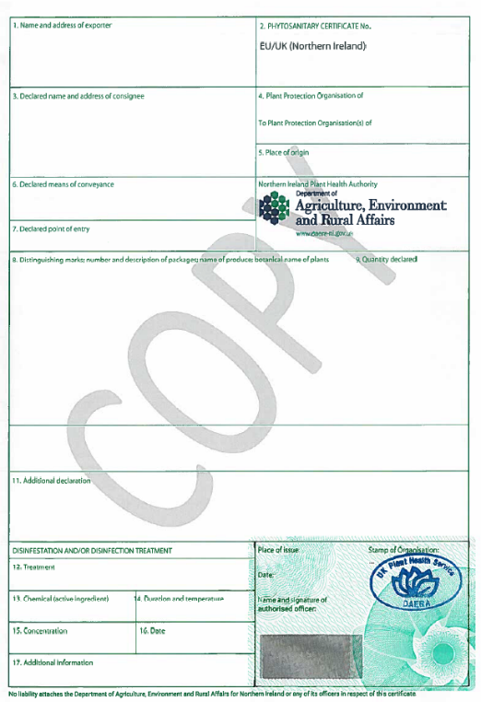
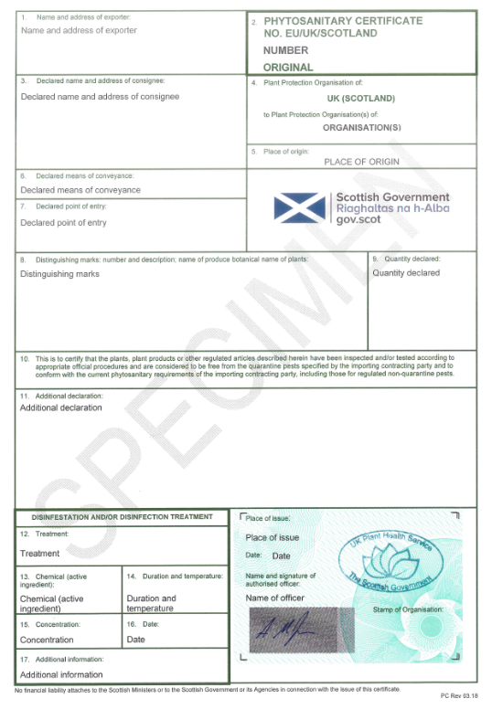
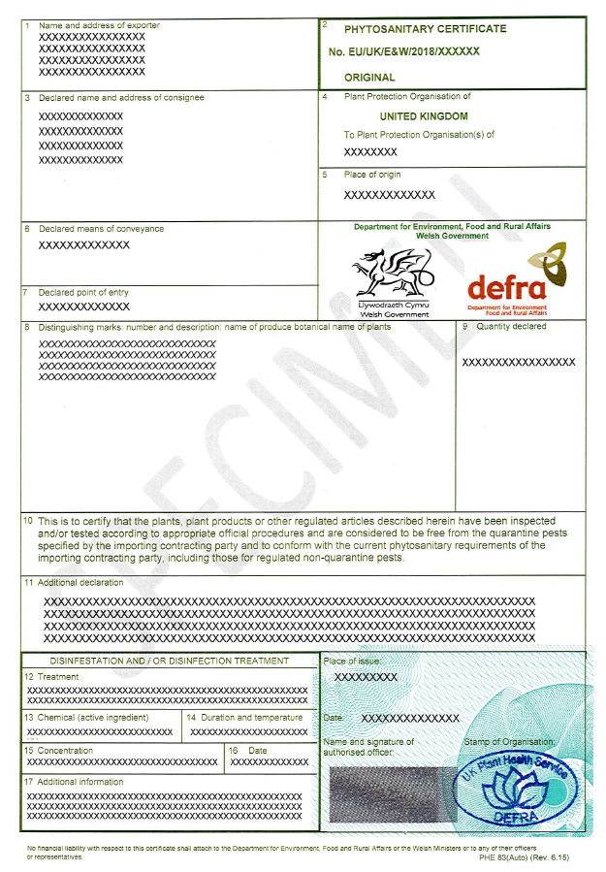
What does a UK PC look like?
Northern Ireland
Scotland
England & Wales
Certifying statement

Slide 30
Knowledge Test

Slide 31
Knowledge Test
Please visit the below link to complete the knowledge test for this module:
PHEATS – Introduction Knowledge Test
https://forms.office.com/Pages/ResponsePage.aspx?id=UCQKdycCYkyQx044U38RAvJ7GY98IcdOvJfSZ-UDeKFUMDY0M0JQVEJYMVdFWUlHS1NKSktXRlUyMy4u

