Slide 1
Regulated pests commonly intercepted with imported cut flowers

Slide 2
Most frequent interceptions
Bemisia tabaci
Liriomyza
Thrips
Spodoptera
The most frequently found regulated pests on cut flowers entering the UK are the tobacco whitefly, Bemisia tabaci, and species of Liriomyza flies in the family Agromyzidae
Less frequently found are Thrips species, and caterpillars of the genera Helicoverpa and Spodoptera
The commodity most frequently rejected for the presence of regulated pests is Chrysanthemum/Dendranthema on which we frequently find Liriomyza on consignments from South America. Bemisia tabaci has been found regularly but less frequently on a range of flowers, including roses India. Thrips and Spodoptera have been occasionally, for instance on chrysanthemum from S. America (Spodoptera), and Dendrobium (Thrips) from the Far East.

Slide 3
Liriomyza flies

Slide 4
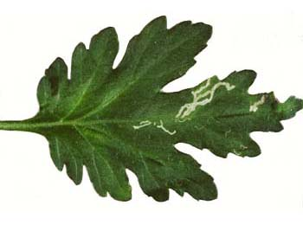
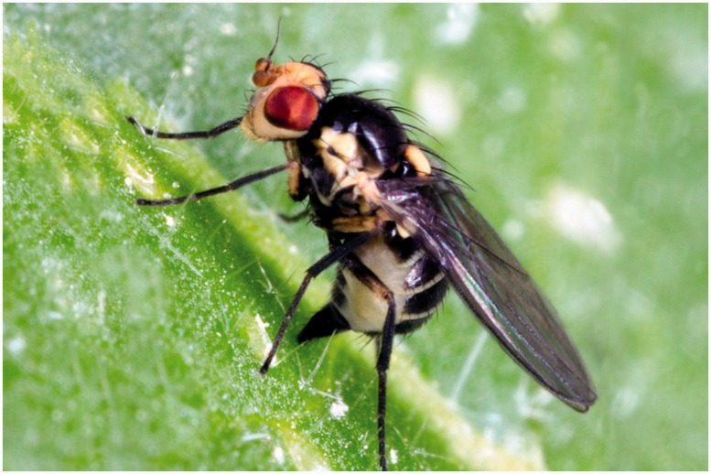
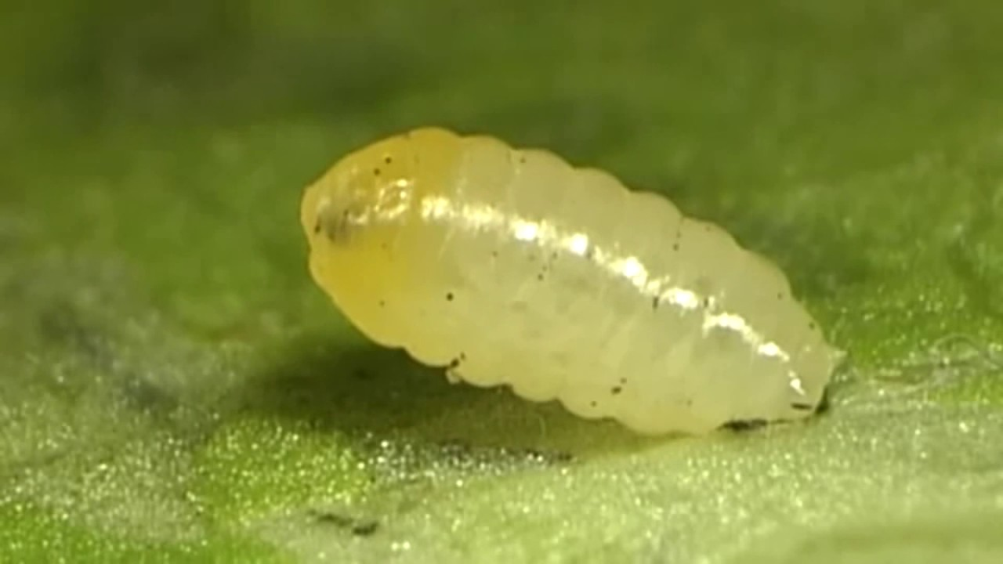
Agromyzidae- Leaf-miner flies
Liriomyza huidobrensis- South American leaf miner or serpentine leaf miner
Leaf miners on a diversity of plant species
May also mine stems and bore (rare)
Sometimes host specific
Shape of the mine is sometimes distinct
Many are agricultural pests

Slide 5
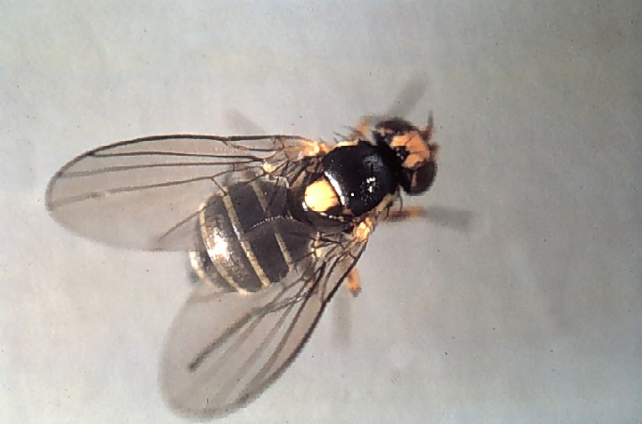
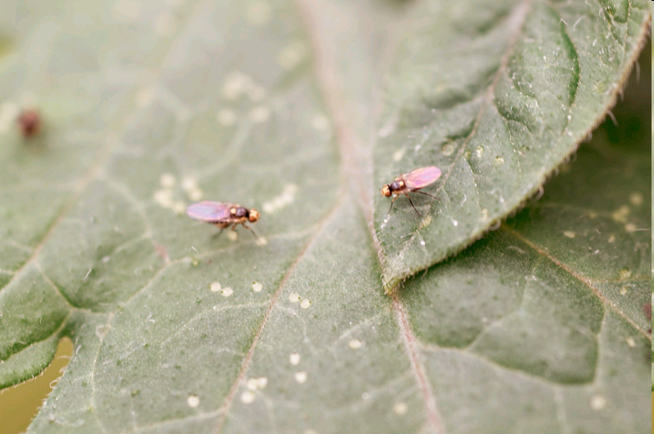
Agromyzidae - Liriomyza species
Liriomyza -one of the 31 genera in the family Agromyzidae
5 EU listed species out of 376 spp. worldwide ( 42 spp. in UK) last check
Adults are all small flies 1.5-2.5 mm long with a distinctive yellow scutellum
Life cycle: egg, 3 larval instars, pupa and adult
- Adult females puncture leaves to feed or oviposit
- Eggs are inserted just below the leaf surface
- Larvae are leaf miners
- Pupation occurs outside the host

Slide 6
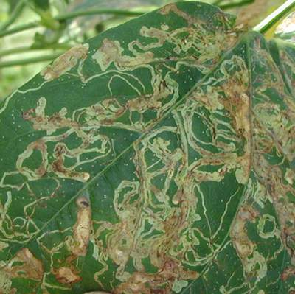
Liriomyza spp. - economic damage
Adults puncture leaves to feed and to lay eggs
Larvae most damaging stage – leaf miners
Premature leaf drop
Delayed host development
Yield reduction
Aesthetic damage – mines and punctures reduce plant quality and devalue plants

Slide 7
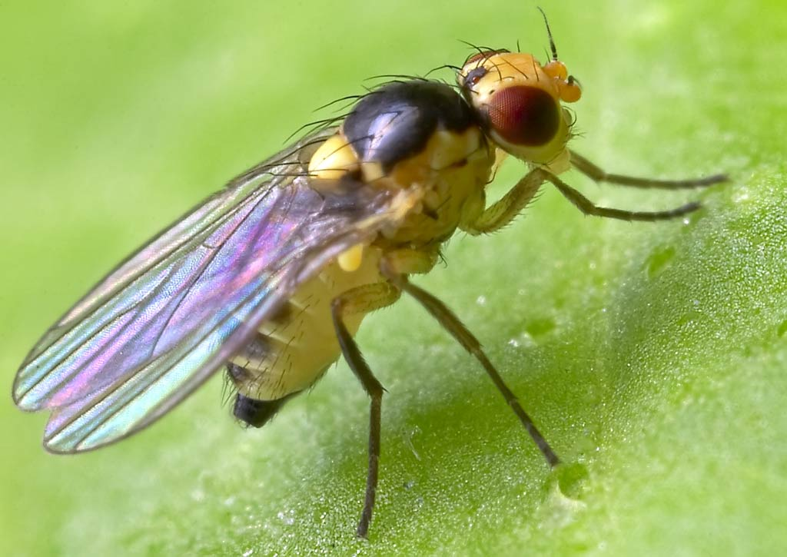
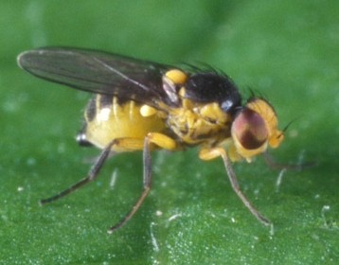
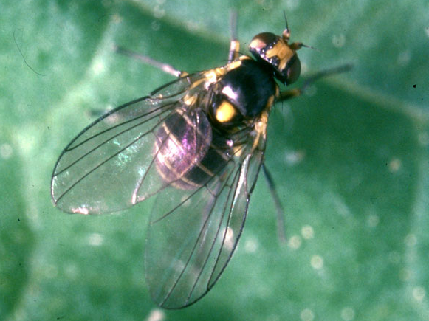
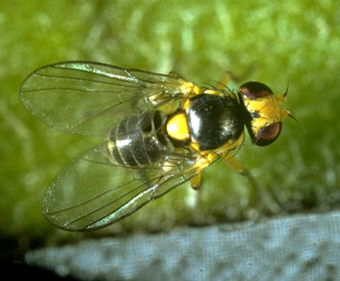
L. bryoniae
L. sativae
L. huidobrensis
L. trifolii

Slide 8
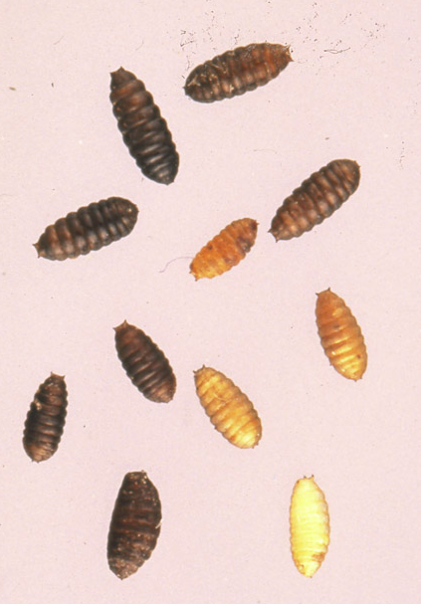
Liriomyza immature life stages
Liriomyza sativae
Liriomyza trifolii
Liriomyza huidobrensis pupae
1.0- 2.5 mm in length

Slide 9
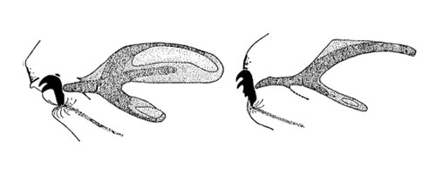
L. bryoniae & L. huidobrensis - Larvae and pupae
Off-white – last instar develops orange markings at the head
Posterior spiracles elliptical with 7-12 pores (bryoniae), 6-9 pores (huidobrensis), 10-12 pores (strigata)
Pupae gold-yellow to dark brown
Pupates in soil and sometimes on lower leaf surfaces

Slide 10
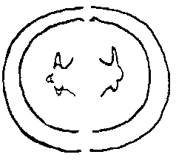
L. sativae / L. trifolii - Larvae and pupae
Uniformly pale yellow/orange becoming strongly yellow
Posterior spiracles a three-pointed cone each point terminating in a single pore
Pupae pale yellow–orange to golden brown
Pupates in soil

Slide 11
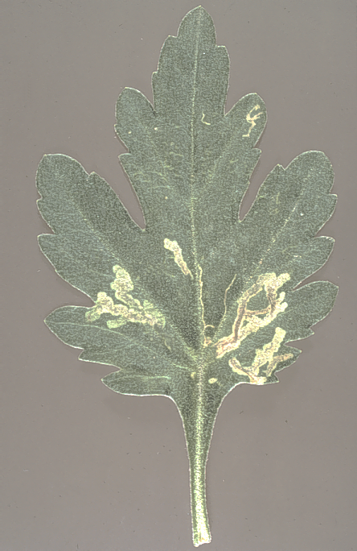
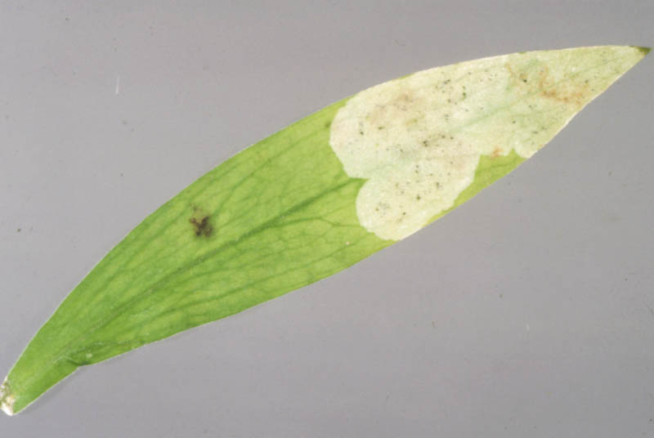
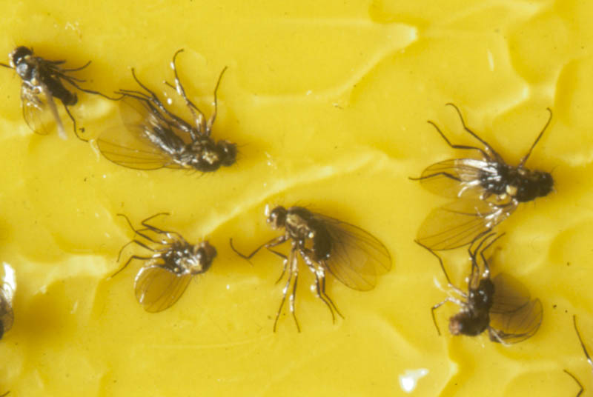
Detection

Slide 12
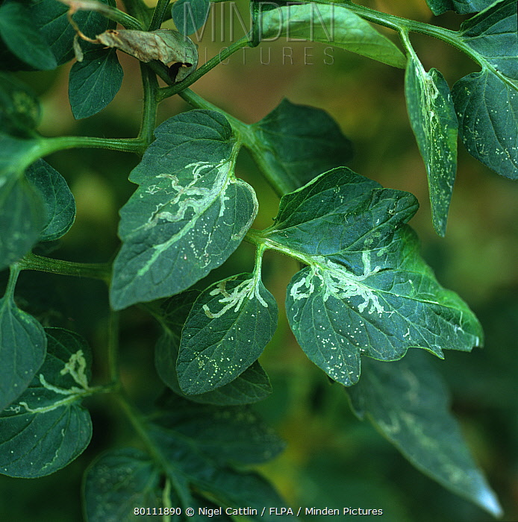
Liriomyza bryoniae: hosts & interceptions
Introduced to the UK a long time ago
Restricted to protected cultivation economic hosts: tomato, cucumber, pepper
Found in most of Europe except Ireland

Slide 13
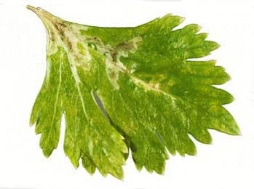
Liriomyza huidobrensis: hosts & interceptions
Originated in the New World; has now spread around the world (since the 1980s)
Highly polyphagous pest of numerous ornamental & vegetable crops
In Europe but not in the UK- Occasional outbreaks.
Numerous interceptions (2348 interceptions 1996-2018), with most from NL, Kenya, Cyprus, Israel.

Slide 14
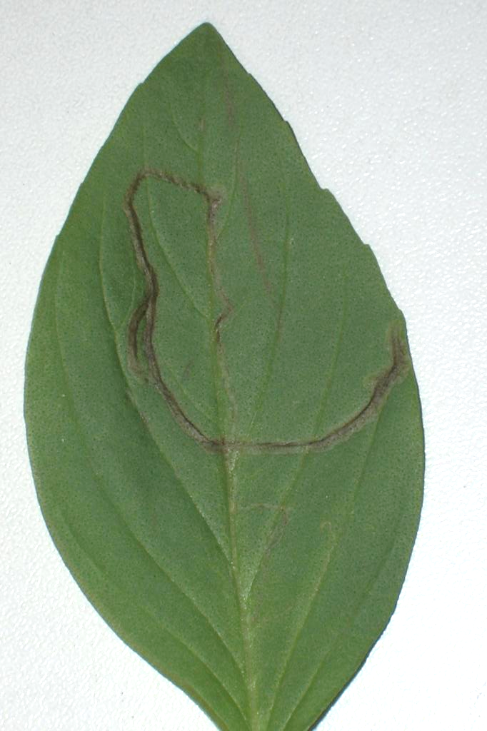
Liriomyza sativae: hosts & interceptions
Originates from the New World, currently spreading around the world (particularly South East Asia & West Africa)
Not in Europe, but has reached Israel
Highly polyphagous pest; mainly on basil from Thailand, Vietnam, Malaysia, Israel, Jordan and Kenya, but also assorted leaves from West Africa -113 interceptions (1996-2018)

Slide 15
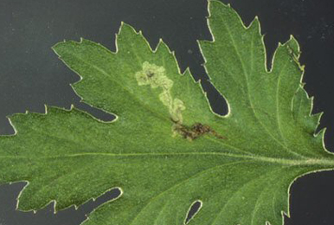
Liriomyza trifolii: hosts & interceptions
Originates in the New World; has now spread around the world (since the 1970s)
Highly polyphagous pest of numerous ornamental & vegetable crops
In Europe but not the UK.
Numerous interceptions – (364 interceptions (1996-2018).

