Slide 1
Exports
The Journey

Slide 2
Content
In this module we will explore how the trade and movement of plants (and plant products) is exported in England & Wales
We will also learn about the different stages of exports and what must be done by all the parties involved for a successful export
You will also find out about the underlying principles of the Plant Health Exports Audited Trader Scheme (PHEATS)

Slide 3
International plant health learning objectives
Understand:
What is PHEATS
The role you will play in PHEATS

Slide 4
Export Journeys – Non PHEATS
This is the general export journey of plant health regulated goods, some commodities may have slightly different journeys.
Pre Export
Do my goods need a phytosanitary certificate
Do I need laboratory tests or growing season inspections
Application
Register with APHA to make export applications
Arrange an export inspection with the PHSI
Export
Arrange transport and Customs declarations
Export of goods
What are the import requirements
Receive phytosanitary certificate

Slide 5
Export Journeys – PHEATS
Below highlighted in red is the main difference between exports covered by the PHEATS scheme and those that aren’t.
Pre Export
Do my goods need a phytosanitary certificate
Do I need laboratory tests or growing season inspections
Application
Register with APHA to make export applications
Authorised person will conduct export inspection (You)
Export
Arrange transport and Customs declarations
Export of goods
What are the import requirements
Receive phytosanitary certificate
Submit export applications (online)

Slide 6
What is PHEATS?
PHEATS (Plant Health Exports Audited Trader Scheme) is designed to facilitate the exports of high frequency produce and cut flower consignments.
It works by delegating the function of the phytosanitary export inspection to a designated authorised person who has undergone sufficient training to ensure that exported consignments remain free from any quarantine pest and diseases.
For eligible businesses there are several steps involved for a business to be a part of the scheme and appoint a Person Responsible (PR) as well as an authorised person(s) to be a part of the scheme to conduct the inspections.
Benefits include reduced inspections fees and a simplified process for the phytosanitary inspection which will save time for businesses who require a quick turnaround of the Phytosanitary Certificate.
Eligibility
Registration & Applications
Training
Audits

Slide 7
Eligibility
To be eligible to join PHEATS, an exporting business:
Export fresh produce and / or cut flowers (the scheme does not apply to produce or cut flowers that are prohibited entry to the importing country)
Apply for export services online
Identify a “Person(s) Responsible” for overall management of the scheme, as well as authorised persons who will conduct the official export inspections. There must be a sufficient number of authorised personnel to conduct the official export inspections required under PHEATS.
Create and implement an approved “Biosecurity Control Management Plan” (BCMP) for PHEATS
Exports of other regulated commodities, such as plants for planting and machinery will require the usual official inspection by APHA or other delivery bodies.
If you are not eligible for the scheme then exports can still be undertaken via the usual exports scheme in that the competent authority will undertake the inspections.
All authorised persons who conduct export inspections must pass all the training modules provided

Slide 8
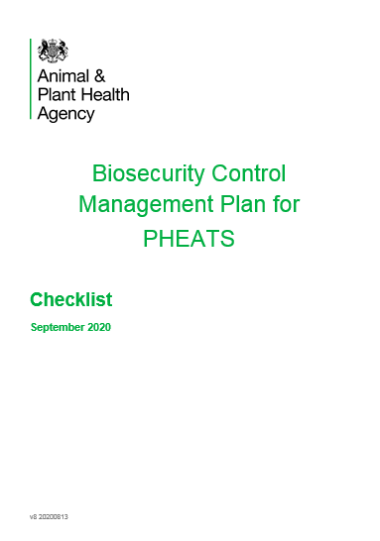
Registration & Applications
Businesses will be required to submit a Biosecurity Control Management Plan (BCMP).
This includes:
Applicant details
Site details incl. site plan & holding areas
Commodities to be exported
Person(s) responsible
Authorised persons
Training records
Inspection facilities
Inspection records
Separate applications for each site that wants to be included in the scheme must be submitted, even if they are from the same business. This will include any direct suppliers who export on a business’ behalf.
There will be an external guidance document that covers the registration process and explains the scheme in more detail.
Site audits will be undertaken to ensure businesses meet the requirements. These audits will both be announced and unannounced.

Slide 9
Training
Training will be conducted online but with face to face assessments as part of the authorisation visits
Every authorised person and Person Responsible must complete the training before being authorised to conduct inspections that are part of the scheme.
There are several modules to training including:
Pest and disease symptom recognition
Understanding of export requirements of the relevant importing country
Inspection methodologies
Units of inspections
Tolerances for soils, seeds and weeds
Inspection area
When to inspect
PC validity
Record keeping
Finding a pest
Consignment rejections
Additional resources available

Slide 10
Audits
Audits will be carried out by PHSI on authorised persons and the business premise to check and review the implementation of the BCMP.
A minimum of one authorised person must be available at each audit.
Audit frequency will vary depending on the compliance of the PRs, authorised persons and operating businesses.
Unannounced audits, may also be undertaken by APHA.
Audits will be recorded internally by APHA but outcomes of any audits will also be provided to the exporting business.
Should any non-compliances or non-conformities be identified then corrective measures will need to be implemented within the given timeframe.

Slide 11
PHEATS Cont…
Overall as an authorised person you will be responsible for ensuring that any inspection of an exported consignment meets the importing country’s import requirements and as such will be providing this assurance during the export application procedure verifying that all the relevant checks have been completed.
PHEATS is only currently available for:
Exports of fruit, vegetables and cut flowers
For exports to the European Union (EU) and Northern Ireland (NI)
For PHEATS exports to Northern Ireland will need to meet the same requirements as exports to the European Union (EU).

Slide 12
Export Journeys – PHEATS
Pre Export
Do my goods need a phytosanitary certificate
Do I need laboratory tests or growing season inspections
Application
Register with APHA to make export applications
Authorised person will conduct export inspection (You)
Export
Arrange transport and Customs declarations
Export of goods
What are the import requirements
Receive phytosanitary certificate
Submit export applications (online)

Slide 13
Export Journeys
Each stage of an export can be further broken down into several steps, which will be covered in more detail.
All information contained within this part of the training will be in relation to the PHEATS process.
Although the main element of PHEATS is for the authorised person to conduct the export inspection. Each authorised person will have to demonstrate a fundamental knowledge of all the steps involved in the exports process to ensure that any consignment exported under PHEATS can meet the import requirements of the importing country and can satisfy the certifying statement on the phytosanitary certificate.

Slide 14
Knowledge Test

Slide 15
Knowledge Test
Please visit the below link to complete the knowledge test for this module:
PHEATS – The Journey Knowledge Test
https://forms.office.com/Pages/ResponsePage.aspx?id=UCQKdycCYkyQx044U38RAvJ7GY98IcdOvJfSZ-UDeKFURU5YOFVaUTUyR0ZXWjRQMUw0RU05OEJaNi4u

