Slide 1
Exports
The Journey: Legislation, special requirements and pre-export

Slide 2
Content
This module will cover the basic principles of the current EU legislation that covers plant health as well as where to find any emergency or official notifications to any changes in the EU’s import requirements.
It will also look at the first steps in the export journey and what you need to do to prepare for an export.

Slide 3
International plant health learning objectives
Understand:
Legislative purpose and principles
What goods don’t require a Phytosanitary Certificate (PC)
Which pieces of legislation can be used to determine the import requirements of the EU.

Slide 4
Export Journeys
Pre Export
Do my goods need a phytosanitary certificate
Do I need laboratory tests or growing season inspections
What are the import requirements
Pre Export:
Requirements
How do I know if a PC is required for my goods to be exported to the EU or NI
What legislation do I need to be aware of and how do I interpret it
Verification
PHSI or CIT verify the importing country’s requirements
What are the import requirements
Do I need any further lab tests or growing season inspections before my export inspection
This will include any current prohibitions

Slide 5
Legislation - Purpose
To prevent the introduction into of organisms harmful to plants and plant products and to prevent their spread within a country.
In order to protect agriculture and the environment and to facilitate international trade of plant and plant products
Notes:
I will use the term Great Britain since Northern Ireland will have a different status with regards to the EU.

Slide 6
Fundamental Requirements
Under IPPC rules any controls must be:
Technically justified - normally this is done by completing Pest Risk Analysis (PRA). A PRA is an evaluation of evidence to determine whether an organism is a pest and whether it should be regulated and if so the strength of any phytosanitary measures to be taken.
Uniform - by following internationally agreed definitions under International Plant Protection Convention (IPPC) and internal Standard Operating Procedures (SOPs)
Transparent - by the publication of import standards (legislation)
To be able to export goods to the EU you will have to know which EU legislation is applicable and where to look up requirements.
Notes:
The presentation ‘Introduction to Import Controls’ covered the international basis of plant health legislation under the WTO and briefly covered the requirement for technical justification and Uniformity.
In this presentation we will look at more detail into ‘Transparency’ – the legislation that is publically available and which describes the processes involved in import controls
These are the processes that must be followed by the exporting National Plant Protection organisation (the NPPO), the exporter, the importer and the importing (NPPO)

Slide 7
EU Legislative Structure
Smarter Rules for Safer Food (SRSF)
The SRSF package includes 3 principal EU regulations, each piece of legislation listed below will also contain various implementing and delegated acts that provide further detailed information about a particular area:
Official Controls Regulation (EU) 2017/625: how controls across the agri-food chain will be monitored and enforced
Plant Health Regulation (EU) 2016/2031: controls for protecting plants from disease and pests
Animal Health Regulation (EU) 2016/429: a framework for the principles of European animal health
The new Plant Health and Official Controls Regulations, became applicable on 14 December 2019 and collectively replaced a number of existing regulations, which modernised and improved plant health controls. These regulations, which apply across the EU.

Slide 8
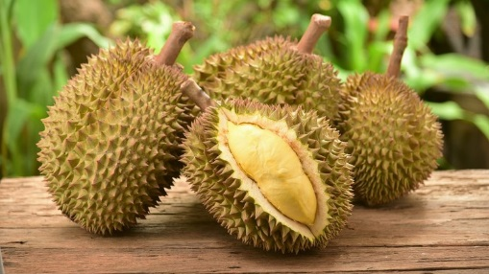
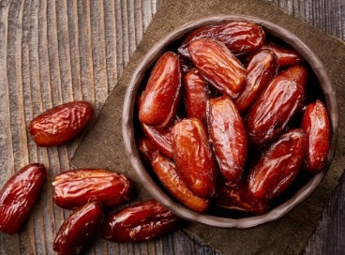
Extended scope of phytosanitary certificate (PC) requirements
With the introduction of the new Plant Health Regulation (PHR) and its accompanying acts it meant that the scope of the goods requiring a PC significantly increased.
PCs now needed for almost all plants and living parts of plants, including seeds intended for planting.
Exemptions
Only five tropical fruits do not require a PC:
Pineapple
Coconut
Durian
Banana (Musa sp.)
Dates

Slide 9
EU Legislative Structure
Smarter Rules for Safer Food (SRSF)
For phytosanitary requirements there are also a few other pieces of legislation that you will need to be aware of for exports:
Phytosanitary Conditions Regulation (PCR) – 2019/2072
Emergency Measures
What is an Emergency Measure
Where the EU has justified grounds and as a matter of urgency need to address a serious pest risk the EU can adopt measures to implement the necessary risk mitigation measures in a harmonised manner at the Union level.
This enables the EU to react fast to new and novel pests diseases without having to go through the full legislative process. They often tend to be time limited and any measures need to be justified.
Emergency Measures can be implemented at any time, so exporters need to be aware of any changes of legislation, as it may affect certain commodities that are exported.

Slide 10
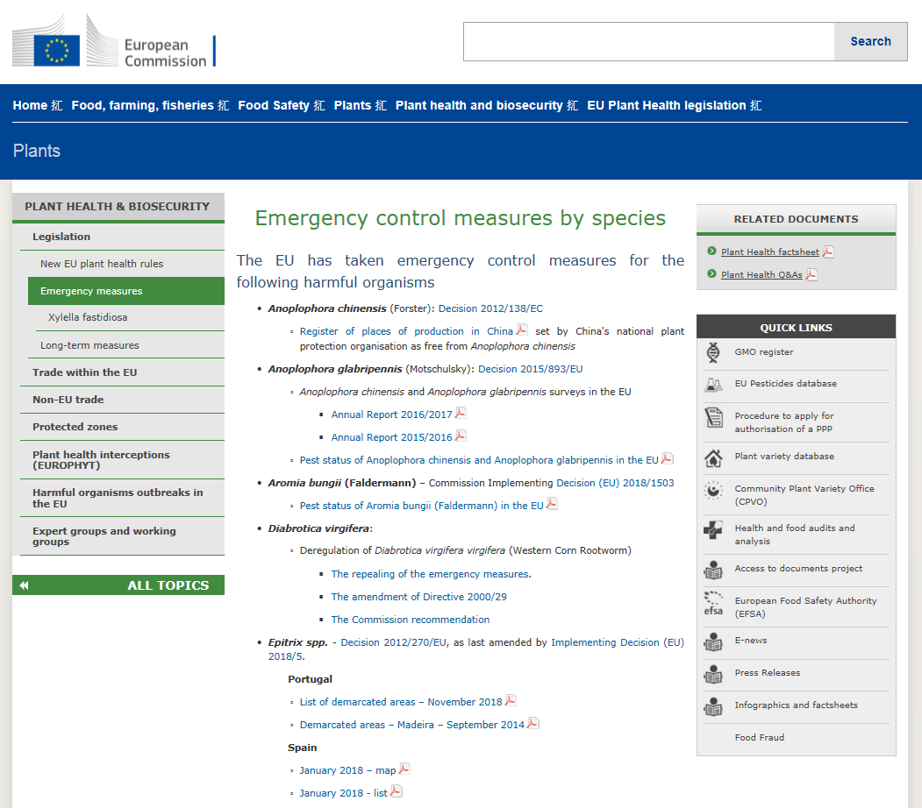
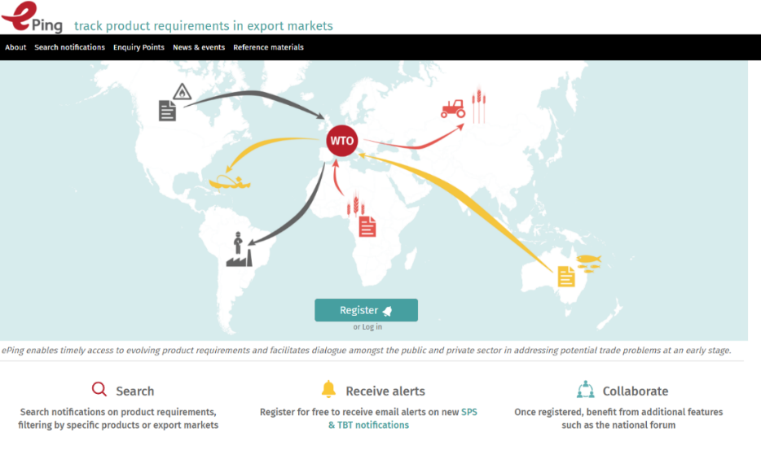
EU Legislative Structure
Emergency Measures
There are several ways to stay up-to-date with EU emergency measures:
Current Emergency Measures can be found the EU’s website (you need to read each one to determine which goods it applies to)
Sign up to the EU’s official journal and sign up for notifications. Where possible you should always use a consolidated version
Review WTO notifications via ePing

Slide 11
EU Legislative Structure
Phytosanitary Conditions Regulation (PCR) – 2019/2072
The PCR contains most of the requirements needed to exports goods to the EU and includes:
A list of all the quarantine pests and diseases
What goods require a PC and pre-notification
Whether any goods have special requirements that need to be met
A list of EU Member States (MS) that have protected zone status.
The PCR can be found by Googling 2019/2072 or from the EU’s website
The PCR is updated to take into account new quarantine pests and diseases as well as new special requirements.
The next slide will show all the annexes in the PCR, which you should have some working knowledge of but also the key Annexes that details the EU’s import requirements, which you will have to know how to navigate to find out if goods are eligible for exports.

Slide 12
PCR - Annexes
Annex | Common Description
I | Definitions
II | List of Union quarantine pests
III | List of protected zones and their quarantine Pests
IV | List of Regulated Non-Quarantine Pests (RNQPs) and their hosts
V | measures to prevent the presence of RNQPs
VI | Prohibitions
VII | Special requirements for goods being imported to the EU
VIII | Special requirements for goods originating in the EU
IX | List of plants and plant products prohibited from entering protected zones
X | Special requirements for certain goods moving into protected zones
XI | Part A – Which goods require a PC and pre-notification Part B – Which goods require a PC Part C – Which goods do not require a PC
Bold denotes relevance for exports

Slide 13
PCR - Annexes
Annex | Common Description
XII | List of goods that require a PC for introduction into a PZ from certain countries
XIII | What goods require a plant passport
XIV | What goods require a PZ plant passport
All fruit, vegetables and cut flowers will require a PC, as stated by Annex XI Part A and Part B. (except for those 5 fruits mentioned in Part C)
This means that all goods being exported to the EU will require a phytosanitary inspection.
Note: All goods and pests will be referenced by their scientific names in Latin. You may have to Google their name, to know what it is. The scientific name will be required on the PC.
Malus = Apples
Pyrus = Pears
Rubus = Raspberries

Slide 14
Knowledge Test

Slide 15
Knowledge Test
Please visit the below link to complete the knowledge test for this module:
PHEATS – Legislation, special requirements and pre-export
https://forms.office.com/Pages/ResponsePage.aspx?id=UCQKdycCYkyQx044U38RAvJ7GY98IcdOvJfSZ-UDeKFUQzlZV1QyMjJWVTdMNTNYNTlEWERLMlBBRy4u

