Slide 1
Spodoptera

Slide 2
Spodoptera spp. (Noctuidae)
30 + species with 4 regulated species and 1 of current concern
Caterpillars all structurally the same, but vary in geographical distribution, and colour pattern
Spodoptera litura – Taro caterpillar
EU - IA1, EPPO - A1
Asia, Pacific Islands, Oceania
Intercepted on orchids and Rosa from the Far East
Spodoptera littoralis – Cotton leafworm
EPPO - A2
Africa, Middle East, Southern Europe to Northern Italy.
Intercepted on Aster, Eryngium and Rosa from Africa
Spodoptera frugiperda – Fall armyworm
EU -IA1, EPPO - A1
Americas
Spread to Africa (2016) & India (2018), China (2019), Australia (2020).
Regularly intercepted on Zea mays from west Africa
Also intercepted on Rosa, Eryngium, Gypsophila and Solidago from Africa
Spodoptera eridania – Southern Armyworm
EU -1AI , EPPO –A1
Southern USA, Central and South America
and the Caribbean, reported in West Africa 2016/17
Yet to be intercepted
Spodoptera onithogalli – Yellow-stripped armyworm
North America- an emerging threat?
Yet to be intercepted

Slide 3
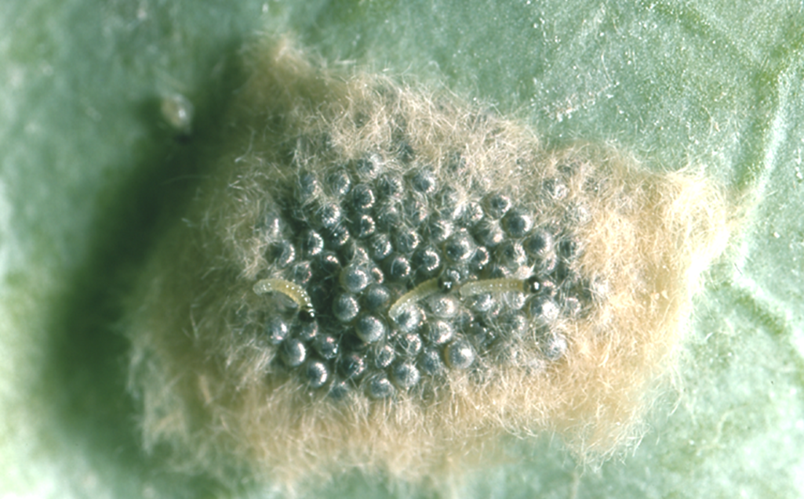
Spodoptera litura & Spodoptera littoralis
Geographical origin important but host less so
Both highly polyphagous on many plant families: ornamentals, fruit and vegetables.
S. litura the most regularly found 183 interceptions to date: S. littoralis - 97 interceptions to date.
Caterpillars are variable and difficult to separate.
If the origin is unknown, rearing or DNA sequencing may been needed.
Eggs 0.6 mm in diameter – Characteristically laid in clusters on the undersides of leaves – covered in brown hair shed from the female moth.

Slide 4
Spodoptera litura & Spodoptera littoralis
Caterpillars
Both species almost identical in early instars
Colouration very variable
5 pairs prolegs
35 – 45 mm max length
Tapered towards a small head
Smooth integument (skin)
Dark spots above spiracles
Large spot on A1 & A8
Smaller on other segments
Paired yellow/white dots
Yellow/orange lines
Notes:
4

Slide 5
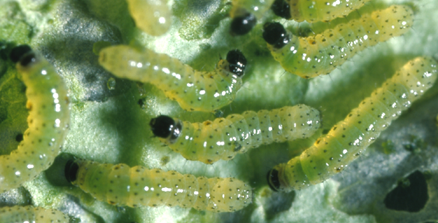
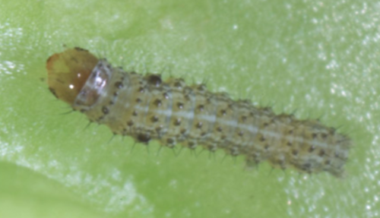
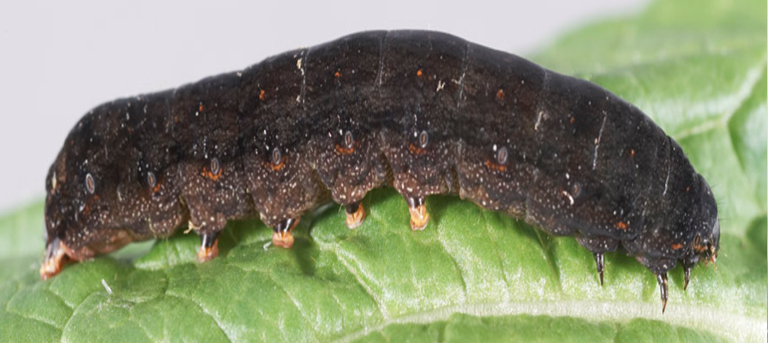
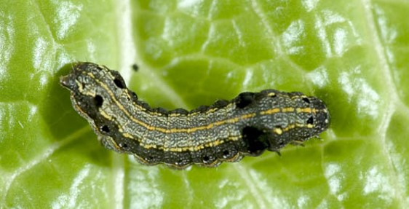
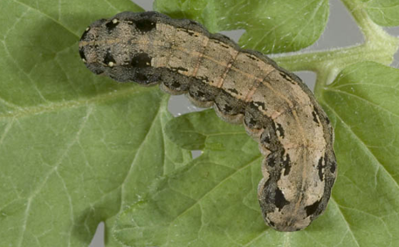
Colour and structural variation in Spodoptera caterpillar instars -
Hatchlings
1st
2nd
5th
4th
3rd

Slide 6
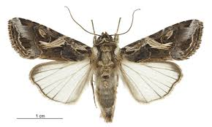
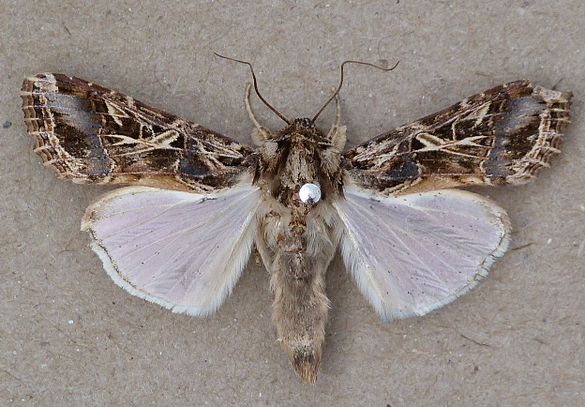
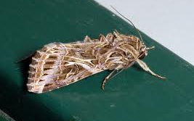
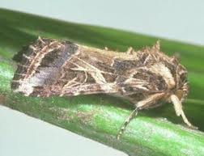
Spodoptera litura & Spodoptera littoralis
Adults
Spodoptera litura
Spodoptera littoralis
Very unlikely to encounter adults
Wingspan 30-38mm
Two species visually indistinguishable – dissection required
Notes:
See another brown moth!

Slide 7
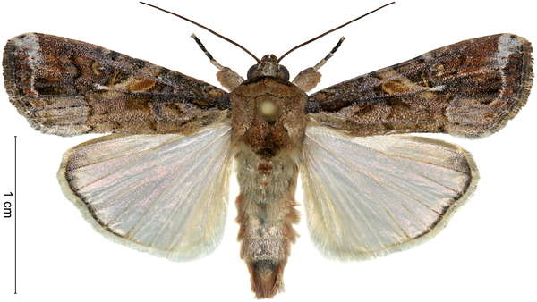
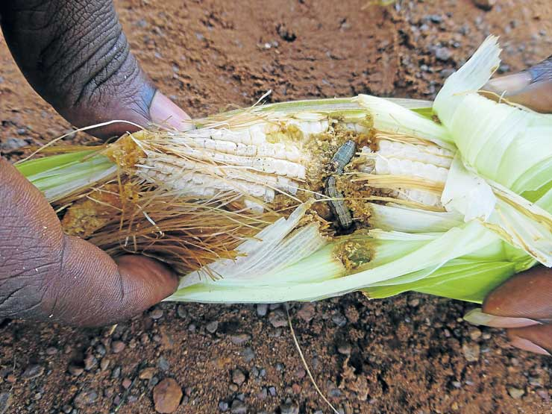
Spodoptera frugiperda – fall armyworm
Native to tropical and subtropical regions of the Americas
Highly polyphagous, causes damages on several crops, most significantly maize and other Poaceae, but has more that 350 known hosts in 26 other plant families.
Virtually indistinguishable from other Spodoptera spp. in the field!
Remarkably rapid spread around the World
2016 - Reported in Africa for first time (Benin, Nigeria, Sao Tomé and Principe and Togo)
2017 - Spread throughout Africa.
2018 recorded in India
2019 recorded in China
2020 recorded in Australia & Papua New Guinea
EU interceptions increased from 2018 - mostly from Africa on maize, but also on cut flowers (rose, Eryngium, Gypsophila, Solidago)

Slide 8
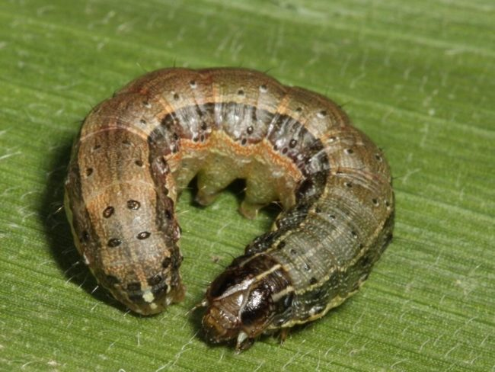
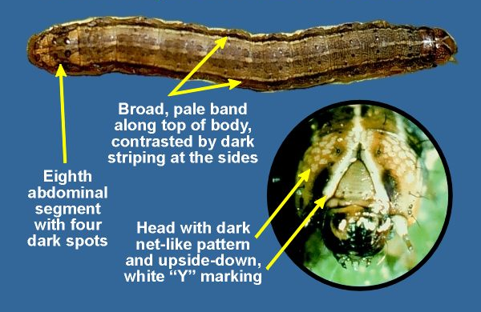
Spodoptera frugiperda – fall armyworm

