Slide 1
Exports
The Journey: Application, inspection methodologies and records

Slide 2
Content
Within this module you will be see how to make an export application and how to include the correct information to ensure your application is completed in a timely manner.
As an authorised person you will also need to inspect a representative sample of any export consignment and maintain and keep accurate and accessible records to show that inspections have been undertaken.

Slide 3
International plant health learning objectives
Understand:
How to register for export services
How to complete an export application for PHEATS
Different inspection methodologies for different commodities
An effective sampling regime to ensure you are looking at a representative sample
How to keep notes of your inspection activities.

Slide 4
How to Register on the Government Gateway

Slide 5
Application Procedure
Application
Register with APHA to make export applications
Responsible person will conduct export inspection (You)
Receive phytosanitary certificate
You or someone within the business will need to register on the government gateway to apply for plant health exports.
Currently you will need to apply for exports on eDomero.
The next few slides will demonstrate how to make an export application on eDomero.
You will also learn :
Online Application System Overview
How To: Enrolling for Government Gateway & eDomero Services
PHE36 General Application Overview
Important Information: Before You Submit Your Phytosanitary Certificate Application
How To: Applying for a PHE36 General Application
How To: Re-using details from a previous application for the same consignee to apply for a PHE36 General Application

Slide 6
Online Application System Overview
eDomero is an online plant health service enabling you to electronically apply for export certification, plant passporting, potato classification and import licensing.
To register on eDomero as a new user you will need:
A Client ID number (this is your unique PHSI identification number) If you don’t already have a client ID number please contact your local Plant Health and Seeds Inspector (PHSI) to obtain one.
A Government Gateway account is needed to use eDomero. If you have not already registered with the Government Gateway you will be prompted to do so before you can enrol to use eDomero.
The following slides will advise how you can enrol for Government Gateway and eDomero services online. If you are already enrolled for these services, you can move ahead to the PHE36 General Application Overview section of this training.
The link to eDomero is: http://edomero.defra.gov.uk/

Slide 7
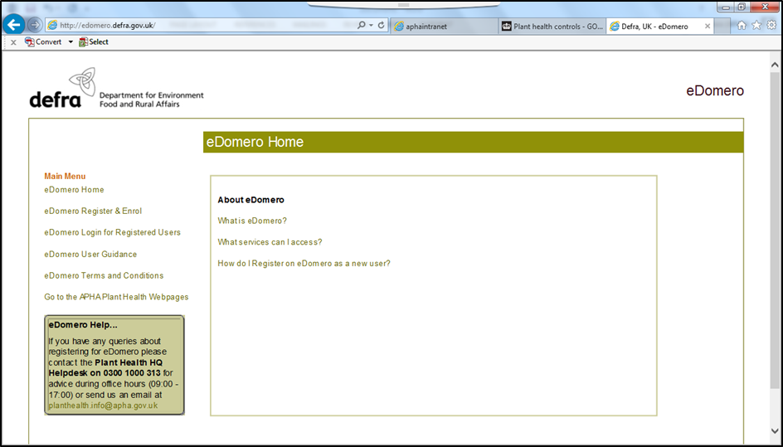
Enrolling for Government Gateway & eDomero Services
Step 1. Open http://edomero.defra.gov.uk/ where you will see the following screen below, and select ‘eDomero Register & Enrol’ from the menu on the left of the screen:

Slide 8
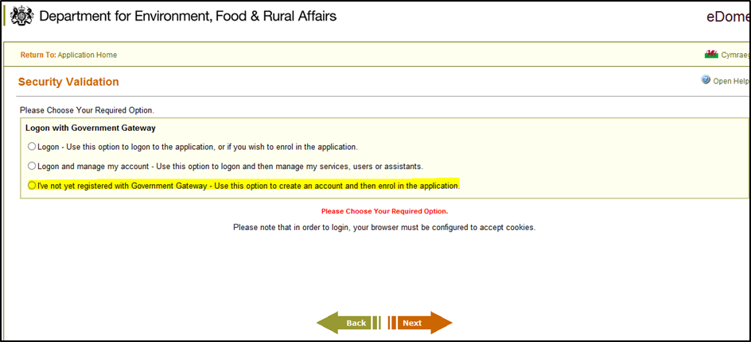
Enrolling for Government Gateway & eDomero Services
Step 2. On the next screen, select ‘I’ve not yet registered with the Government Gateway – Use this option to create an account and then enrol in the application’ and click the ‘Next’ button:
Alternatively, if you are already registered on the Government Gateway, select ‘Logon – Use this option to logon to the application, or if you wish to enrol in the application’ and enter your Government Gateway User ID and password as prompted (and then follow instructions from step 11)

Slide 9
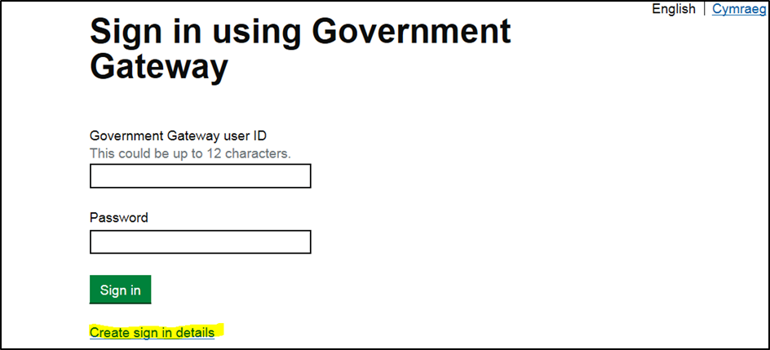
Enrolling for Government Gateway & eDomero Services
Step 3. Click on ‘Create sign in details’ in order to create a Government Gateway User ID:

Slide 10
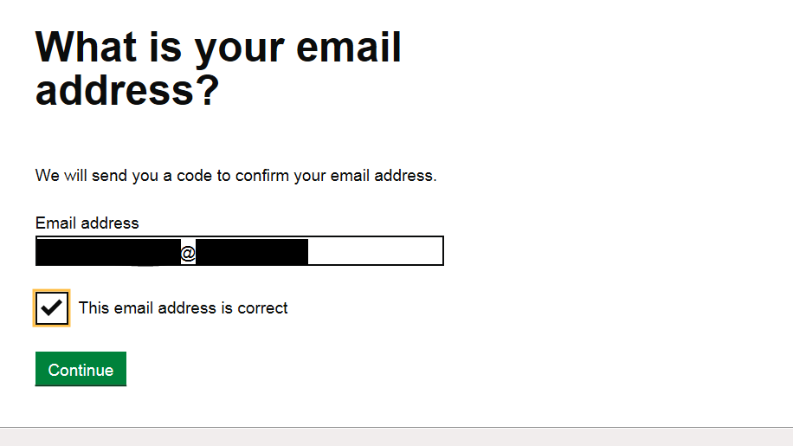
Enrolling for Government Gateway & eDomero Services
Step 4. Enter your e-mail address and tick the box to confirm that this e-mail address is correct, then click ‘continue’. A code will be sent to the confirmed e-mail address, this code will be required at the next screen:

Slide 11
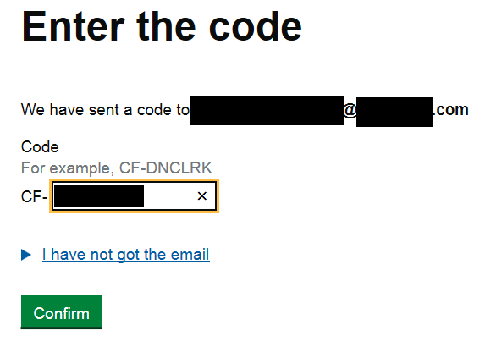
Enrolling for Government Gateway & eDomero Services
Step 5. From the e-mail sent, enter the code provided (the start of the code is already populated, so it’s just the remainder of the code required after the dash) and click ‘Confirm’. If the e-mail has not been received, click on the ‘I have not got the e-mail’ link and follow the onscreen instructions:

Slide 12
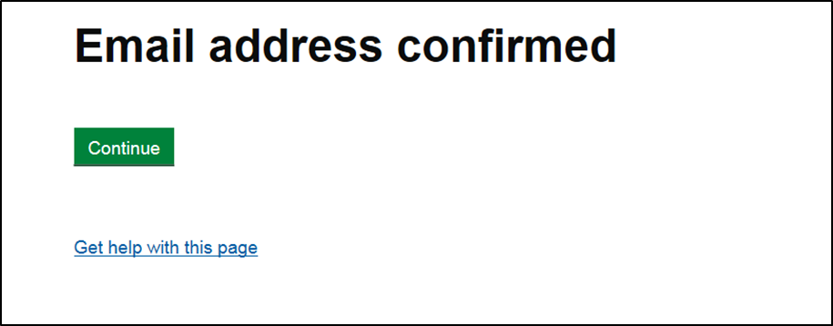
Enrolling for Government Gateway & eDomero Services
Step 6. If you have entered the code and clicked ‘confirm’, the e-mail address will now be confirmed. Select the ‘continue’ option:
Step 7. You will now be required to enter your full name and click on ‘continue’:

Slide 13
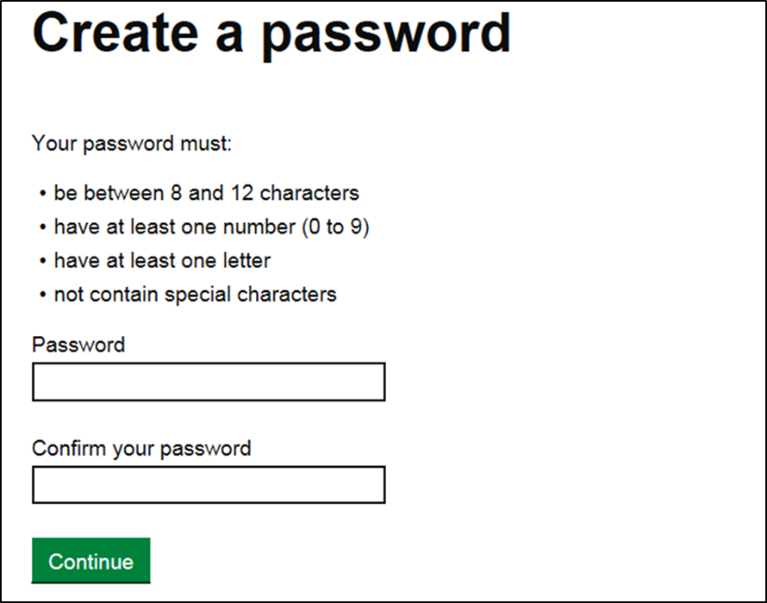
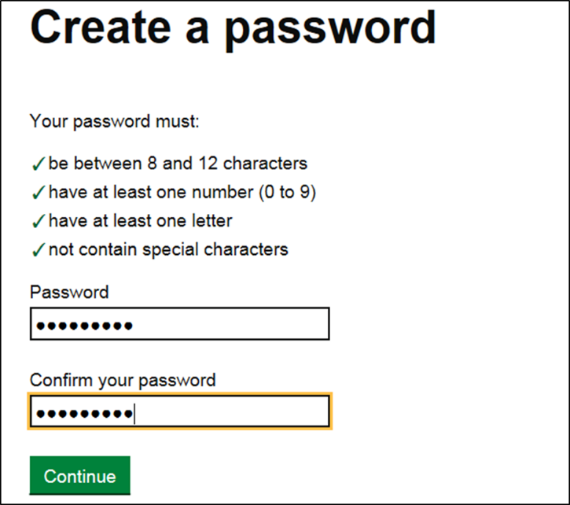
Enrolling for Government Gateway & eDomero Services
Step 8. Now create a password following the requirements stated below and click ‘continue’:
NB - If your password meets the required criteria each criterion will be auto-ticked. Any aspects that do not meet this will be marked with a red cross and you will need to amend the password as necessary. Then click ‘continue’.

Slide 14
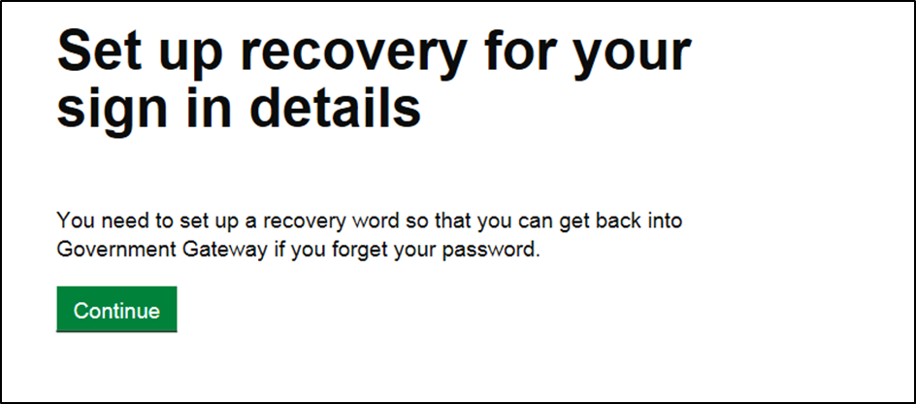
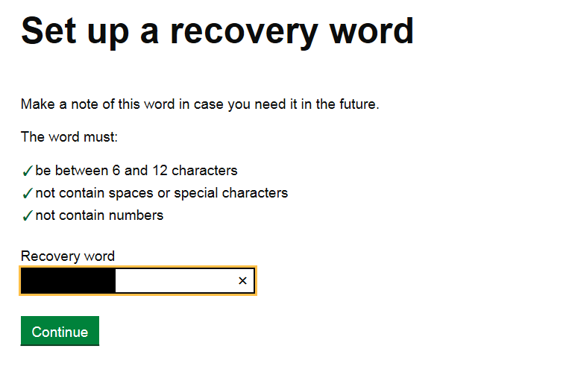
Enrolling for Government Gateway & eDomero Services
Step 9. You will now need to set up a recovery word in order for you to regain access to the Government Gateway in the event that you forget your password. Click ‘continue’ in order to progress to the next screen:
NB - The recovery word must conform to the required standard as below, then click ‘continue’:

Slide 15
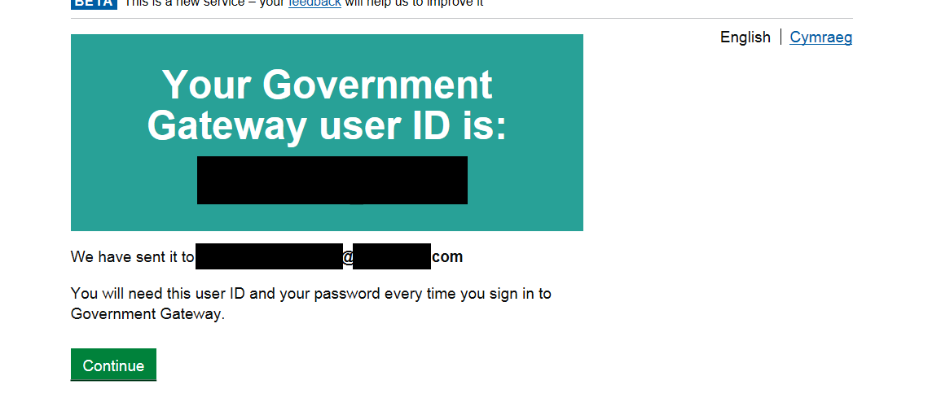
Enrolling for Government Gateway & eDomero Services
Step 10. Your Government Gateway user ID will be confirmed and sent to the e-mail address provided. Click ‘continue’ and this will take you on to the enrolment for the eDomero service.

Slide 16
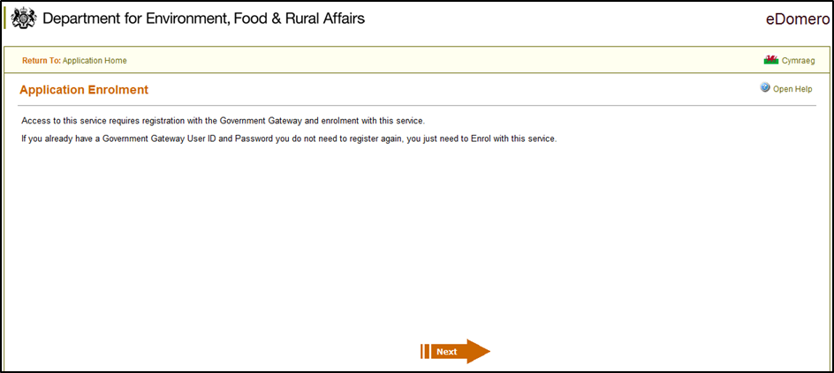
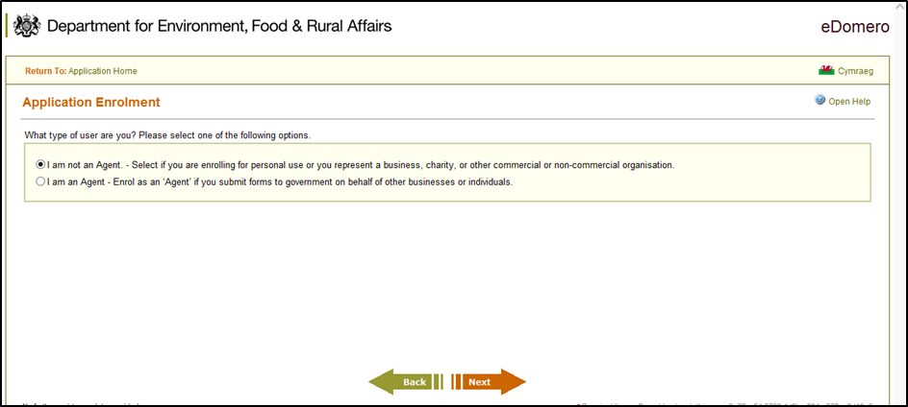
Enrolling for Government Gateway & eDomero Services
Step 11. Following on from the Government Gateway registration and confirmation of your Government Gateway User ID, you will now need to enrol for eDomero services by clicking ‘next’:
Step 12. Unless you submit applications regularly on behalf of another business or individual as an agent, you will need to select the ‘I am not an Agent’ option and click on ‘next’:

Slide 17
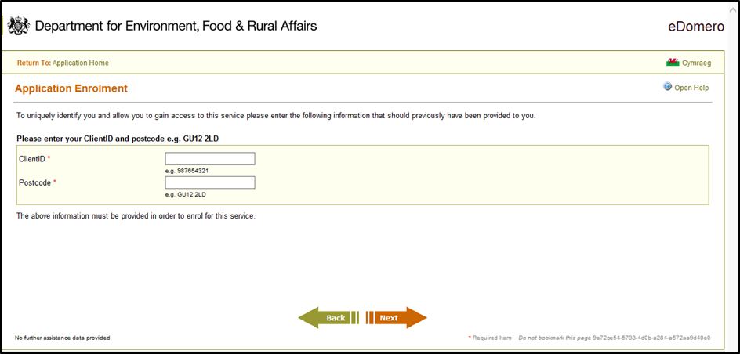
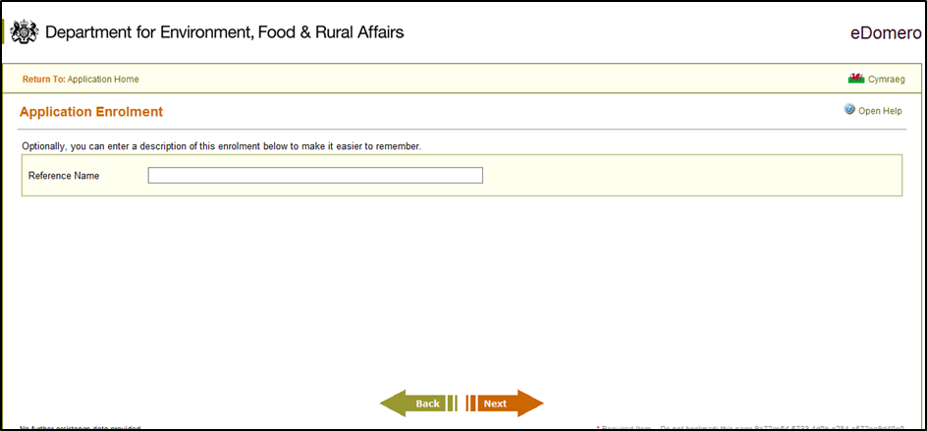
Enrolling for Government Gateway & eDomero Services
Step 13. Enter your Client ID reference number (CRN) and your postcode and click ‘next’:
Step 14. Enter a personal reference to this enrolment (this step is not mandatory):

Slide 18
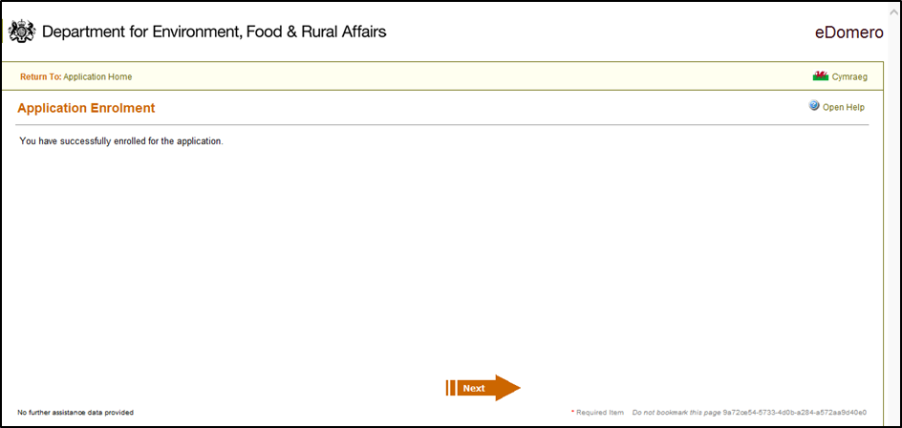
Enrolling for Government Gateway & eDomero Services
Step 15. Your enrolment for eDomero is now complete, click on ‘next’:

Slide 19
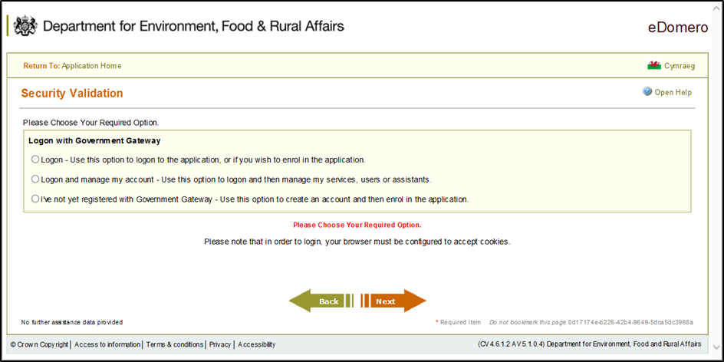
Enrolling for Government Gateway & eDomero Services
Step 16. You will now be directed to the homepage of eDomero where you will need to select the ‘eDomero Login for Registered Users’:
Step 17. Select the option to ‘Logon – Use this option to logon to the application, or if you wish to enrol in the application’ and select ‘next’:

Slide 20
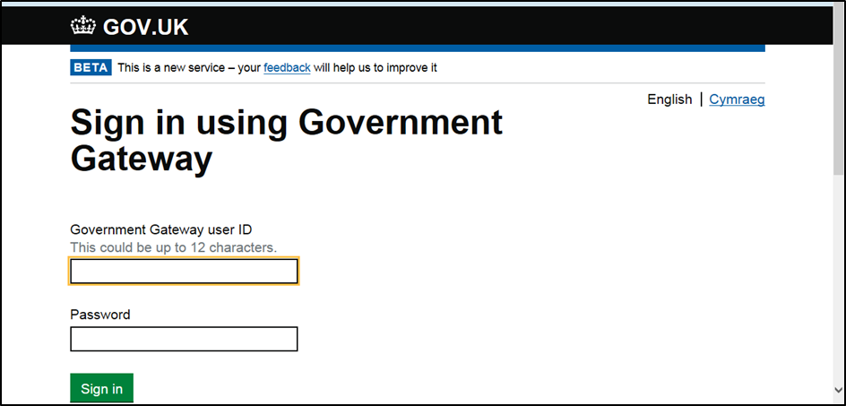
Enrolling for Government Gateway & eDomero Services
Step 18. Sign into the Government Gateway using your Government Gateway User ID and Password, you will then be directed back to the eDomero homepage for you to make your required online application:

Slide 21
PHE36 General Application Overview
How to make an export application

Slide 22
PHE36 General Application Overview
PHE36 General application is an application for Inspection and Certification of Plants/Produce for Export – General
PHE36 General application should be used for applying for a phytosanitary certificate (PC) under the PHEATS scheme for exporting fresh produce and cut flowers only (the application should not include commodities that are prohibited e.g. potatoes to the EU)
PHE36 General applications should only be made once the authorised person has officially inspected the consignment.
Import PC or PEACH numbers must be attached to the application for commodities with a country of origin outside the UK. Import PC must include the special requirements (additional declarations) required for export to the EU.

Slide 23
Important Information: Before You submit Your Phytosanitary Certificate Application

Slide 24
Important Information before you submit your application…
The Animal and Plant Health Agency (APHA) will produce the phytosanitary certificate (PC) for England and Wales.
PCs will only be produced with the information input on the eDomero application. APHA will not add or remove information on a PC.
It is the client’s responsibility to ensure their application holds the correct required information. If an error is made the application will need to be cancelled and the client will need to submit a new PHE36 General application.
Applications submitted with missing or incorrect information will be rejected by APHA and the client will need to submit a new PHE36 General application.
Applications must include the accepted scientific names, at least to genus level but preferably to species level for each commodity.
To request PCs to be issued, you should email a list of their submitted application numbers to PHEATS@apha.gov.uk once their applications are ready.

Slide 25
Applying for a PHE36 General Application
On the eDomero ‘Secure Home Page’
Select ‘New application’.

Slide 26
Applying for a PHE36 General Application
Click on the + button for Export Forms.

Slide 27
Applying for a PHE36 General Application
Select ‘Add new PHE36 General’
You can re-use information on a previous application – how to do this will be covered in later slides

Slide 28
Applying for a PHE36 General Application
To read the APHA’s Personal Information Charter click on the www.gov.uk link and use the search box on the webpage to find the Charter.
Tick the box next to ‘I Agree’.
Click ‘Continue’.

Slide 29
Applying for a PHE36 General Application
Inspection Details:
If the inspection premises is the same as the Applicant Address click on ‘Same as applicant address’
If the inspection premises is different from the Applicant Address input the details in the Inspection Address section and Click ‘Go’ and select the correct address.
Complete:
‘Customer Reference’ this can contain an internal reference number to assist with cross references
‘Date ready for inspection’ – (input the current date as you will already have completed your own inspection)
‘Date of Despatch’
‘Email Address’
Secondary Email Address – (can be added if necessary)
Click ‘Next’

Slide 30
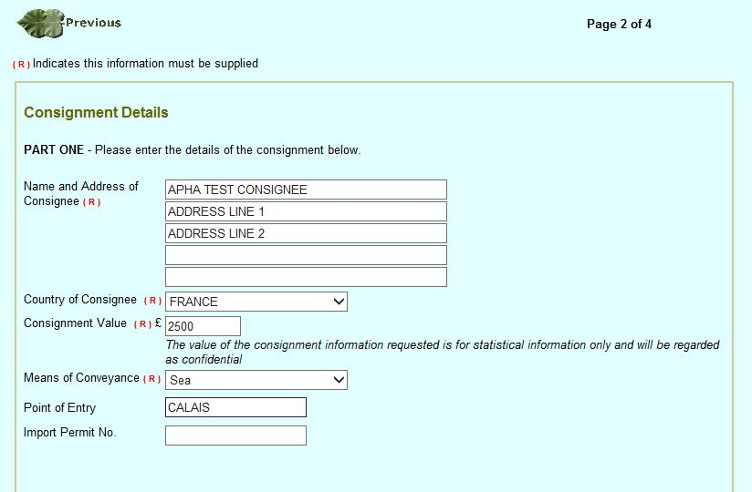
Applying for a PHE36 General Application
Consignment Details:
Enter the Name and Address of Consignee
Use the drop down list to select the ‘Country of Consignee’
Enter the ‘Consignment Value’
Use the drop down list to select the ‘Means of Conveyance’
Enter the ‘Point of Entry’ (this should be the port/airport and/or country of entry)
If an Import Permit is required enter the ‘Import Permit No’(a copy of the Import Permit must be attached to the application if one is required)

Slide 31
Applying for a PHE36 General Application
Commodity Details:
There are two ways of adding commodities to a PHE36 General application which will be demonstrated in the following slides:
Example 1 shows how to add commodity details when you have a few different commodities.
Example 2 shows how to add commodity details when you have a large amount of different commodities.
(Only commodities that have passed the official inspection should be added)

Slide 32
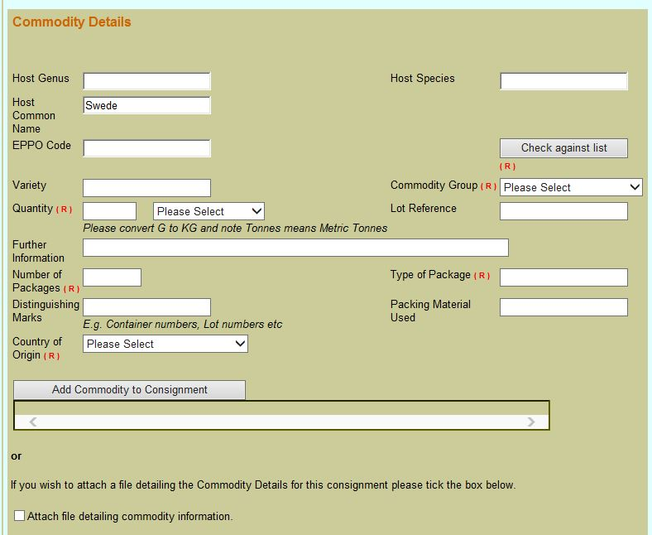
Applying for a PHE36 General Application
Commodity Details (Example 1)
If you do not know the botanical (scientific) name of your commodity, type in your commodity name in to the ‘Host Common Name’ field.
Click on ‘Check against list’
The screen will refresh and eDomero will add the genus and species to the ‘Host Genus’ and ‘Host Species’ fields.
You must click the ‘Check against list’ button otherwise you cannot complete the rest of the application.
If you don’t know the Scientific name you can always try an internet search for it.

Slide 33
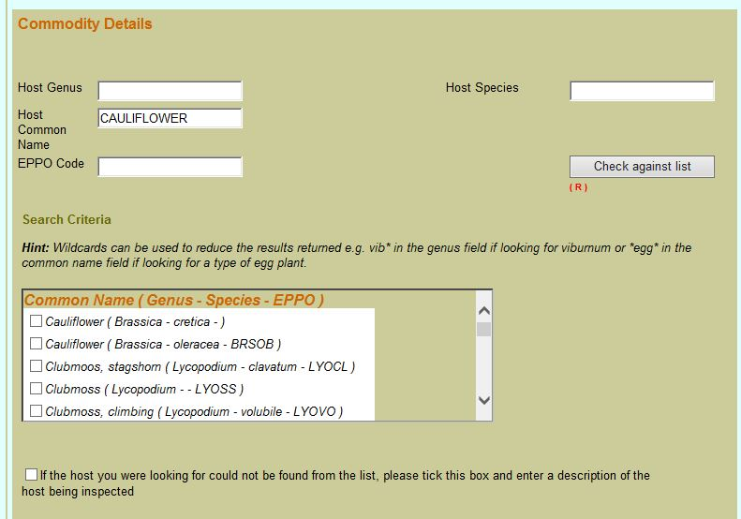
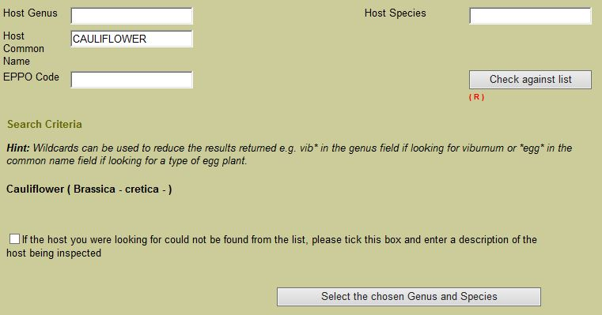
Applying for a PHE36 General Application
Commodity Details (Example 1 Continued):
If eDomero holds more than one genus/species it will bring up a list for you to select from.
In this example ‘cauliflower’ was typed into the ‘Host Common Name’ field and when the ‘Check against list’ button was clicked eDomero brought up a pick list to select from. Select the correct genus/species from the drop down list.
The screen will refresh and the selected genus/species will appear
Click on the ‘Select the chosen Genus and Species’ button

Slide 34
Applying for a PHE36 General Application
Commodity Details (Example 1 Continued):
The ‘Variety’ field is where, if applicable, you would enter the variety of your commodity.
Commodity Group - Click the drop down arrow and select the appropriate commodity group. For PHEATS you will only be required to select the Produce (fruit/flowers/veg).

Slide 35
Applying for a PHE36 General Application
Commodity Details (Example 1 Continued):
‘Quantity’ - Enter the numeric quantity of the consignment.
Select the unit of measurement from the dropdown list. Kilograms is preferred.
Lot Reference - If applicable, enter any lot references in the 'Lot reference’ box

Slide 36
Applying for a PHE36 General Application
Commodity Details (Example 1 Continued):
‘Further Information’ - if applicable, enter additional information. Additional information should only be relevant to phytosanitary requirements and will appear as an additional page to the PC exactly as it is inputted by the client, but may contain information not relevant to the phytosanitary status of the consignment.
‘Number of Packages’ – enter the number of packages.
‘Type of Packages’ – enter the type of packages

Slide 37
Applying for a PHE36 General Application
Commodity Details (Example 1 Continued):
‘Distinguishing Marks’ – distinguishing marks on packages (e.g. lot numbers, serial numbers) and conveyance identification numbers or names (e.g. container numbers or vessel name in the case of bulk shipments) should be included if necessary for the identification of the consignment.
‘Packing Material Used’ – the type of packing material can be added to this field.
‘Country of Origin’ - From the drop down menu, select the country of origin for your consignment. (The place of origin refers to places where the commodity was grown or produced and where it was possibly exposed to infestation or contamination by regulated pests)
Click on ‘Add Commodity to Consignment’

Slide 38
Applying for a PHE36 General Application
Commodity Details (Example 1 Continued):
On clicking the ‘Add Commodity to Consignment’ button, the page will refresh and the commodity details will appear in the box. If you have any further commodities to add, repeat the steps to add each of your commodity details.

Slide 39
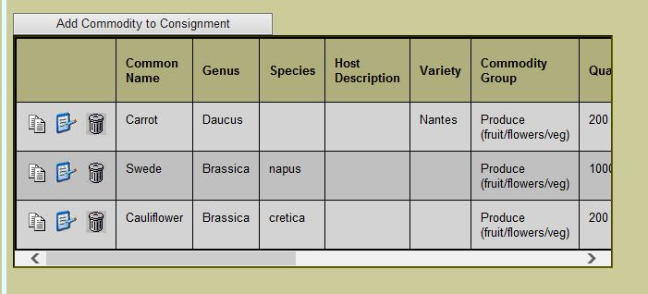
Applying for a PHE36 General Application
Commodity Details (Example 1 Continued):
The example below shows three commodities added to the PHE36 General Application.
Use the scroll bar to view full commodity details.

Slide 40
Applying for a PHE36 General Application
Commodity Details (Example 1 Continued):
Once all commodities are entered:
Click on ‘Add Consignment Record’
Click ‘Next’

Slide 41
Applying for a PHE36 General Application
Commodity Details (Example 1 Continued):
Import PC or PEACH numbers must be attached to the application for commodities with a country of origin outside the UK. Import PC must include Additional Declarations (ADs) required for export to the EU. Also, if a commodity requires an Import Permit this must also be attached.
To upload the file(s) - Simply add a short description and upload the file by browsing your folders when prompted with this screen. Once uploaded click ‘Next’.

Slide 42
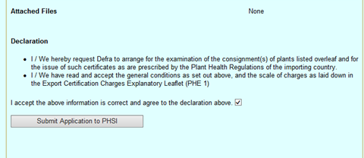
Applying for a PHE36 General Application
Commodity Details (Example 1 Continued):
Review the application information to check the accuracy.
If you wish to amend any information simply click ‘Previous’ and alter the relevant information.
If everything is correct:
Read the declaration
Select the box agreeing to the declaration
Click ‘Submit Application to PHSI’.

Slide 43
Applying for a PHE36 General Application
Commodity Details (Example 1 Continued):
Your application number will then be displayed on screen as below.
You must make a note of your application reference as this will be needed to request your phytosanitary certificate.
Email a list of application numbers once they are ready to be issued to PHEATS@apha.gov.uk .
End of process for Example 1.

Slide 44
Applying for a PHE36 General Application
Commodity Details (Example 2)
If you have a large list of commodities, which have passed the official inspection, when submitting your application you can utilise the file attachment section of the application to attach a commodity list (i.e. a spreadsheet or Word.doc).
Any commodity list attachments used must include all of relevant commodity information as highlighted in the main body of the PHE36 application against each commodity line i.e.:
Commodity name
Scientific name
Country of origin
Number of packages
Quantity (weight)
If information is missing from the attachment, the application will be rejected and you will need to submit a new application and attach an updated commodity list containing the correct information.

Slide 45
Applying for a PHE36 General Application
Commodity Details (Example 2 Continued):
The following actions have already been covered in the earlier slides:
Log on to eDomero
On the ‘New Application’ page click on the ‘+’ symbol next to ‘Scheme: Export Forms
Select ‘Add new PHE36 General’
Read the ‘Animal and Plant Health Agency Personal Information Charter’
Select ‘I Agree’
Click on ‘Continue’
Complete the Inspection details page. If the Inspection Address is the same as the applicant address select ‘Same as applicant address’ if not, input the details into the ‘Inspection Address’ section to find the correct address. Input ‘Date ready for inspection’ (using current date) Input ‘Date of Despatch’. Add the applicant’s email address. Click ‘Next’

Slide 46
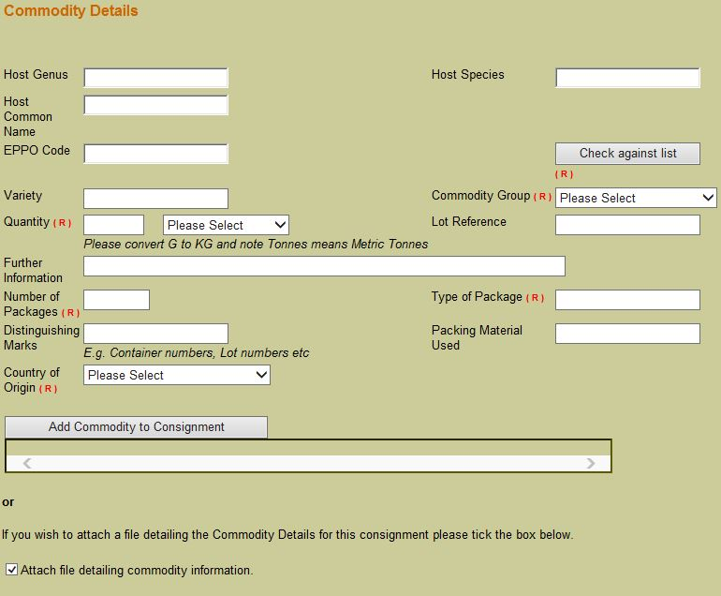
Applying for a PHE36 General Application
Commodity Details (Example 2 Continued):
If a large number of commodities, which have passed the official inspection, are on the consignment, they can be added to the application by attaching a file to the application.
Scroll down the ‘Commodity Details’ page.
Select ‘Attach file detailing commodity information’

Slide 47
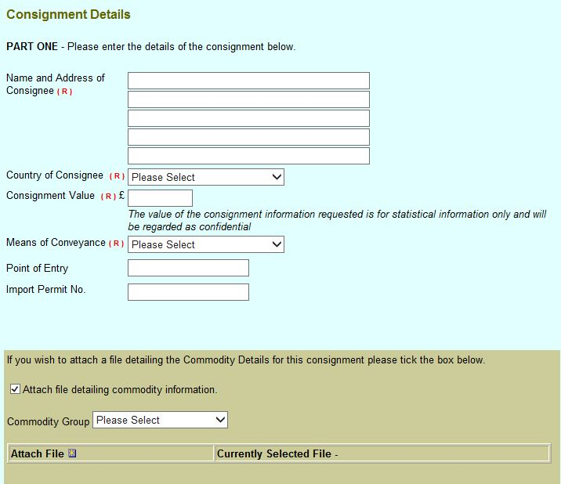
Applying for a PHE36 General Application
Commodity Details (Example 2 Continued):
The screen will refresh.
Input:
‘Name and Address of Consignee’
‘Country of Consignee’
‘Consignment Value’
‘Means of Conveyance’
‘Point of Entry’
Import permit Number (if applicable)
To attach files:
Select the ‘Commodity Group’ using the drop down selection.
Click on the box next to ‘Attach File’

Slide 48
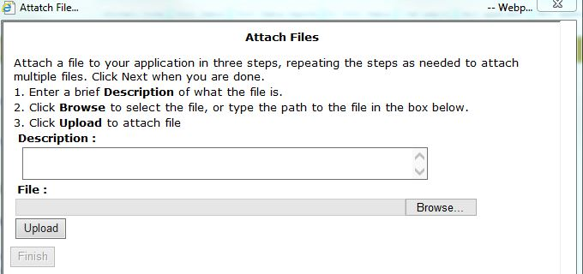
Applying for a PHE36 General Application
Commodity Details (Example 2 Continued):
A separate Attach Files box will appear. To upload the file(s) - Simply add a short description and upload the commodity file by browsing your folders. Once uploaded click ‘Finish’.

Slide 49
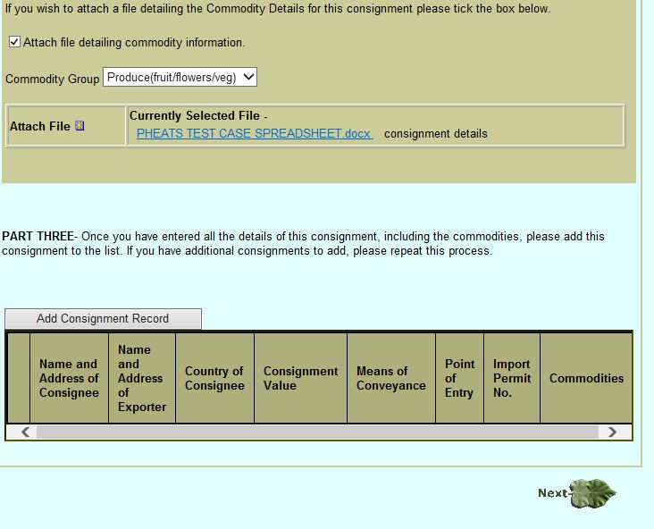
Applying for a PHE36 General Application
Commodity Details (Example 2 Continued):
Once the commodity file has been attached.
Click ‘Add Consignment Record’
The screen will refresh and the consignment details will appear.
Click ‘Next’

Slide 50
Applying for a PHE36 General Application
Commodity Details (Example 2 Continued):
Import PC or PEACH numbers must be attached to the application for commodities with a country of origin outside the UK. Import PC must include Additional Declarations (ADs) required for export to the EU. Also, if a commodity requires an Import Permit this must also be attached.
To upload the file(s) - Simply add a short description and upload the file by browsing your folders when prompted by this screen. Once uploaded click ‘Next’.

Slide 51
Applying for a PHE36 General Application
Commodity Details (Example 2 Continued):
Review the application information to check the accuracy.
If you wish to amend any information simply click ‘Previous’ and alter the relevant information.
If everything is correct:
Read the declaration stated
Select the box agreeing to the declaration
Click ‘Submit Application to PHSI’.

Slide 52
Applying for a PHE36 General Application
Commodity Details (Example 2 Continued):
Your application number will then be displayed on screen as below.
You must make a note of your application reference as this will be needed to request your phytosanitary certificate.
Email a list of application numbers once they are ready to be issued to PHEATS@apha.gov.uk
End of process for Example 2.

Slide 53
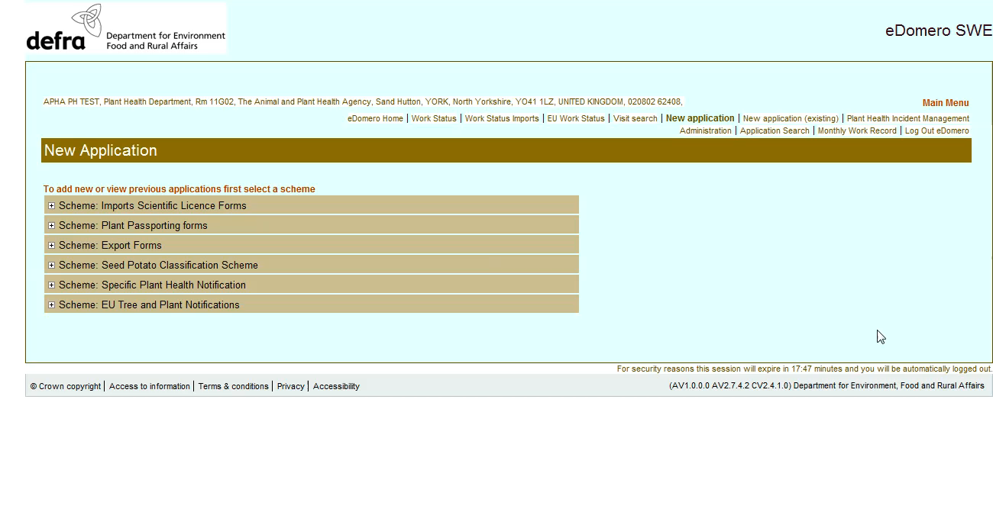
Applying for a PHE36 General Application
Video demonstration of applying for a PHEATS Application using a PHE36 General application form:

Slide 54
How To: Re-using details from a previous application for the same consignee to apply for a PHE36 General Application

Slide 55
How to re-use details from a previous application for the same consignee to apply for a PHE36 General Application
You can re-use details from previous applications for the same consignee to make a new application.
To do this:
Click on ‘New application’

Slide 56
How to re-use details from a previous application for the same consignee to apply for a PHE36 General Application
Click on the + button for Export Forms.

Slide 57
How to re-use details from a previous application for the same consignee to apply for a PHE36 General Application
If previous applications have been made you will see a ‘+’ in front of the ‘Add new PHE36 General line.
Click on the ‘+’

Slide 58
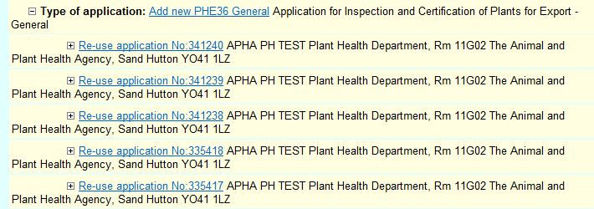
How to re-use details from a previous application for the same consignee to apply for a PHE36 General Application
The previous applications will appear. To find a previous application for the same consignee you will have to click on the ‘+’ button in front of ‘Re-use application No:xxxxx’ until you find one for the same consignee.

Slide 59
How to re-use details from a previous application for the same consignee to apply for a PHE36 General Application
Click on the ‘+’ button to view the consignment details.
If your new application is for the same consignee and country of export you can re-use that application to apply for the new PHE36 General Application. Select the correct previous application by clicking on on ‘Re-use application No:xxxxx’

Slide 60
How to re-use details from a previous application for the same consignee to apply for a PHE36 General Application
Read the APHA’s Personal Information Charter
Tick the box next to ‘I Agree’.
Click ‘Continue’.

Slide 61
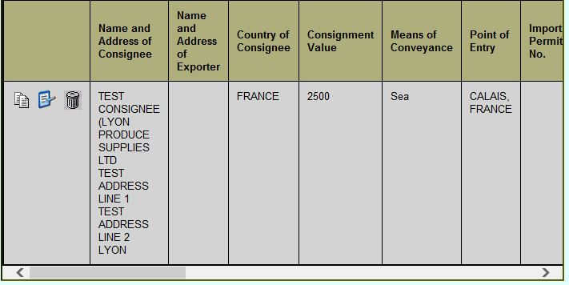
How to re-use details from a previous application for the same consignee to apply for a PHE36 General Application
Complete the Inspection details section (as shown in the previous slides)
On the Commodity Details page scroll down to the bottom of the page to view the previous application’s details. Check the details to see if any information needs to be changed.
If you need to edit the application - the blue notepad icon is the edit button, the white page icon is copy and the bin icon is delete.

Slide 62
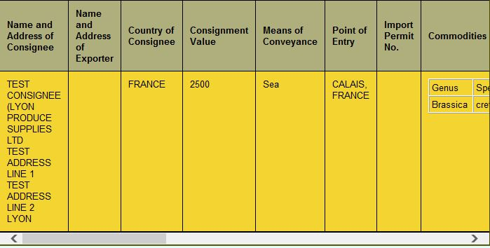
How to re-use details from a previous application for the same consignee to apply for a PHE36 General Application
If you need to edit the application details click on the blue notepad icon. The application details will change colour.

Slide 63
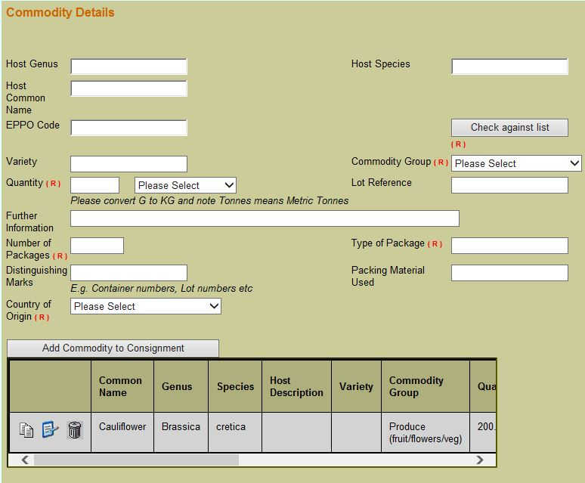
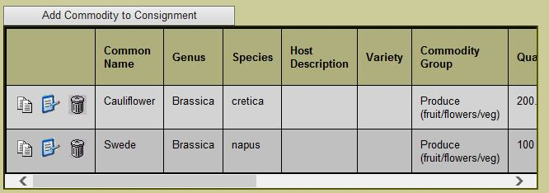
How to re-use details from a previous application for the same consignee to apply for a PHE36 General Application
Make the necessary alterations to the ‘Commodity Details’ page and add any new commodities to the consignment by clicking ‘Add Commodity to Consignment’
Delete any commodities from the previous application which are not applicable to the new application by clicking on the bin icon.

Slide 64
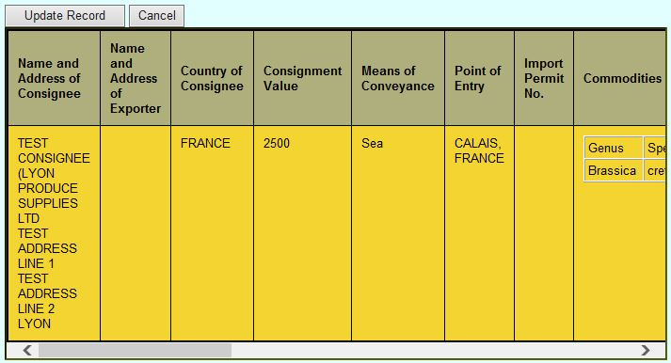
How to re-use details from a previous application for the same consignee to apply for a PHE36 General Application
Click on ‘Update Record’

Slide 65
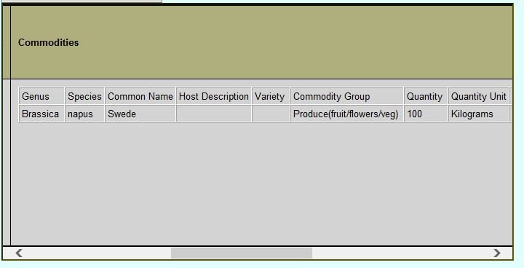
How to re-use details from a previous application for the same consignee to apply for a PHE36 General Application
The updated application details will then appear in the Consignment Record Box.
Use the scroll bar to view the full consignment details.
Once you have checked that the application is correct – click ‘Next’ and this will take you to the page where you can attach files.
You can continue with the application from this point as shown in the previous slides.

Slide 66
Inspection of a Consignment
How to inspect an export consignment

Slide 67
Inspections
International Standards
It is usually not feasible to inspect entire consignments, so phytosanitary inspections are performed mainly on samples obtained from a consignment. It is noted that the sampling concepts are available in ISPM 31 (Methodologies for sampling a consignment).
Sampling methodologies used will depend on the sampling objectives (for example, sampling for testing) and may be solely statistically based or developed noting particular operational constraints. Methodologies developed to achieve the sampling objectives, within operational constraints, may not yield the same statistical confidence levels in the results as fully statistically based methods, but such methods may still give valid results depending on the desired sampling objective. If the sole purpose of sampling is to increase the chance of finding a pest, selective or targeted sampling is also valid.

Slide 68
Inspections
Intensity – How much should you look at
Authorised persons should inspect 60 items of produce of every genus from 5 packages or bulk bins (or from all if less than 5). If the consignment contains less than 60 items then the whole consignment should be inspected. If 5 packages contain less than 60 items then more packages should be selected until 60 items is reached.
Where items are contained in secondary packaging (e.g. small bags in boxes) then the individual items should be drawn, where possible, from at least 5 of the secondary packages.
For consignments of leafy vegetables containing less than 500 items, then 30 items from 5 packages should be inspected.
When selecting items to inspect, they should be drawn evenly from each box or package, e.g. top, middle and bottom of a consignment. Authorised persons should ensure that items are only inspected once during the inspection process. An inspection of any plant material should involve a visual examination of at least 75% of the surface area of each item.
Location – Where to look in a consignment

Slide 69
Inspection Rates
Consignment Inspection Procedure
Small Consignments (<5 packages / boxes / bulk bins, etc.) | Large Consignments (5 packages / boxes / bulk bins, etc.) | Mixed Consignments (e.g. a net of both lemons and limes, or a bunch of multiple flower types)
Inspect 60 items of every genus from all of the containers. When selecting items to inspect, draw items evenly from each container, e.g. top, middle and bottom | Inspect 60 items of every genus from 5 containers. If 5 containers contain less than 60 items, more containers should be selected until 60 items reached. When selecting items to inspect, draw items evenly from each container, e.g. top, middle and bottom | Inspect a random sample of 60 items from each batch from 5 containers, or from all containers if less than 5. When selecting items to inspect, draw items evenly from each container, e.g. top, middle and bottom
This sampling scheme will able to identify with 95 % reliability a level of presence of infected plants of 5 % or above
This means that if the pest is present on just 5% of the commodity that 95 times out of a 100 you will be able to detect it.

Slide 70
Inspections
Fruit and Vegetables
For fruit and vegetables which bear other botanical structures such as leaves or calices, then these should be visually examined, both on the upper surface and underneath. Produce which may exhibit signs of having pests or diseases should be cut to investigate further.
Where the leaves of cut flowers remain, particular attention should be paid to the underside of the leaves. Flowers packed in tied bunches can be examined without the need to split the bunch, provided 75% of the surface area is visible. Where there is a potential for thrips to be present then the flowers should be inverted over a white surface and tapped to induce the thrips to detach from the plant material. Where cut flowers are in mixed bouquets that contain regulated genera, then the bouquet can be considered as the item and 20 bunches from 5 boxes should be inspected.
Soil is prohibited from all third countries to the EU other than Switzerland. Root and tubercle vegetables should be managed or treated in a way to render it practically free from soil with a maximum tolerance of 1% by weight.
Cut Flowers
Soil

Slide 71
Recording Inspections
Notebooks
All export inspections must be recorded in a notebook.
Details recorded for an inspection should include enough information that enables the record to be tied back to an application.
They will act as official records for the authorised person and must be bound and paginated.
These records can be asked to be viewed by APHA at any time and must be retained for 3 years.
Record the facts of the inspections including pest/disease findings, samples taken, inspecting less boxes than specified in SOP etc.
Record details that are not already captured in eDomero such as outcome of inspection (pass/fail)
Time and date entries
Fill in as soon as practicable
Log unusual occurrences/differences e.g. damaged goods or goods not found
Can use abbreviations – these need to be consistent and explainable

Slide 72
Notebooks – Filling in your notebook (ELBOW)
Erasures | Never erase an entry made in your notebook. Strike through with one single line
Lines missed | These should also be struck through with a single stroke
Blank spaces | Strike through with a single stroke
Overwriting | Do not write over existing entries. Strike through the mistake
Written in ink | All entries must be written in ink.
Spare pages | Strike through a page with a single stroke Endorse missed pages or data with ‘Omitted in error’

Slide 73
Notebook Example

Slide 74
Knowledge Test

Slide 75
Knowledge Test
Please visit the below link to complete the knowledge test for this module:
PHEATS – Application, inspection methodologies and records
https://forms.office.com/Pages/ResponsePage.aspx?id=UCQKdycCYkyQx044U38RAvJ7GY98IcdOvJfSZ-UDeKFUMUQxR1g2OVJMWkNZUlNSWElaUkRUVTNOSi4u

