Slide 1
Exports
The Journey: Special Requirements (EU Only)

Slide 2
Content
This module will introduce the concept of special requirements. Some goods will need to meet special conditions before being allowed to be imported into the EU.
You will learn where to find the special requirements and what the alternative options mean.
You will also look at the complexities of special requirements where the goods are not of GB origin.

Slide 3
International plant health learning objectives
Understand:
What is a special requirement
The difference between some of the options available
What a pest free area is
What a pest free place of production or site is
Special requirements for goods not of GB origin
How to send samples if required

Slide 4
Special Requirements
What are special requirements?
Some fruit, vegetables and cut flowers have special requirements which means they can’t be exported unless they meet certain requirements.
Where a fruit, vegetable or cut flower poses a pest risk of an unacceptable level due to the likelihood that it hosts a quarantine pest, and that pest risk can be reduced to an acceptable level by applying one or more measures, then these measures must be, where applicable, be included on the PC.
A special requirement will often have several options to choose from. It is up to the competent authority to determine which one is best applicable. You will however have to demonstrate a knowledge of knowing where to find them.
The Competent Authority (CA) is the central authority responsible for the organisation of official controls and of other official related activities. The CA in England and Wales is APHA.
The special requirement and the selected option will then have to be declared in box 11 of the PC or if there isn’t enough room it can be entered on a certified additional sheet.

Slide 5
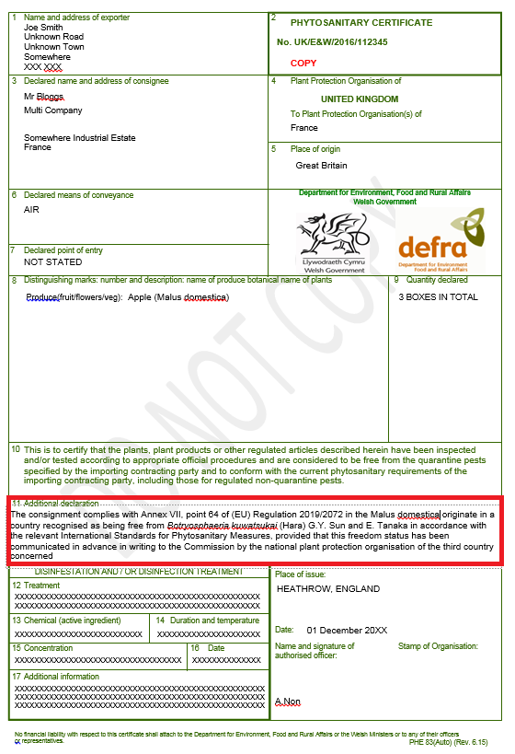
Special Requirements
What do they look like?
The European Union requires that Phytosanitary Certificates be issued for plants, plant products and other regulated articles imported into the EU, to indicate that they are free from the pests specified in Annex II of the PCR (2019/2072).
They must meet the EU phytosanitary import requirements Annex VII and X in the PCR (2019/2072). This is in accordance with the FAO/IPPC international standard "Guidelines for Phytosanitary Certificates" (International Standard for Phytosanitary Measures - ISPM No.12).

Slide 6
Special Requirements
What do they look like in the legislation?
 | Plants, plant products and other objects | CN code | Origin | Special requirement
64 | Fruits of Malus Mill. and Pyrus L | 0808 10 10 0808 10 80 0808 30 10 0808 30 90 | Third countries | Official statement that the fruits: (a) originate in a country recognised as being free from Botryosphaeria kuwatsukai (Hara) G.Y. Sun and E. Tanaka in accordance with the relevant International Standards for Phytosanitary Measures, provided that this freedom status has been communicated in advance in writing to the Commission by the national plant protection organisation of the third country concerned, Or (b) originate in an area established by the national plant protection organisation in the country of origin as being free from Botryosphaeria kuwatsukai (Hara) G.Y. Sun and E. Tanaka in accordance with the relevant International Standards for Phytosanitary Measures, which is mentioned on the phytosanitary certificate referred to in Article 71 of Regulation (EU) No 2016/2031, under the rubric ‘Additional declaration’, provided that this freedom status has been communicated in advance in writing by the national plant protection organisation of the third country concerned to the Commission, Or (c) originate in a place of production where official inspections and surveys for the presence of Botryosphaeria kuwatsukai (Hara) G.Y. Sun and E. Tanaka are carried out at appropriate times during the growing season to detect the presence of the pest, including a visual inspection of a representative sample of fruits, shown to be free of the pest and information on traceability is included in the phytosanitary certificate referred to in Article 71 of Regulation (EU) No 2016/2031, Or (d) have been subjected to an effective systems approach or an effective post-harvest effective treatment to ensure freedom from Botryosphaeria kuwatsukai (Hara) G.Y. Sun and E. Tanaka and the use of a systems approach or details of the treatment method are indicated on the phytosanitary certificate referred to in Article 71 of Regulation (EU) No 2016/2031, provided that the systems approach or the post-harvest treatment method have been communicated in advance in writing by the national plant protection organisation of the third country concerned to the Commission.

Slide 7
What do all the options mean?
The appropriate special requirements will be selected by the GB competent authority. For PHEATS this will be done by APHA.
However, as an authorised person you will have to demonstrate a knowledge as to where the requirements can be found.
Generally there tend to be 4 options:
Country freedom
Area freedom
Place of production or site freedom
Treatments
There may be other options available, different to the options above, such as testing, so always check the special requirements for each commodity.
There may be more than one special requirement for a commodity.
Pest Free Areas can only be declared by the competent authority and is not something that industry can designate.

Slide 8
Definitions (ISPM 5)

Slide 9
Definitions
Place of production
Production site

Slide 10
Definitions

Slide 11
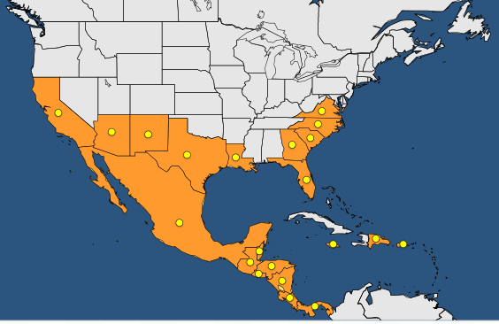
Special requirements (Pest Free Area example)
Anthonomus eugenii (pepper weevil)

Slide 12
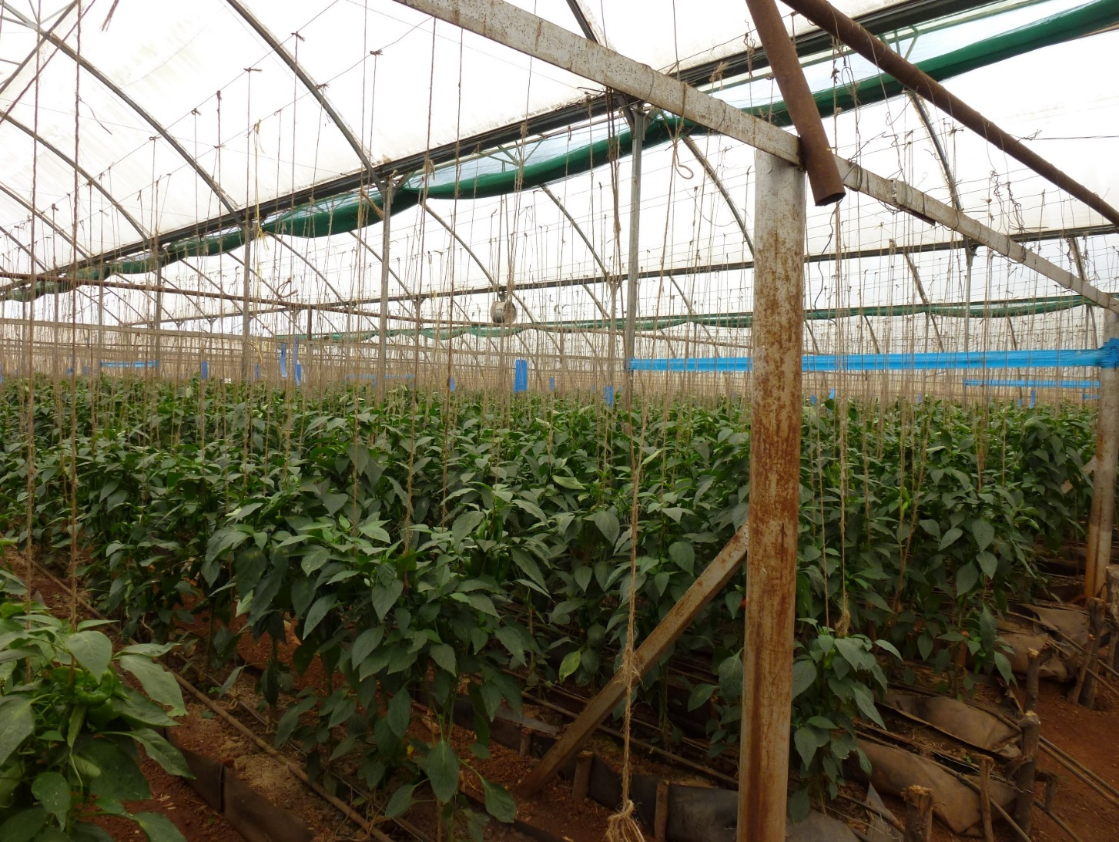
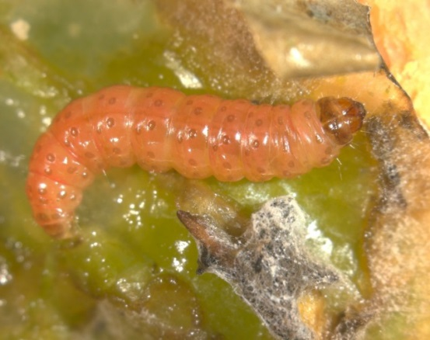
Special requirements (Pest Free Place of Production example)
Thaumatotibea leucotreta (false codling moth)

Slide 13
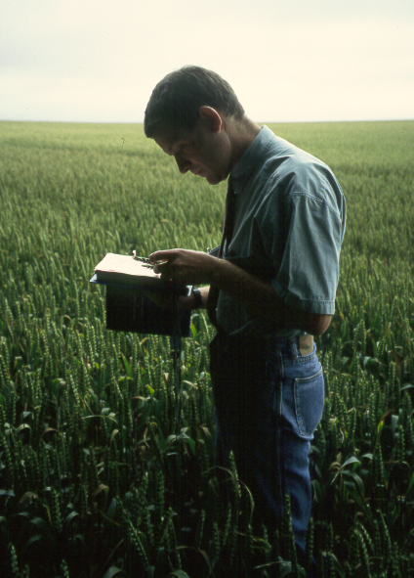
Special Requirements
Some goods may require growing season inspections or lab testing prior to export.
What is a growing season inspection?
Typically a growing season inspection is required to establish freedom from pests and diseases which may not be apparent in the harvested plants, produce or seeds, derived from the growing crop, at the time of export.
For example this may apply to plants being exported in the dormant state and to flower bulbs. In order to carry out a growing season inspection the local plant health and seeds inspector may have to inspect the plants in active growth several months before the export is due to take place.
The special requirement will state whether a growing season is required.

Slide 14
Special Requirements
Further Considerations
Where there is only a single requirement in the right hand column (special requirements) then no special requirement is needed on the PC as the PC is considered to attest that the special requirements has been met, but there is still a requirement for the consignment to meet the requirement:
Whenever there is more than one option for a special requirement then the exporting country will need to clarify which option it meets. This will be shown in the next few slides.
 | Plants, plant products and other objects | CN Code | Origin | Special Requirement
50 | Plants for planting of Fragaria L. other than seeds | ex 0602 10 90 ex 0602 90 30 | Third Countries | Official statement that the plants originate in an area known to be free from Anthonomus signatus Say and Anthonomus bisignifer Schenkling.

Slide 15
Further Considerations
Goods not of GB origin and special requirements
The EU’s readiness notice to stakeholders published in March 2020 for plant health was quite specific in relation to goods being exported from GB to the EU of goods that were not of GB origin and provided some examples:
“The import of fruits of Citrus, Malus and Pyrus, which may originate from other third countries and have been re-exported from the United Kingdom to the Union, needs to be accompanied by a phytosanitary certificate and is subject to specific requirements, in relation to origin of those fruits from countries, areas or places of production free from specific pests, information on traceability or official inspections and surveys concerning the presence of those pests.”
What is required:
GB’s and the EU’s import requirements are closely aligned. Where GB’s requirements are materially the same as the EU, the GB competent authority will be able to infer that the requirements have been met.
If goods are to be re-exported from GB to the EU or NI which are not of GB origin and are subject to special requirements in relation to country of origin, then the original or a certified copy of the original PC when it was imported in to GB must be provided to show that the goods have met the GB requirements.
For goods that don’t require a PC for import into GB, but are then being re-exported to the EU or NI, which have special requirements pertaining to the country of origin the competent authority will not be able to infer the requirements have been met. This will apply to exports of citrus. Even though there is no need for a PC for entry to GB, a PC will be required with special requirements saying that it meets the EU’s import requirements to enable re-export further down the line.
These PCs will need to be uploaded as part of the export application to enable APHA to create the PC.

Slide 16
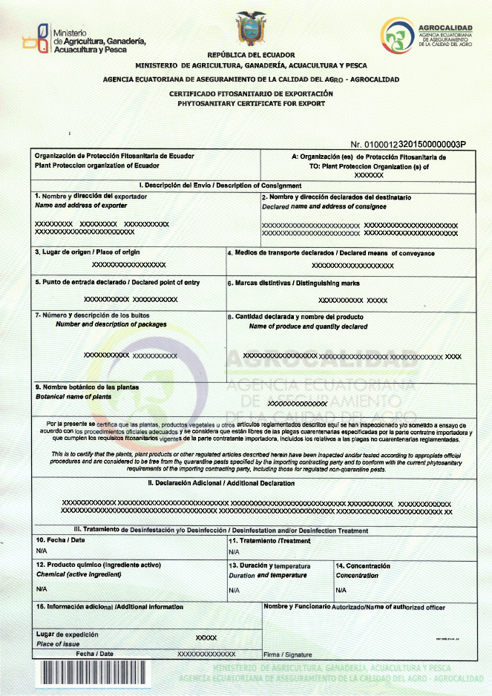
Further Considerations
Goods not of GB origin
What statements would you expect to see on the original PC from Ecuador if you were planning on re-exporting the goods mentioned on the previous slide to the EU?
GB Import Special Requirement:
This consignment complies with point 97 (a) of The Plant Health (Phytosanitary Conditions) (Amendment) (EU Exit) Regulations 2020 in that it originates in a country which, in accordance with the measures specified in ISPM4, is known to be free from Botryosphaeria kuwatsukai (Hara) G.Y. Sun and E. Tanaka
EU Import Special requirement
This consignment complies with point 64 (a) of The Phytosanitary Conditions Regulation 2019/2072 in that it originates in a country which, in accordance with the measures specified in ISPM4, is known to be free from Botryosphaeria kuwatsukai (Hara) G.Y. Sun and E. Tanaka
Assumption is that Ecuador is free from Botryosphaeria kuwatsukai

Slide 17
Further considerations
Goods not of GB origin
It is not within the power of the GB competent authority such as APHA to determine which special requirement is applicable where it requires a statement from the country of origin and the goods are not of GB origin.
Example:
Fruits of Malus Mill. and Pyrus
(a) originate in a country recognised as being free from Botryosphaeria kuwatsukai (Hara) G.Y. Sun and E. Tanaka in accordance with the relevant International Standards for Phytosanitary Measures, provided that this freedom status has been communicated in advance in writing to the Commission by the national plant protection organisation of the third country concerned,
Or
(b) originate in an area established by the national plant protection organisation in the country of origin as being free from Botryosphaeria kuwatsukai (Hara) G.Y. Sun and E. Tanaka in accordance with the relevant International Standards for Phytosanitary Measures, which is mentioned on the phytosanitary certificate referred to in Article 71 of Regulation (EU) No 2016/2031, under the rubric ‘Additional declaration’, provided that this freedom status has been communicated in advance in writing by the national plant protection organisation of the third country concerned to the Commission,
Or
(c) originate in a place of production where official inspections and surveys for the presence of Botryosphaeria kuwatsukai (Hara) G.Y. Sun and E. Tanaka are carried out at appropriate times during the growing season to detect the presence of the pest, including a visual inspection of a representative sample of fruits, shown to be free of the pest and information on traceability is included in the phytosanitary certificate referred to in Article 71 of Regulation (EU) No 2016/2031.
Or
(d) have been subjected to an effective systems approach or an effective post-harvest effective treatment to ensure freedom from Botryosphaeria kuwatsukai (Hara) G.Y. Sun and E. Tanaka and the use of a systems approach or details of the treatment method are indicated on the phytosanitary certificate referred to in Article 71 of Regulation (EU) No 2016/2031, provided that the systems approach or the post-harvest treatment method have been communicated in advance in writing by the national plant protection organisation of the third country concerned to the Commission

Slide 18
Export Journeys
Pre Export
Do my goods need a phytosanitary certificate
Do I need laboratory tests or growing season inspections
What are the import requirements
Pre Export:
Requirements
How do I know if a PC is required for my goods to be exported to the EU or NI
What legislation do I need to be aware of and how do I interpret it
Verification
PHSI or CIT verify the importing country’s requirements
What are the import requirements
Do I need any further lab tests or growing season inspections before my export inspection
This will include any current prohibitions

Slide 19
Export Journeys
PHSI or CIT verify the importing country’s requirements
This will include any current prohibitions
Verification
Pre Export:
Centre for International Trade (CIT) will check to ensure that any goods listed on the export application have the appropriate special requirements.
CIT will also check that there are no prohibited goods listed on the export application (Annex VI of 2019/2072).
This will include:
Potatoes
Momordica originating from third countries where Thrips palmi is known to occur and where effective pest mitigations are lacking.

Slide 20
Export: Special Requirement Guide
In order to help you to determine what the special requirements are for each fruit, vegetable or cut flower a quick reference guide has been developed for reference. This can be provided to you by your local plant health inspector.
It is still best practice to refer to the most up-to-date legislation. If you are unsure as to what the special requirements are for your commodity, please contact your local PHSI.
Note: APHA will determine which special requirement is applicable for goods originating in Great Britain (GB).

Slide 21
Sending a sample to Fera
If you find a suspect pest or disease in contravention of the export requirements, under no circumstances should that commodity be exported
You should notify your local plant health inspector immediately.
A sample may be sent to the official laboratory (FERA Science) for diagnosis
Triple contain the suspect pest or diseased commodity (i.e. put in two sample bags and a box) and
Send this as a commercial sample to the Fera Science laboratory

Slide 22
Sending a sample to Fera
If you decide to send this as a commercial sample to the Fera Science laboratory, please follow this guidance and contact the lab for fee information:
https://www.fera.co.uk/crop-health/sample-shipping-information
In all cases a record of the official inspections, suspect pests and disease and the inspection outcome must be kept

Slide 23
Knowledge Test

Slide 24
Knowledge Test
Please visit the below link to complete the knowledge test for this module:
PHEATS – EU Special Requirements
https://forms.office.com/Pages/ResponsePage.aspx?id=UCQKdycCYkyQx044U38RAvJ7GY98IcdOvJfSZ-UDeKFUOERJNUJPQzYxM0I3OENSTlNCRDlWQVA5My4u

