Slide 1
Pests and diseases associated with fruit and vegetables

Slide 2
Fruit flies
The family Tephritidae, including Bactrocera, Anastrepha, Dacus, Zeugodacus

Slide 3
Introduction to Tephritidae
One of the largest families of Diptera (4,500 described species belonging to 500 genera)
World-wide, most species in tropical and subtropical areas.
One of the most economically important pest groups, causing billions of ££ in losses annually worldwide
250 species are recorded as damaging economically important crop plants and 70 species are considered major economic pests
The larvae of most tephritids feed on living plant tissue, particularly the fruit or other seed bearing organs of flowering plants; others are leaf miners, stem borers or live in the roots.

Slide 4
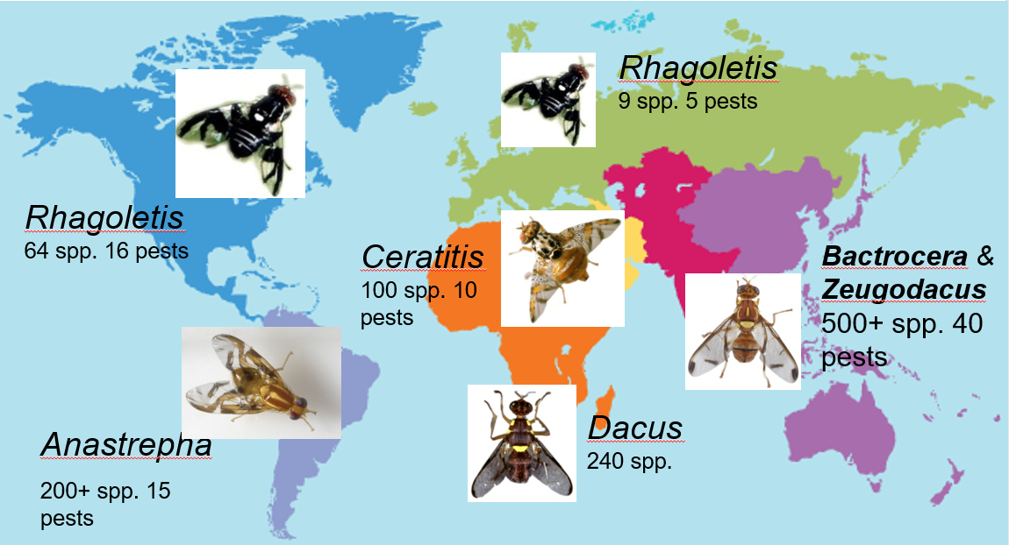
6 Main Genera

Slide 5
Frequently Intercepted Species
Latin name | Common name
Anastrepha obliqua | West Indian Fruit Fly
Bactrocera correcta | Guava Fruit Fly
Bactrocera dorsalis complex | Oriental Fruit Fly
Bactrocera zonata | Peach Fruit Fly
Ceratitis capitata | Mediterranean Fruit Fly
Dacus ciliatus | Lesser Melon Fly
Zeugodacus cucurbitae | Melon Fly

Slide 6
Distribution of the Main Genera in Europe
Anastrepha Not present Bactrocera 1 native species in southern Europe (B. oleae) B. dorsalis outbreak Italy Oct‘18 Zeugodacus Not present Ceratitis 1 species (C. capitata – long established in southern Europe) Dacus Not present Rhagoletis 6 native species (plus 3 or 4 introduced species – R. completa, R. cingulata, R. suavis and (?)R. indifferens)

Slide 7
Detection
External examination
Rotting fruit (smell & stains)
Oviposition holes
Emergence holes
Pupae and larvae in box

Slide 8
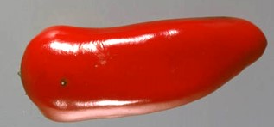
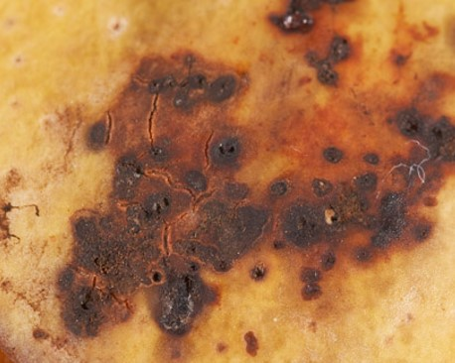
Oviposition Punctures

Slide 9
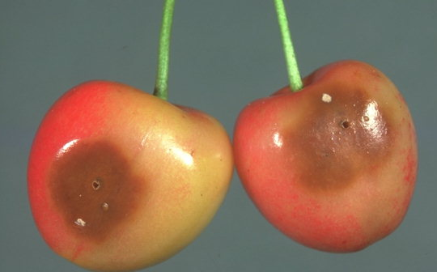
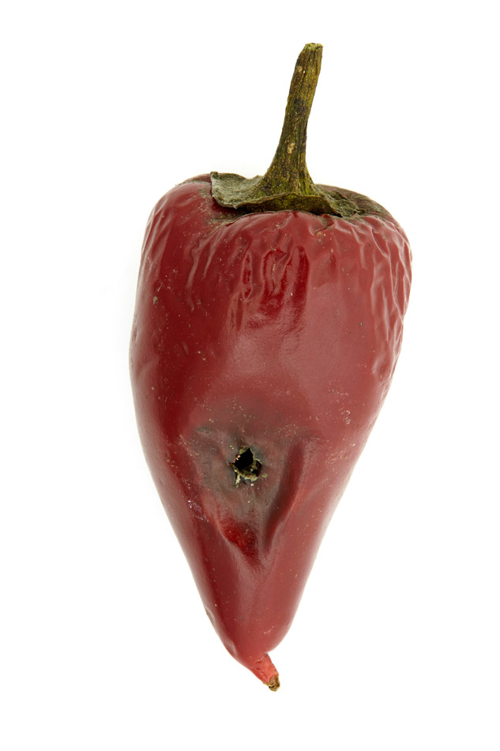
Exit Holes

Slide 10
Detection
Internal examination
Eggs
Tunnelling
Larvae

Slide 11
Eggs under the skin of the host

Slide 12
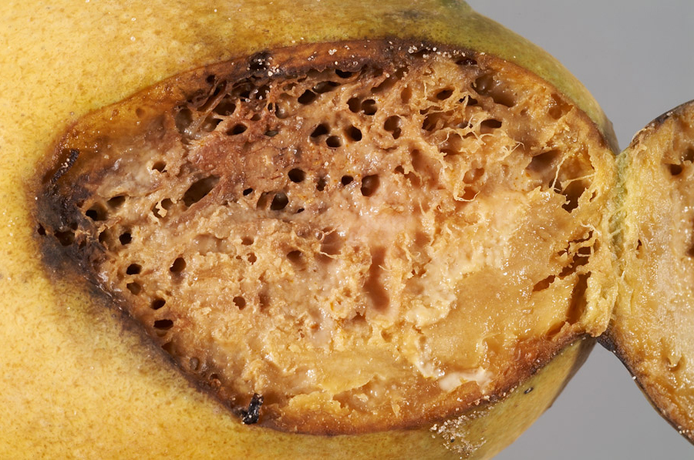
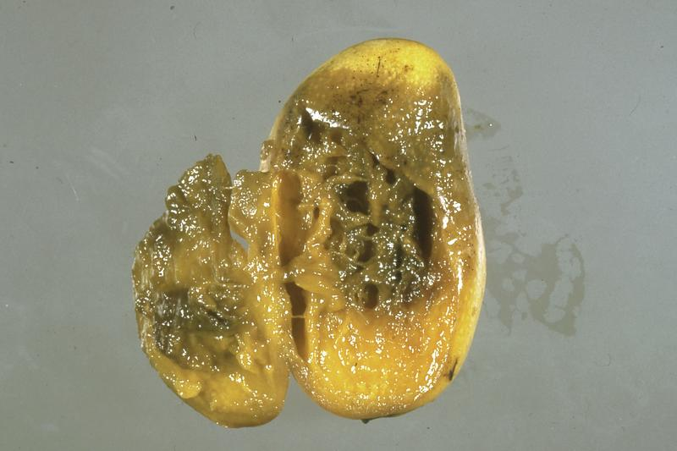
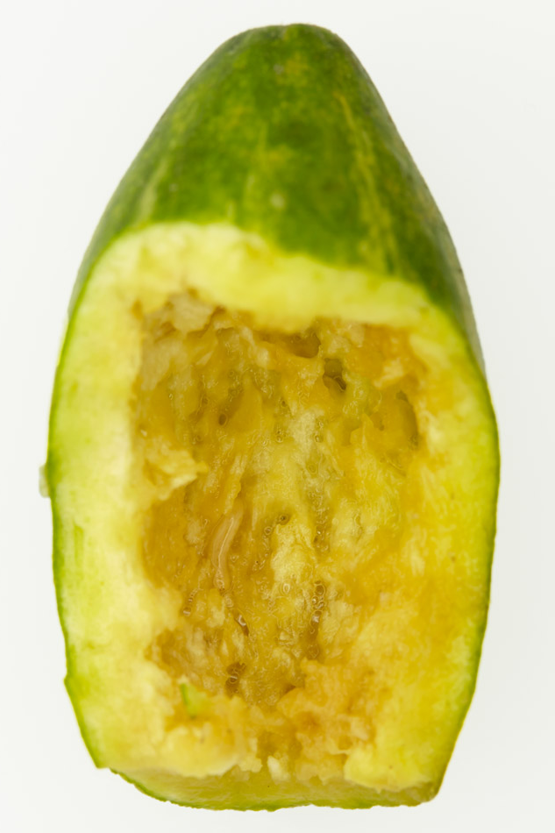
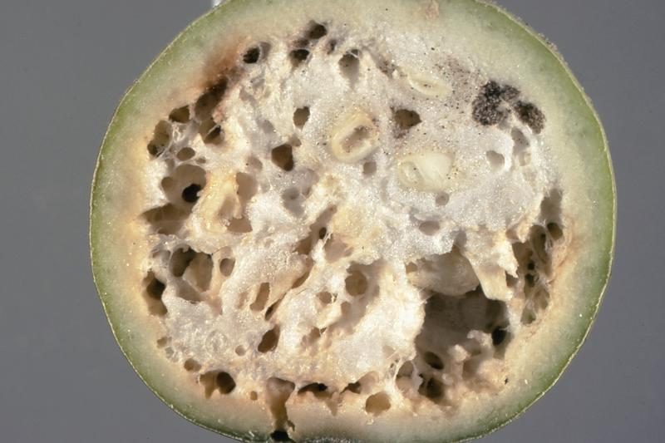
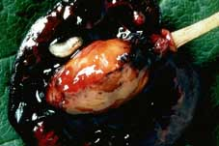
Tunnelling

Slide 13
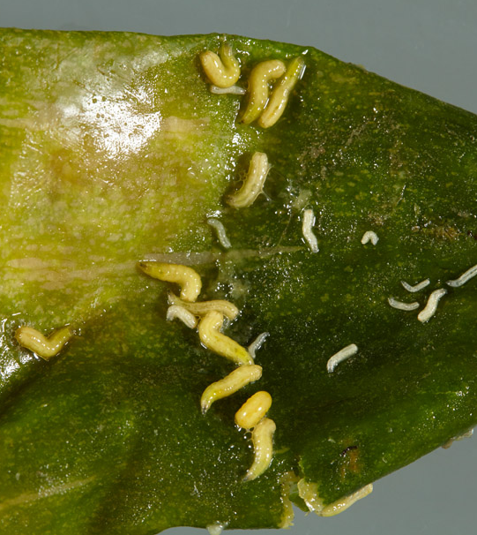
Larvae - Maggots

Slide 14
Zeugodacus cucurbitae
Native to Asia
Introduced to parts of Africa, Hawaii & other Pacific Islands
125 hosts
Major pest of cucurbits causing 30-100% losses
Costly quarantine restrictions and eradication measures
>200 million Euros to eradicate from Ryukyu Islands (Japan)
Until 2015 – “Bactrocera cucurbitae”

Slide 15
Bactrocera dorsalis
Native to Asia
Introduced to Kenya (2003), rapid spread across 20+ countries
Wide host range, favourites are mango, guava, citrus and banana
Out-competing native fruit flies (Ceratitis cosyra) in Africa where it was first described as a new species, Bactrocera invadens
Massive economic impact, Kenyan mango farmers lost $1.7 million in two years

Slide 16
Ceratitis capitata
“Medfly” – not quarantine listed
Widespread in tropical Africa, Madagascar; introduced to Mauritius, Reunion, Seychelles, North Africa, southern Europe, Middle East, Central and South America, western Australia and Hawaii.
Highly polyphagous
Common on Citrus, Capsicum, Mangifera and Psidium
Many records from private houses in UK; emerged from imported fruit

Slide 17
Rhagoletis cingulata
Eastern cherry fruit fly
Native to Eastern North America
Introduced to Europe (1999): Austria, Croatia, Czech Republic, France, the Netherlands, Germany, Hungary, Italy, Netherlands, Switzerland, Slovenia
Affects commercial cherry production
Damage caused by the introduced spotted winged drosophila (Drosophila suzukii) could be mistaken for Eastern cherry fruit fly.

Slide 18
Rhagoletis pomonella
Apple maggot fly
Originated in eastern North America, native host - hawthorn
Not present in Europe
Since late 1970’s it infested commercial Malus and spread to much of N. America.
Cotoneaster, Prunus and Pyrus
No UK interceptions since 1920’s
Defra contingency plan written 2018
Potential to be a significant pest

