Slide 1
Pests and diseases associated with fruit and vegetables

Slide 2
The regulated pests and diseases most commonly intercepted on fruit and vegetables
Whiteflies (in particular, Bemisia tabaci)
Fruit flies (the family Tephritidae, including Bactrocera, Anastrepha, Dacus, Zeugodacus)
Thrips (including Thrips palmi and Scirtothrips dorsalis)
Lepidoptera (in particular Spodoptera frugiperda)
False Codling Moth (Thaumatotibia leucotreta)
Citrus diseases (Citrus black spot, citrus scab and citrus canker)
Viruses on sweet peppers and chillies

Slide 3
Whiteflies
In particular, Bemisia tabaci

Slide 4
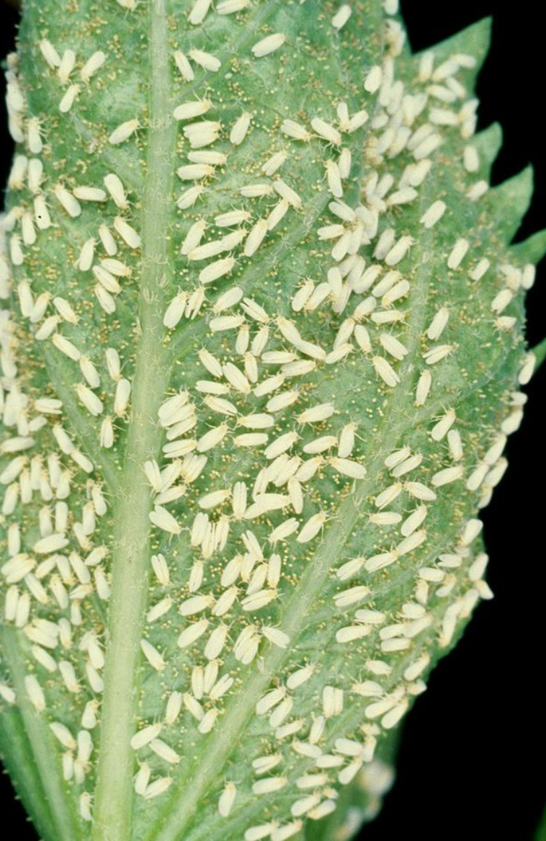
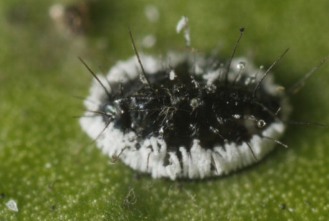
Quarantine Listed Whiteflies
Bemisia tabaci – tobacco whitefly
Cosmopolitan; polyphagous
Aleurocanthus spiniferus – orange spiny blackfly
Italy, Croatia, Montenegro, Asia, Africa, Hawaii; polyphagous, Citrus
Aleurocanthus woglumi – citrus blackfly
Pantropical; polyphagous, Citrus
Bemisia tabaci
Aleurocanthus sp.
Bemisia tabaci

Slide 5
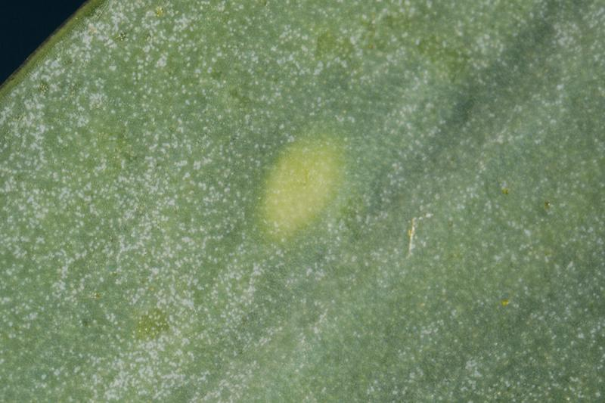
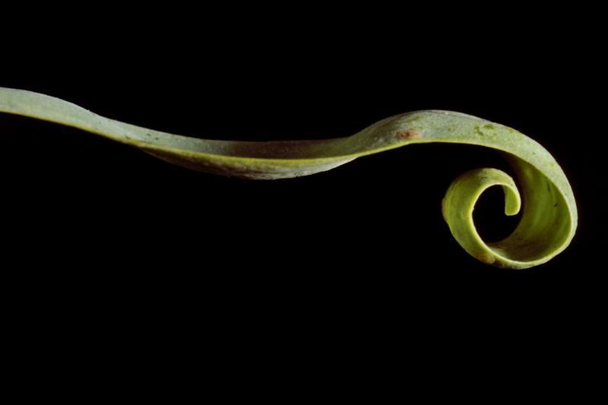
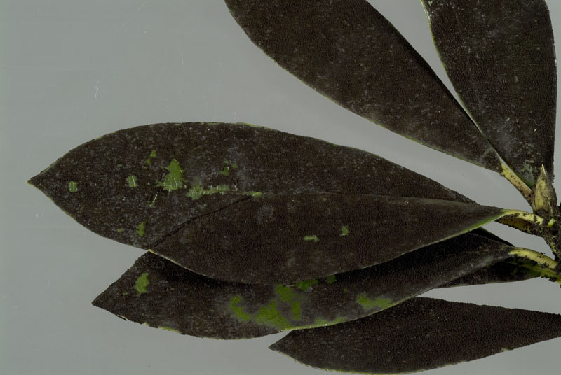
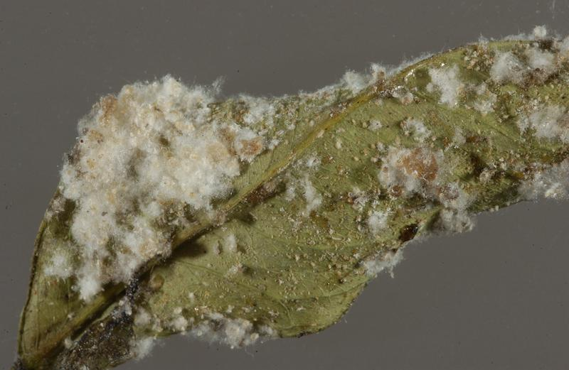
Whitefly detection – Plant Damage
Symptoms caused by whitefly are very similar to other sap-feeding insects, such as aphids, psyllids and scale insects
White colonies are frequently attended by ants which feed on egested honeydew
Chlorosis on upper surface of leaf
Distortion
Black mould growing on honey dew
Waxy deposits

Slide 6
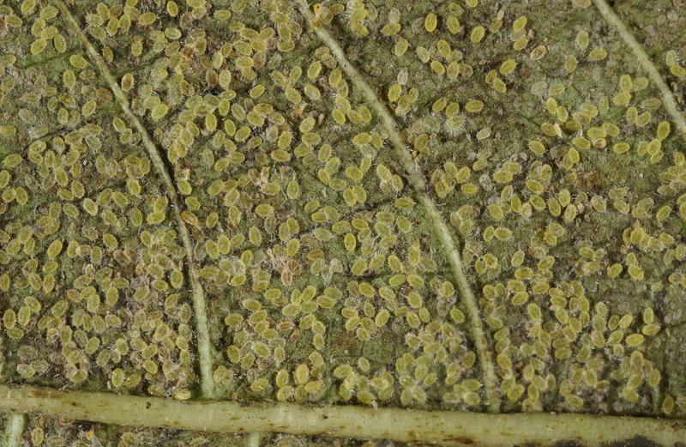
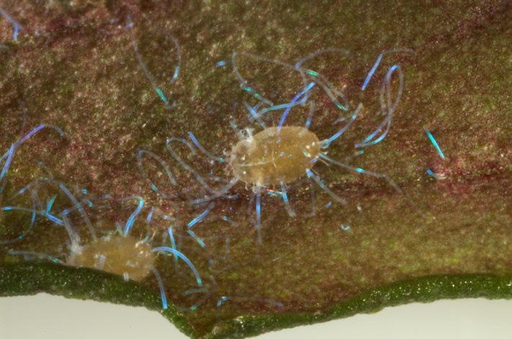
Whitefly detection – Pupae
Heavy infestation, all immature stages present
Waxy pupa
Spiky pupa
Black pupa
Iridescent blue wax
Patterned pupa

Slide 7
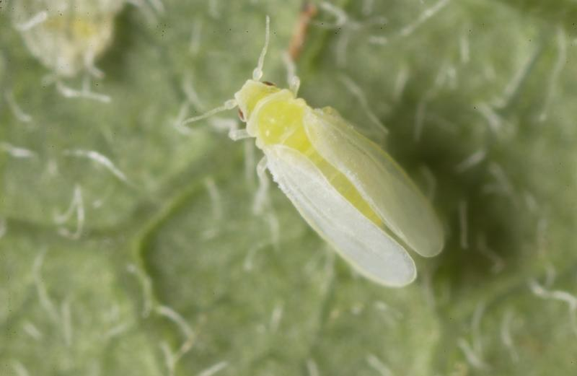
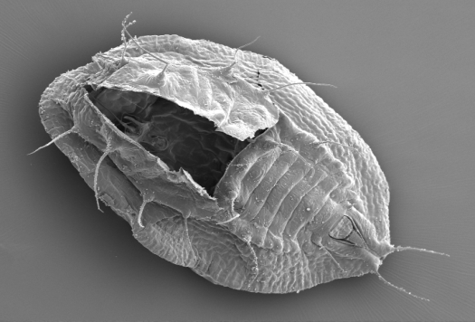
Bemisia tabaci – Tobacco whitefly
REGULATED
Species Complex (36+ spp.)
Major non-indigenous plant pest
Vector of 111+ plant viruses
Polyphagous (800+ plant spp.)
Cosmopolitan
Commonly transported in trade
Between a quarter and a half of all Fera identifications are Bemisia tabaci

Slide 8
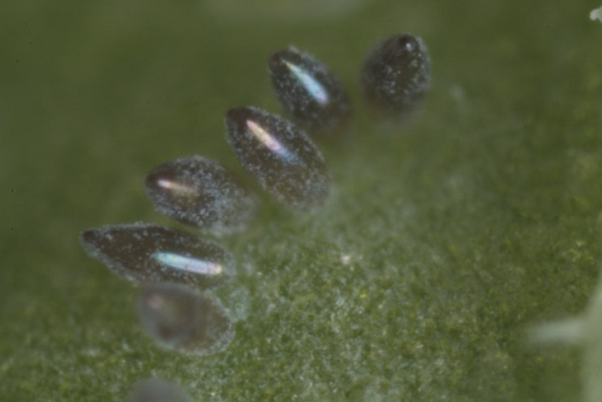
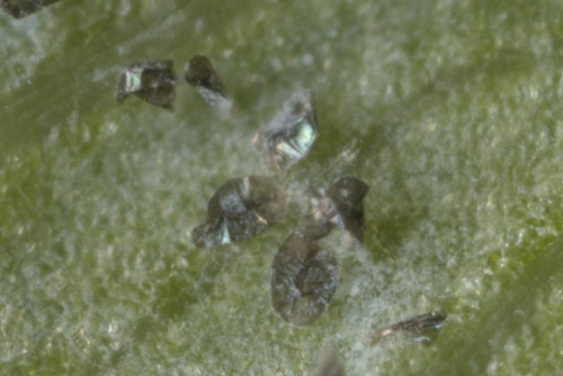
Bemisia tabaci cf. Trialeurodes vaporariorum
Eggs – key characters
Oviposition Pattern
Colour of mature eggs
Do they remain erect or collapse after hatching
Bemisia tabaci
Trialeurodes vaporariorum

Slide 9
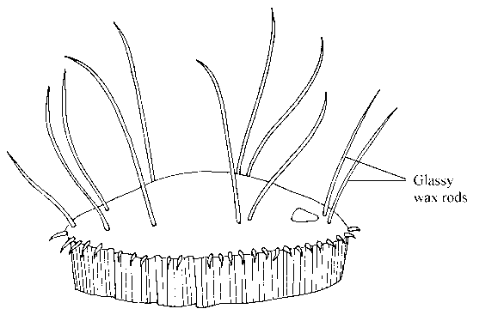
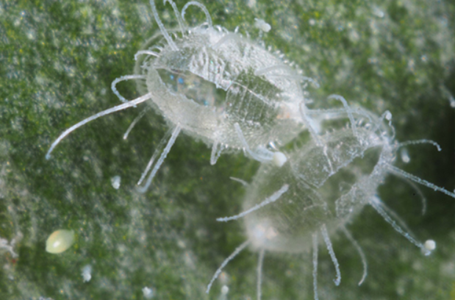
Bemisia tabaci cf. Trialeurodes vaporariorum
Pupa (Puparium) – key characters
Colour
Shape
Presence of pallisade wall
Dorsal wax rods
Marginal papillae
Bemisia tabaci
Trialeurodes vaporariorum
Mixed populations containing both species are fairly common!
Trialeurodes vaporariorum

Slide 10
Bemisia tabaci cf. Trialeurodes vaporariorum
Adults – key characters
Size
Colour
Wing position
Flight
Bemisia tabaci
Identification of adults in the field is not reliable!
Trialeurodes vaporariorum

