Slide 1
Pests and diseases associated with fruit and vegetables

Slide 2
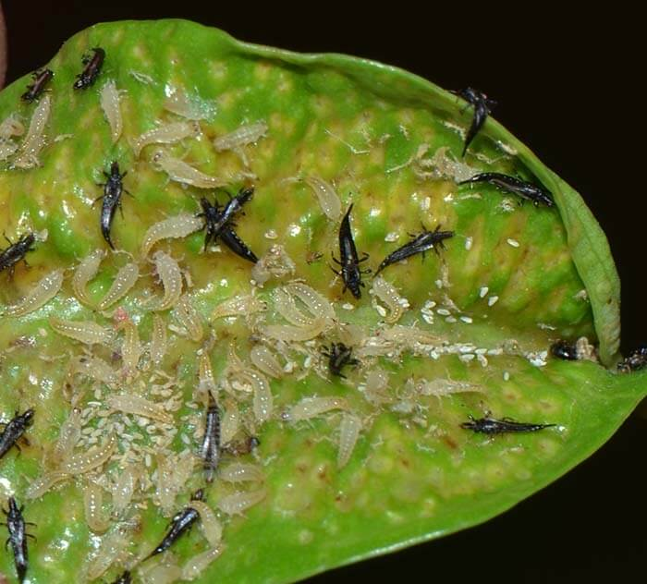
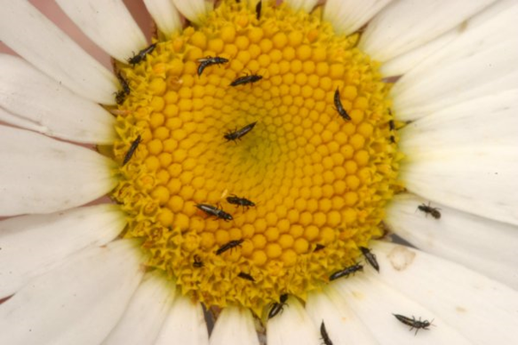
Thrips
Joe Ostojá-Starzewski –Senior Entomologist
Fera Science Ltd., National Agri-Food Innovation Campus, Sand Hutton, York, UK YO41 1LZ
August 2020

Slide 3
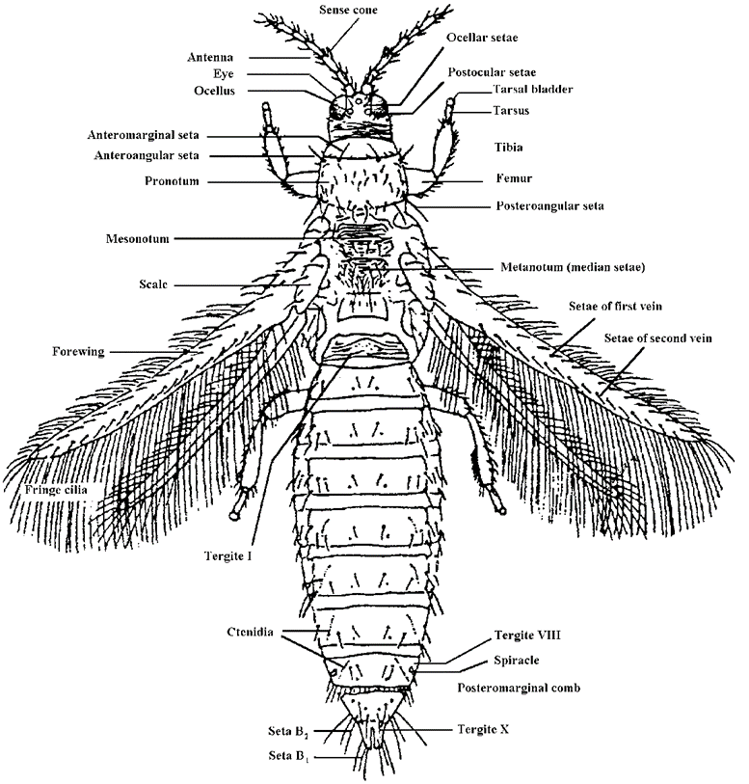
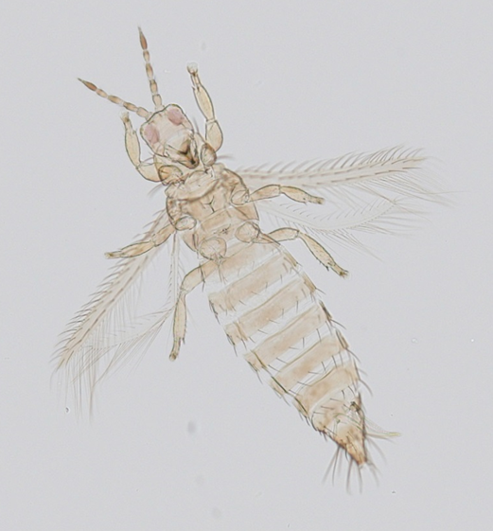
Thrips –Thysanoptera (= fringed-wing)
Worldwide: c. 6000 species
Mostly plant feeding
British list contains 160 established/ naturally occurring species
19 non-established incursions (including Thrips palmi, Scirtothrips dorsalis)
PHSI interceptions of 52 other non-native species to date.
Regulated species
Thrips palmi
Scirtothrips dorsalis, S. aurantia, S. citri

Slide 4
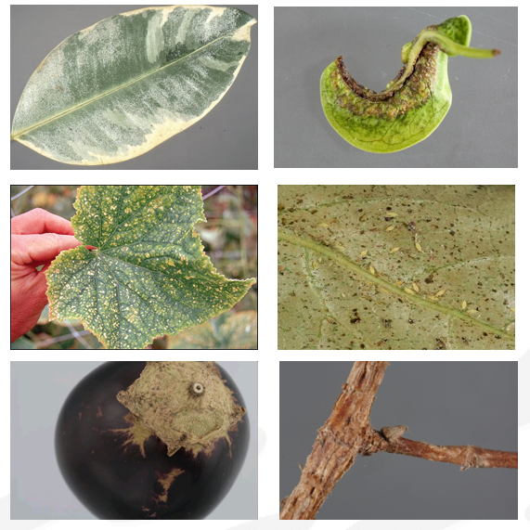
Detection
Thrips feed by piercing and sucking
Leaf silvering
Deformity, growth malfunction in host
Discoloration of upper leaf surface
Look on the underside of the leaf
In flowers, buds, leaf avils
Hidden areas e.g. under clyces (calyx sing.)

Slide 5
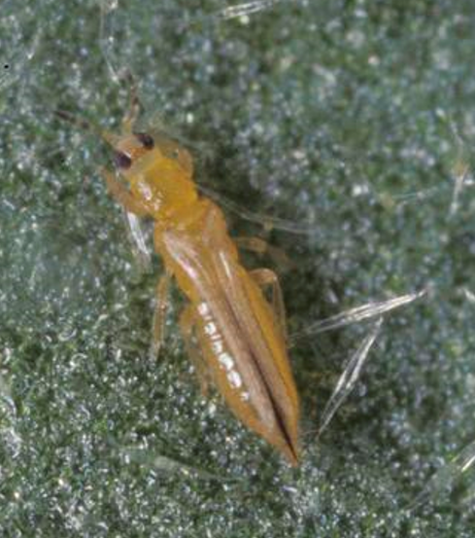
Thrips palmi melon thrips; EU annex designation 1A1
Polyphagous, 36+ families Solanaceae and Cucurbitaceae
Populations build up rapidly
Feed gregariously
Scars and deformities on flowers, fruits and leaves
Edibles: aubergines, basil, peppers and cucumbers
Ornamentals: Chrysanthemums, Orchidaceae, Cyclamen, etc.
Tospovirus vector of: Capsicum Chlorosis virus, Melon yellow spot virus and Tomato Spotted Wilt Virus

Slide 6
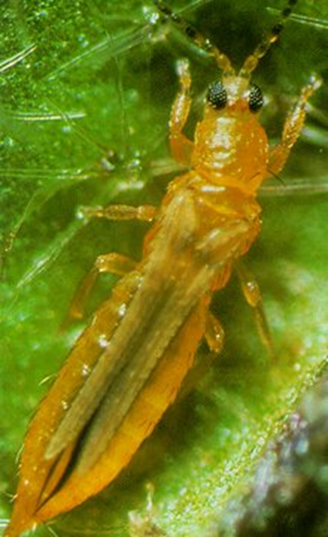
Field recognition
Adult females c.1.3 mm (males 1.0 mm) – Wings may or may not reach the end of the abdomen
Yellow body with only furthest antennal segments darkened (may appear orange-tinged)
Possible to confuse with numerous other native and non-native species, particularly Thrips flavus
S. aurantii, S.citri, S. dorsalis, some T. tabaci, and males of many species including F. occidentalis are also all or mostly yellow thrips

Slide 7
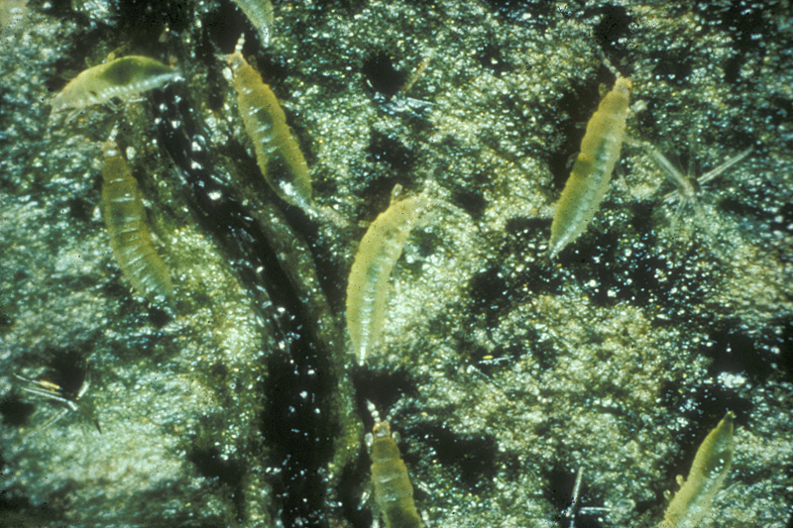
Immature stages

Slide 8
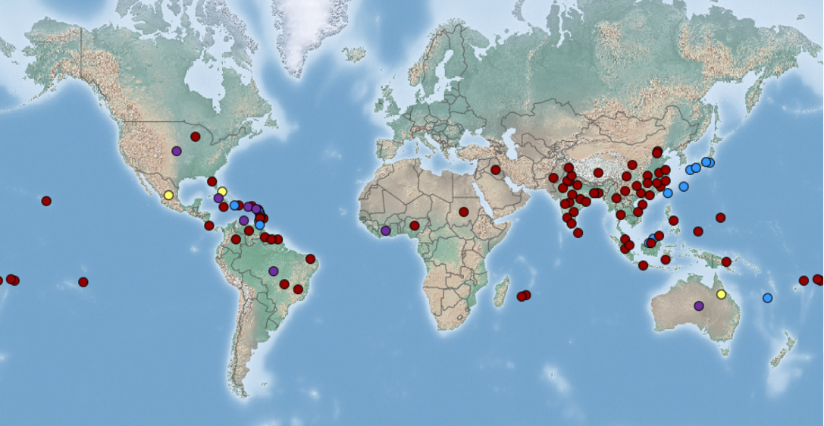
Thrips palmi - distribution

Slide 9
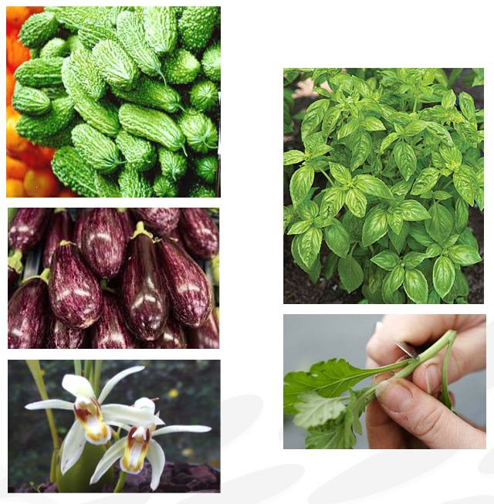
Interceptions
Nearly 600 confirmed interceptions 1996-date.
Bitter-gourd (265) and Aubergine (97)
Dominican Republic (126)
Thailand (119).
India (107)
Ghana, Laos, Malaysia, Nigeria, Pakistan, Philippines, Sierra Leone, Sri Lanka & Vietnam
Orchids from Thailand, Malaysia, Singapore (106)
Chrysanthemum cuttings (108) mainly from Kenya, few from Brazil.

Slide 10
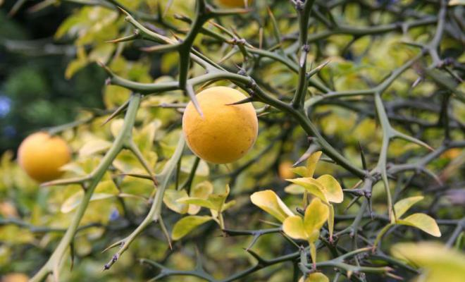
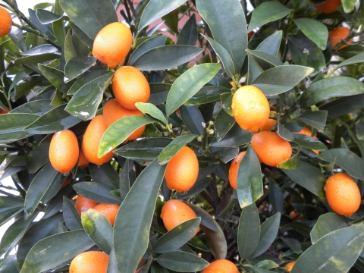
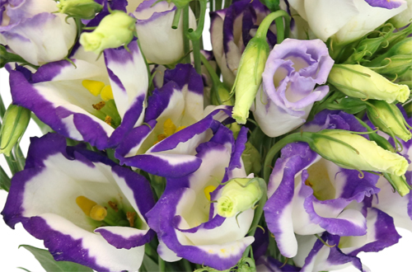
Scirtothrips spp.
S. aurantii, S. citri, S. dorsalis
All are predominantly yellow thrips
All are prohibited on Citrus, Fortunella and Poncirus, but S. aurantii and, to an even greater extent, S. dorsalis are much more polyphagous with more than 100 other hosts recorded between them.
S. aurantii: intercepted twice, both ex. Kenya: in 2000 on Lisianthus (2♀ ); in 2013 on weed mixed with Coriandrum (1♀).
S. citri: 2 ♀ found at Kew gardens in 2008
S. dorsalis the most frequently intercepted

Slide 11
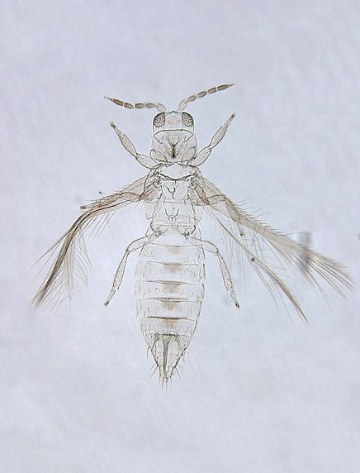
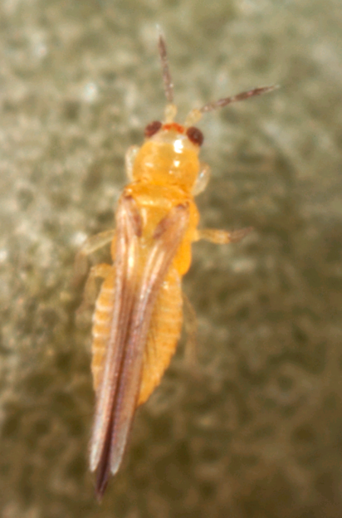
Scirtothrips dorsalis – chilli thrips

Slide 12
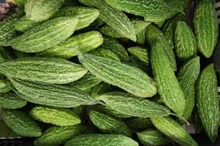
Scirtothrips dorsalis
Originally from SE Asia
During the past two decades it has been expanding its range - now present in Florida, the Caribbean, Israel, Kenya, West Africa, South Africa
Now often intercepted by PHSI, @ 180 records since 1999
Most frequently encountered on Momordica fruit from Kenya (73).
Also intercepted from Cayman Island, Ghana, India, Pakistan, Sri Lanka, Thailand and USA.

Slide 13
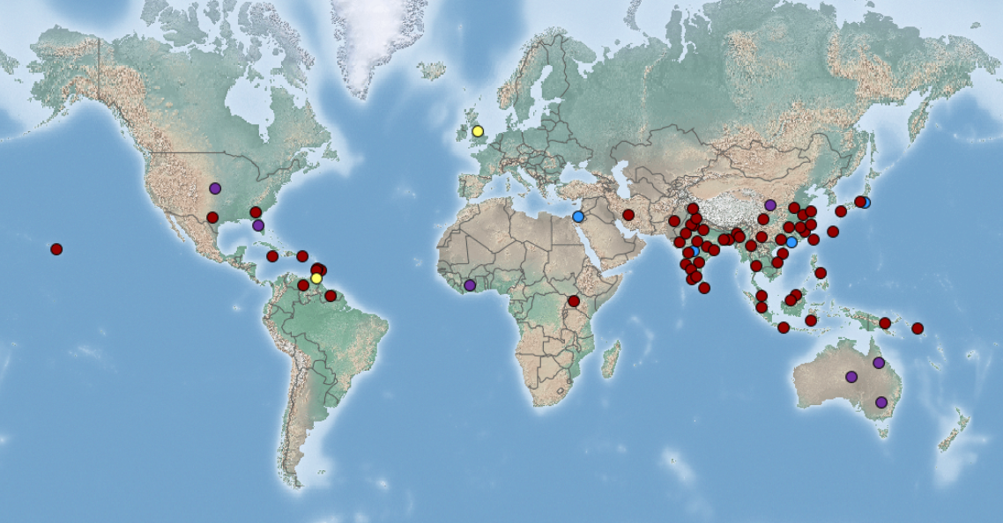
Scirtothrips dorsalis - distribution

Slide 14
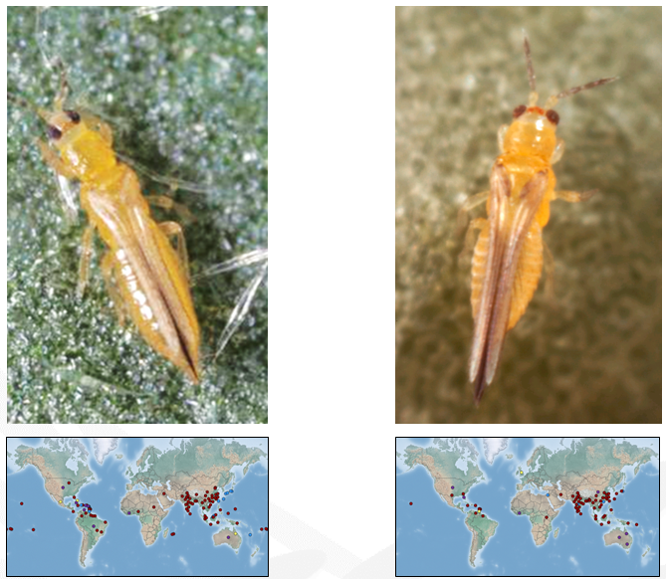
Thrips palmi & Scirtothips dorsalis

