Slide 1
Pests and diseases associated with fruit and vegetables

Slide 2
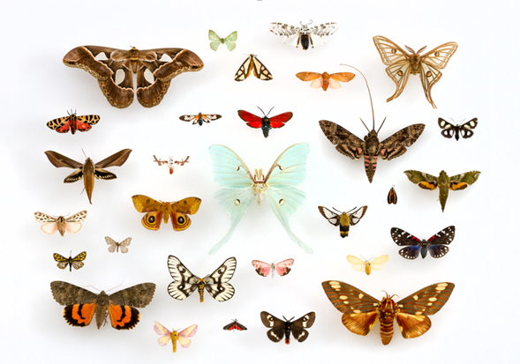

Lepidoptera –Moths and Butterflies
Joe Ostojá-Starzewski –Senior Entomologist
Fera Science Ltd., National Agri-Food Innovation Campus,
Sand Hutton, York, UK YO41 1LZ
August 2020

Slide 3
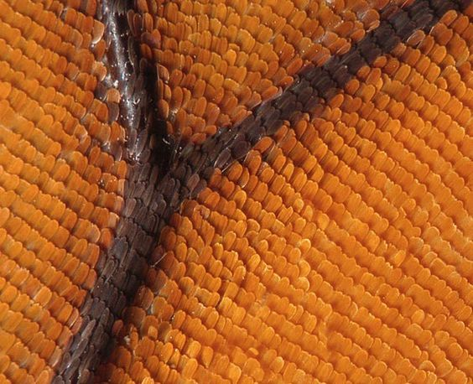
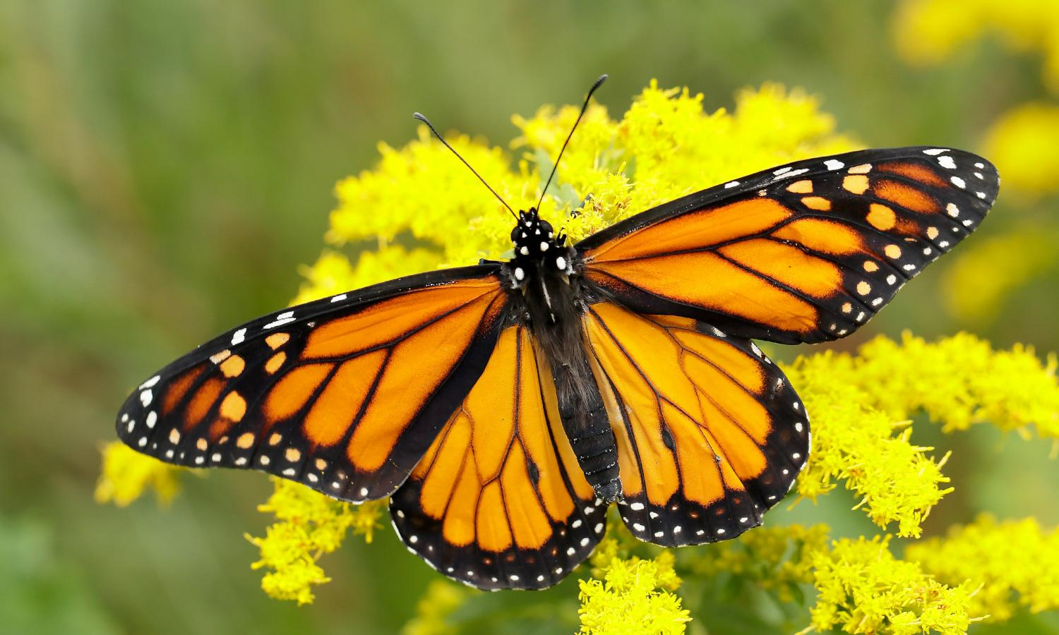
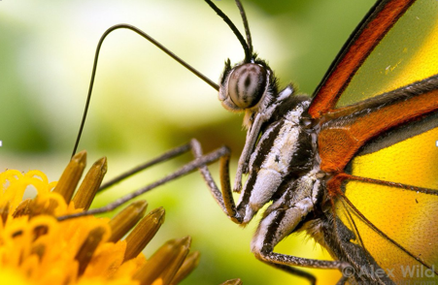
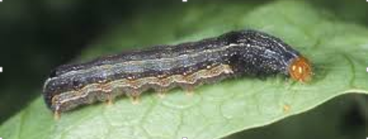
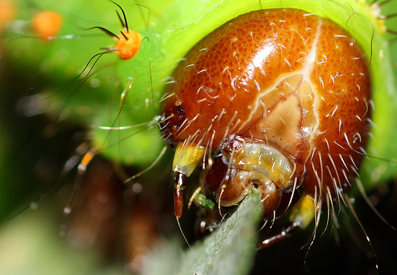
Lepidoptera
(from the Greek Lepidos = scale and Pteron = wing)
180 000 known species divided between 126 families ~10% of all know insect species
<2.5mm – 45 cm wingspan, average 2.5cm
2 pairs of membranous wings
Wings & body covered in scales
Adults –Sucking/lapping mouthparts
Larvae (caterpillars) chewing mouthparts.
Most (99%) are plant feeding.. But there are also detritivores, parasites and predators
Caterpillars - Most frequently encountered life stage – Main focus
Notes:
27

Slide 4
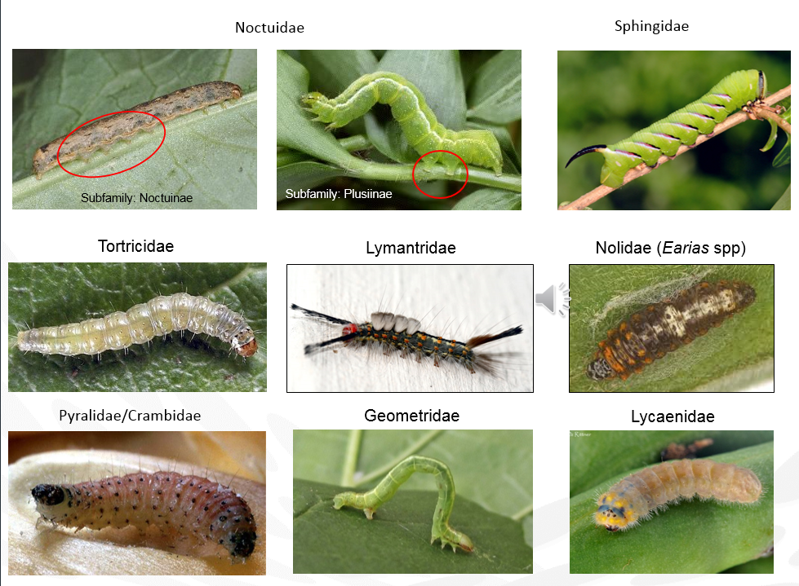
Shape and structure
Subfamily: Plusiinae
Number of prolegs
Hairy, smooth
Spiny (spiculated)
Warty, bumpy
Hairs in clumps or covered all over
How active?
Colour, patterns ?

Slide 5
Signs of caterpillar infestation
Caterpillars = eating machines (Mouth > Gut > Anus)
Damage and frass (excrement) deposits are often the most visible indication of the presence of caterpillars
Defoliation Windowing Skeletonization Webbing & leaf rolling | Mining Linear Blotch Bore holes (tunnelling) Frass

Slide 6
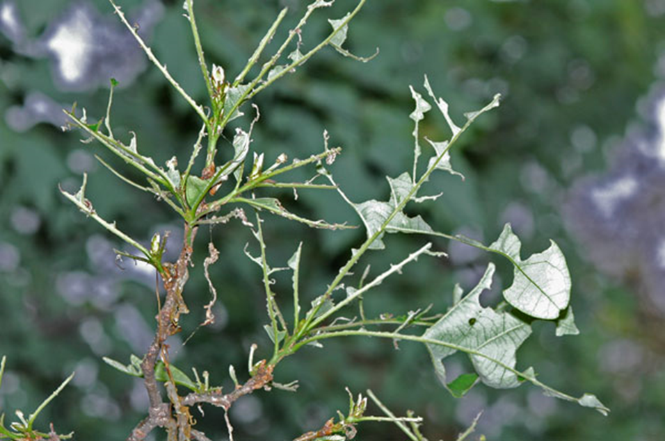
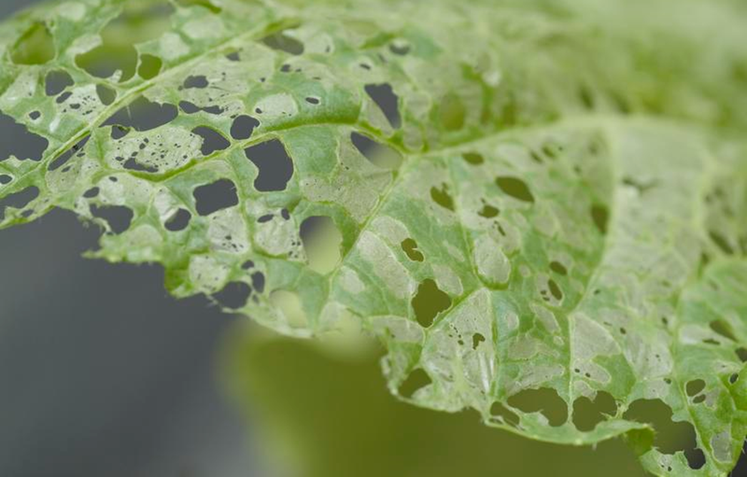
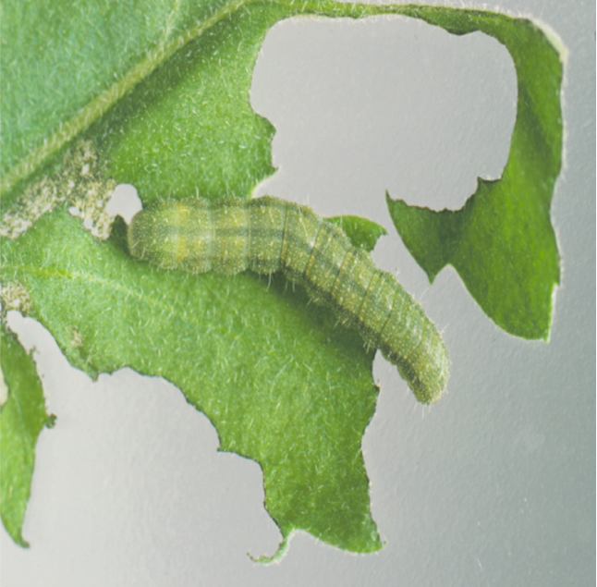
Signs of infestation - Windowing and skeletonization

Slide 7
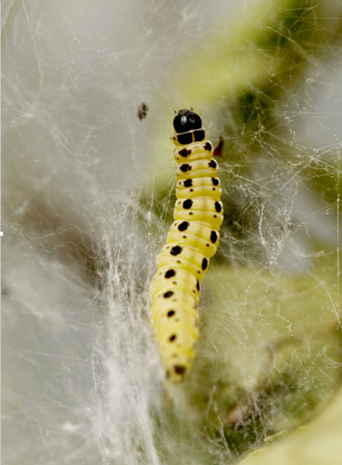
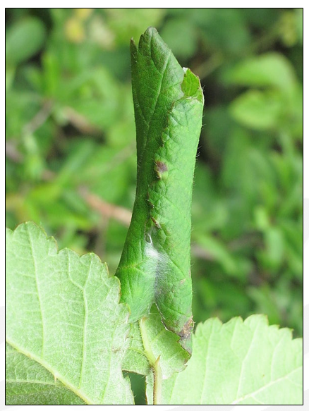
Signs of infestation – Webbing & leaf rolling

Slide 8
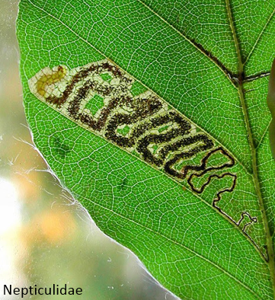
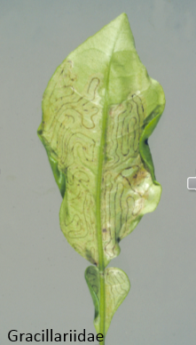
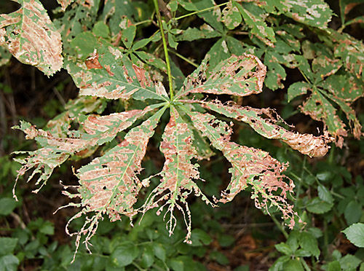
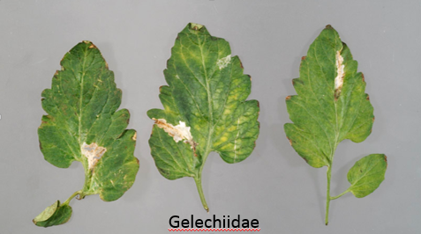
Signs of infestation - mining
Linear
Blotch
Gracillariidae
Nepticulidae
Gracillariidae

Slide 9
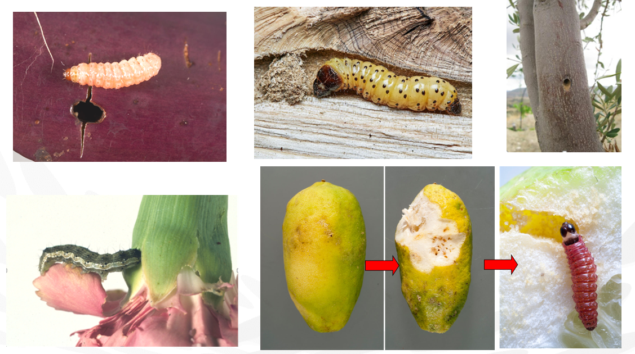
Signs of infestation – boring & tunnelling

