Slide 2
Table of contents
Background
1 January 2022 – what is happening then?
Customs requirements
1 July 2022 – what is happening then?
Compliance and enforcement
IT systems update
Jan vs Jul

Slide 3
Background

Slide 4
Phased import regime
Phase 1, since 1 January 2021
High-priority plants and plant products require a phytosanitary certificate (PC), pre-notification
Import inspections* at Places of Destinations (PoDs)
Phased approach to help businesses adjust to the new arrangements
* Risk-based physical and identity checks. Documentary checks are carried out remotely.

Slide 5
What's happening on 1 January 2022?

Slide 6
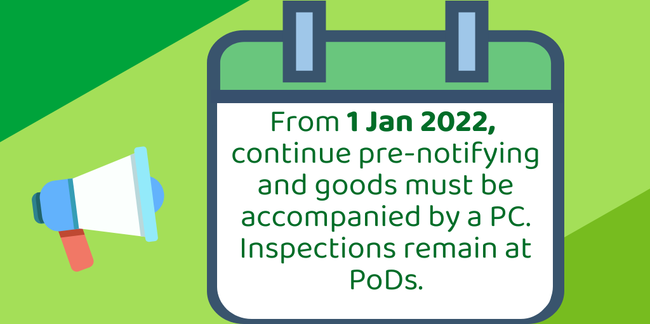
High-priority plants and plant products

Slide 7
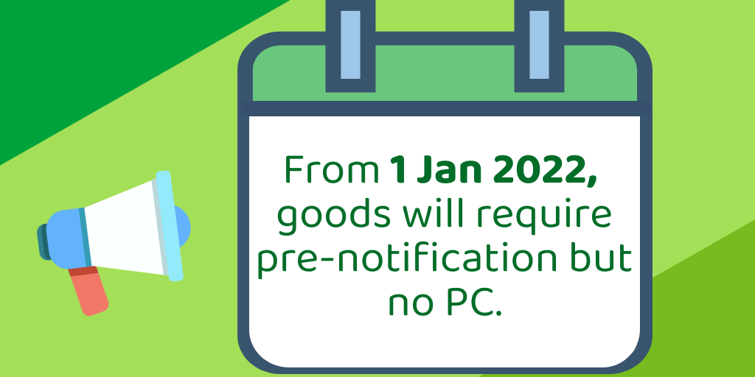
Regulated and notifiable EU produce and cut flowers

Slide 8
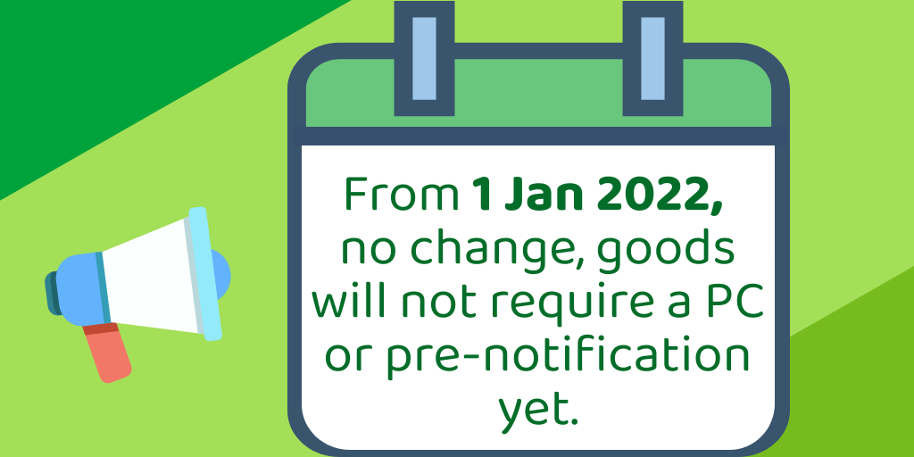
All other regulated EU plants and plant products

Slide 9
Compliance and enforcement

Slide 10
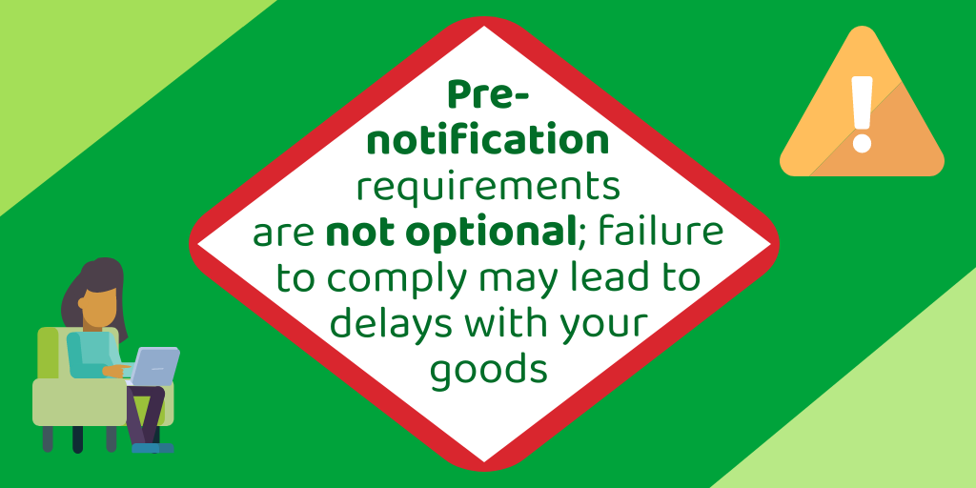
Pre-notifying is a legal requirement..

Slide 11
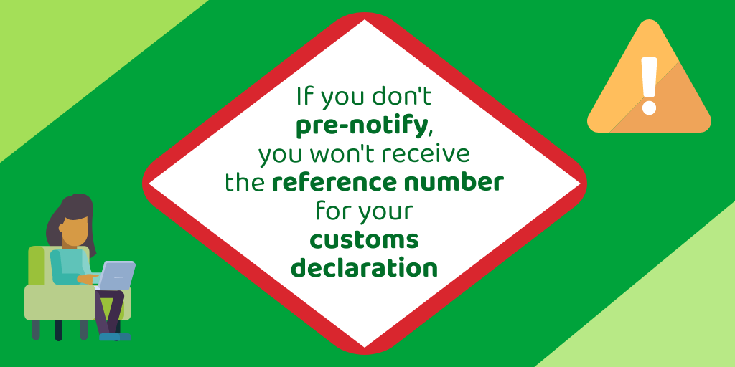
If you do not pre-notify, you can't submit a customs declaration...

Slide 12
What’s happening on 1 July 2022?

Slide 13
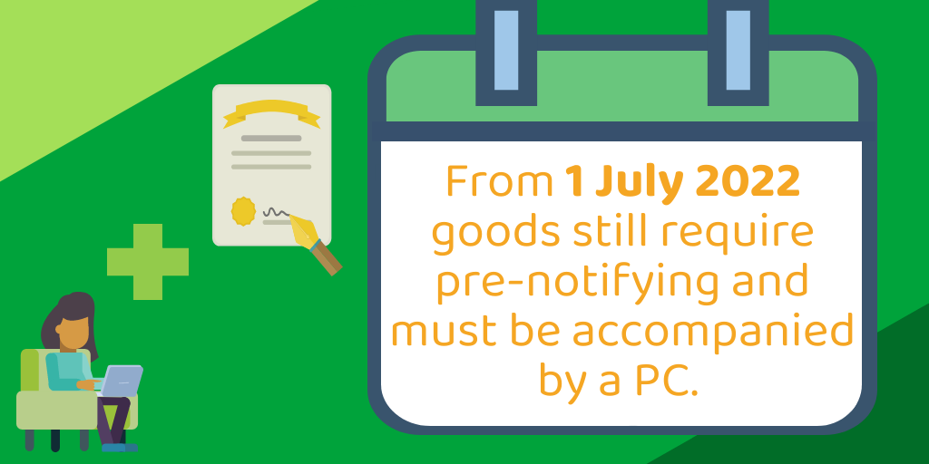
High-priority plants and plant products

Slide 14
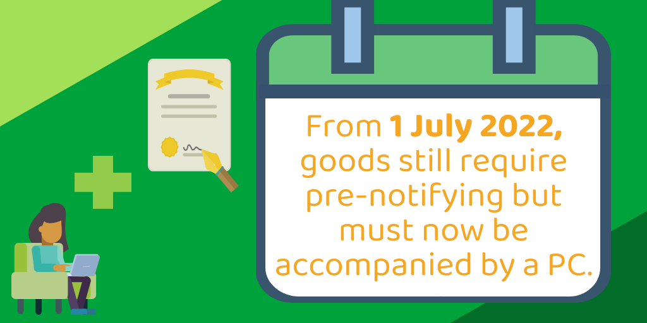
Regulated and notifiable EU produce and cut flowers

Slide 15
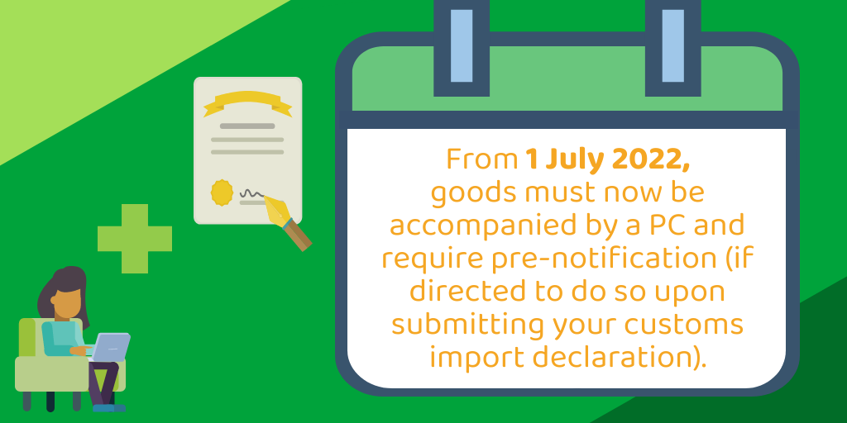
All other regulated EU plants and plant products

Slide 16
What about plant health checks?

Slide 17
IT systems update

Slide 18
PEACH or IPAFFS?

Slide 19
Summary: Jan vs Jul

Slide 20
